Slide 1
Non-violent Action: A Force for Change
Case study lesson:
Sheffield’s Anti-Apartheid Movement

Slide 2
Starter Activity
In 3 groups sort your set of cards into the correct order based on the information on the cards
Notes:
https://pixabay.com/photos/lone-tree-field-wheat-tree-4127920/
Attribution: Nottmpictures/ Pixabay License (Don't use images with identifiable brands to create a misleading association with a product or service.)

Slide 3
Correct order of cards: background to apartheid
In 1948, the all-white government of South Africa introduces apartheid (apartness).
Laws are passed which provide separate areas of housing and work (schooling). Marriage between the races is not allowed. Public services – buses, park benches, beaches and shops are also segregated.
Notes:
Image: public domain

Slide 4
Correct order of cards: background to apartheid
To make sure that apartheid is followed all Black South Africans have to carry a ‘passbook’. It sets out where they can live and work. It also contains criminal and tax records. It has to be carried at all times, for inspection.
Notes:
Image: National Library of South Africa, Cape Town Campus: An anti-pass march by women, 1956.

Slide 5
Correct order of cards: background to apartheid
In 1960, during a demonstration against the pass laws, the South African police shoot and kill unarmed Black people. The story receives worldwide media coverage and reaction.
In South Africa, groups such as the African National Congress (ANC) move from non-violent action to more direct, including armed struggle.
Notes:
Image: Sam Nzima: Hector Pieterson being carried by Mbuyisa Makhubo after being shot by South African police. His sister Antoinette Sithole runs beside them.

Slide 6
Correct order of cards: background to apartheid
In 1964, Nelson Mandela (centre), leader of the ANC is sent to prison for life after the Rivonia trial. He will become the focus of a worldwide struggle to see the end of apartheid in South Africa.
Notes:
Image: Peter Magubune: Nelson Mandela treason trial 1958

Slide 7
Correct order of cards: background to apartheid
Over time, firstly, the enforcement of the Apartheid laws and also the actions of successive the all-white governments lead to different life experiences for South Africa’s citizens.
Notes:
Image: public domain.

Slide 8
Correct order of cards: key events
The United Nations General Assembly passes a General (world-wide) Resolution, December 1980. The UN calls on artists not to perform in South Africa, due to its’ government passing laws segregating its’ own people on the basis of their race - apartheid. Many of the artists who ignore this call face campaigns opposing their actions.
Notes:
Image: public domain.

Slide 9
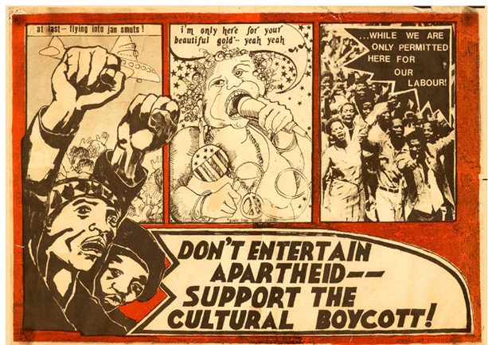
Correct order of cards: key events
In October 1983, Marti Caine is placed on the UN list of performers who have played in Sun City, Bophuthatswana, a banned area which was under South African control. Its ‘inter-racial’ cabaret seats can only be afforded by rich whites.
Notes:
Image: Art Institute Chicago

Slide 10
Correct order of cards: key events
'Funny Girl’, Press Conference, February 1984
Announcing a revival of the musical show, for the Crucible Theatre, Sheffield. Marti Caine speaking: (about South Africa) ‘There are injustices. But I have seen worse injustices in **Brixton and *Attercliffe.’
(Working class and racially mixed areas of *Sheffield and **London)
Notes:
Image: The Guardian

Slide 11
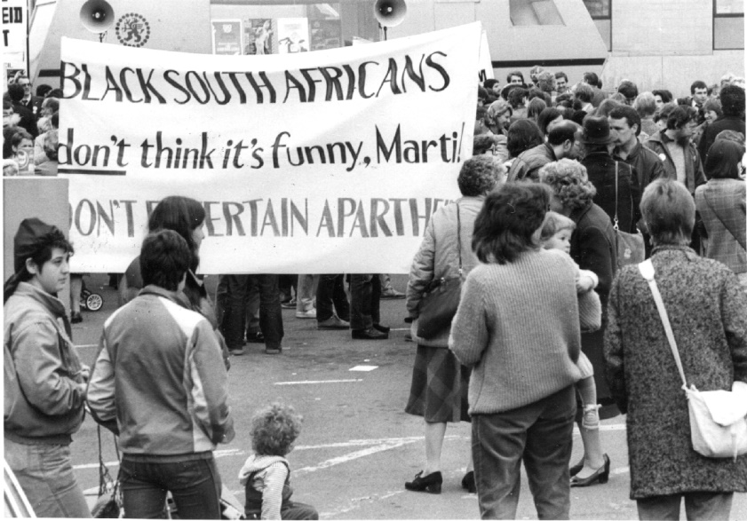
Correct order of cards: key events
Opening Night of ‘Funny Girl’ on 18th May 1984. Up to 500 local people picket outside the Crucible Theatre, Sheffield.
‘The challenge was not convincing people of the arguments; the challenge was persuading people to find time to commit themselves.’ (Paul Blomfield interview, 2012)
Notes:
Image: Sheffield Newspapers, AAM Forward to Freedom Archive: Sheffield AA supporters at the Crucible Theatre

Slide 12
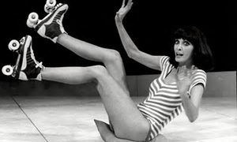
Correct order of cards: key events
Press photograph of Marti Caine on stage.
‘Funny Girl’ proves to be a huge hit during its May-June 1984 run at The Crucible, especially amongst older, local people.
Notes:
Image: The Guardian

Slide 13
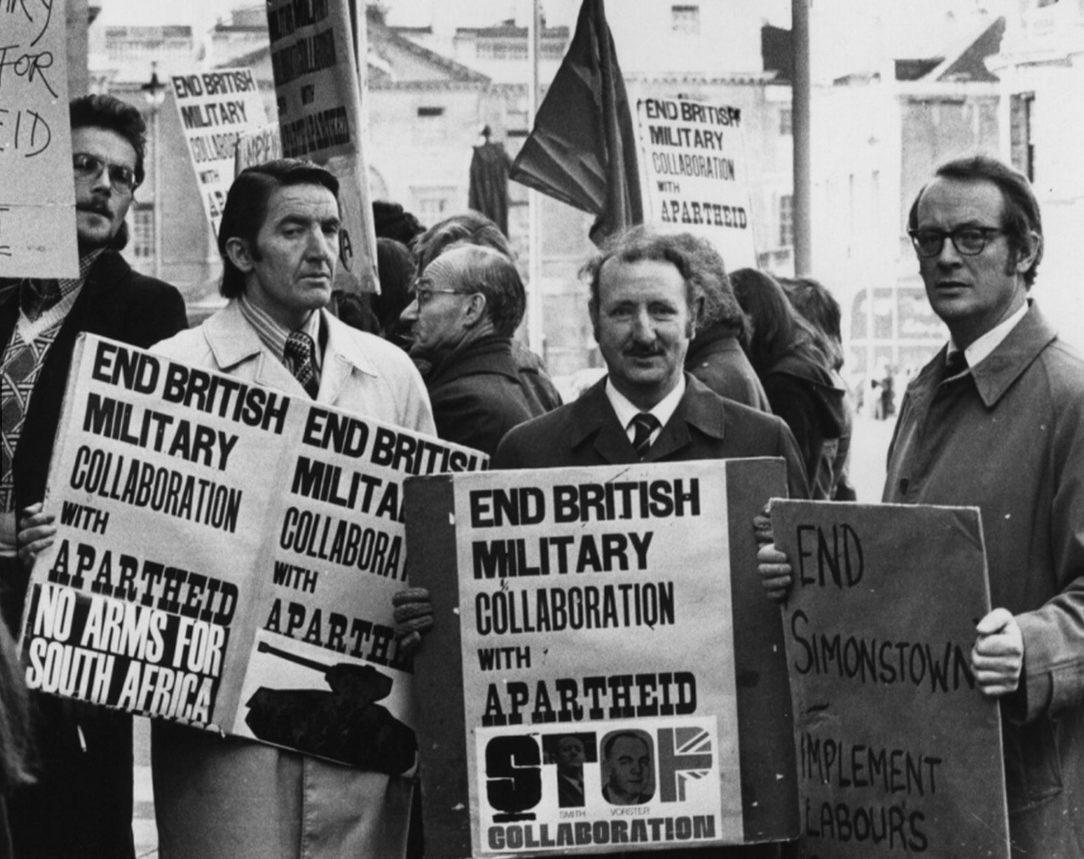
Correct order of cards: groups engaged and tactics used to end apartheid
Throughout the 1970s Yorkshire M.P.s campaigned against South Africa –
(left to right) Dennis Skinner, Martin Flannery and Bob Cryer.
Notes:
Photo courtesy of Kate Flannery

Slide 14
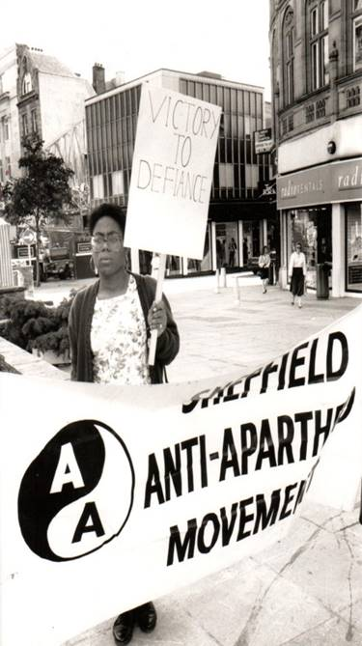
Correct order of cards: groups engaged and tactics used to end apartheid
1978, support to end Apartheid comes from the Black community of Burngreave (Pitsmoor). Meetings also involve the Overseas Student Bureau, from Sheffield University Asian Youth Movement and West Indian Association amongst others.
Sheffield’s Anti-Apartheid meetings have a number of Black members such as Dorothy Dixon-Barrow, Lionel and Guy Lambert.
Notes:
Image: Paul Blomfield

Slide 15
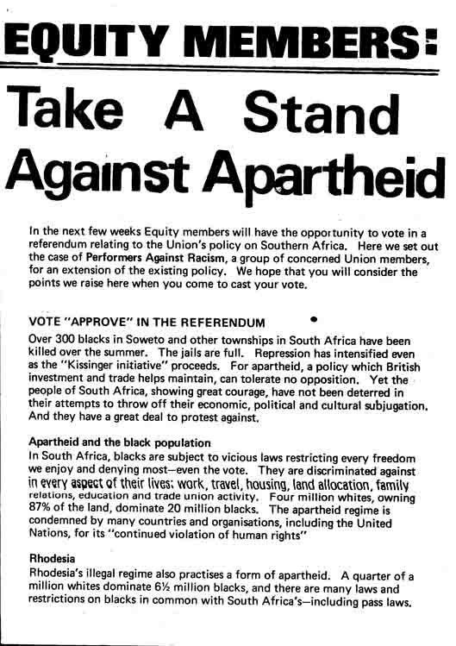
Correct order of cards: groups engaged and tactics used to end apartheid
Petition with signatures from staff of the Crucible Theatre sent to their funders, Sheffield City Council. 49 members of the Crucible staff sign a petition stating their disapproval of working with a person on the UN banned list. The theatre promises from July 1984 to follow the Council’s new ruling to only cast performers not on the UN banned list.
Notes:
Image: Performers Against Racism, Forward to Freedom: Equity referendum, 1976

Slide 16
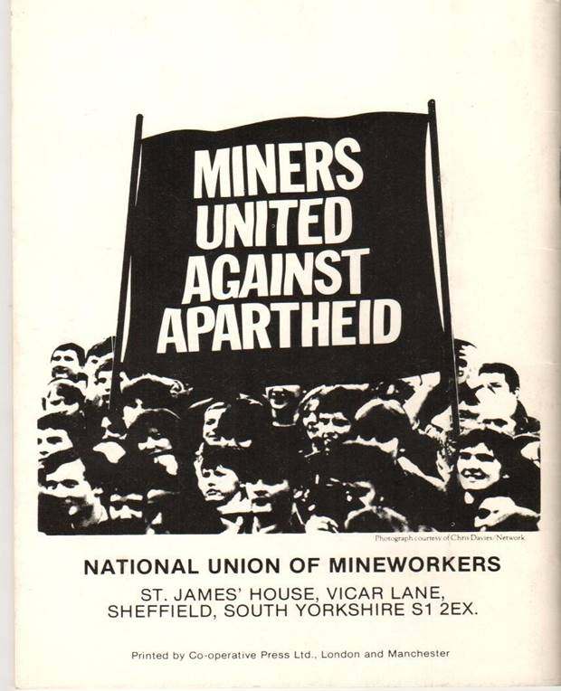
Correct order of cards: groups engaged and tactics used to end apartheid
1984, Yorkshire Miners voice their opposition to South Africa. In particular they gave support to the miners of South Africa.
Other workers from the Trade Unions in Britain join in campaigns to end apartheid in South Africa.

Slide 17
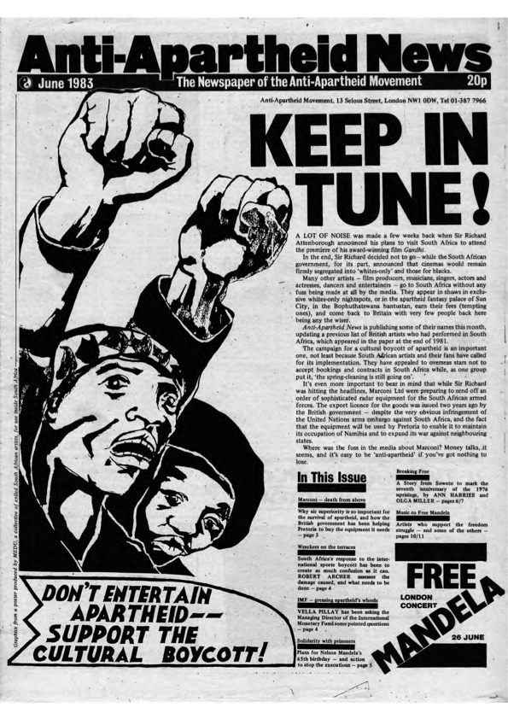
Correct order of cards: groups engaged and tactics used to end apartheid
Letter(s) to Marti Caine, February – March 1984.
Sheffield Anti-Apartheid group sends letters to Marti Caine asking her to not perform again in apartheid-led South Africa. While her friends stated she is not biased, Caine does not respond.
‘We were always a solidarity movement. We did not bring change; we supported the people of South Africa in bringing change.’ (Paul Blomfield, interview 2012)
Notes:
Image: AAM Archives Committee, Forward to freedom: AA News November 1982

Slide 18
Correct order of cards: groups engaged and tactics used to end apartheid
Opening Night of ‘Funny Girl’ on 18th May 1984, up to 500 local people picket outside the Crucible Theatre, Sheffield.
‘The challenge was not convincing people of the arguments; the challenge was persuading people to find time to commit themselves.’
(Paul Blomfield interview, 2012)
Notes:
Image: Sheffield Newspapers, AAM Forward to Freedom Archive: Sheffield AA supporters at the Crucible Theatre

Slide 19
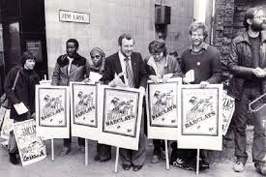
Correct order of cards: groups engaged and tactics used to end apartheid
1985, Anti-Apartheid protestors outside Barclays Bank on Jew (*Jehu) Lane. Many students have bank accounts with Barclays.
* named after King Jehu of Israel who drove fast chariots as did Sheffield’s 28th Century cab/coach drivers; or as a waiting place of coach/cab drivers who congregated here; or due to frequency of Jewish people in the area historically.
‘We would stand outside branches of Barclays Bank ... but people would say to you: “There are three of you… How can you persuade a major… bank to change?”’ (Paul Blomfield interview, 2012)
Notes:
Image: Paul Blomfield

Slide 20
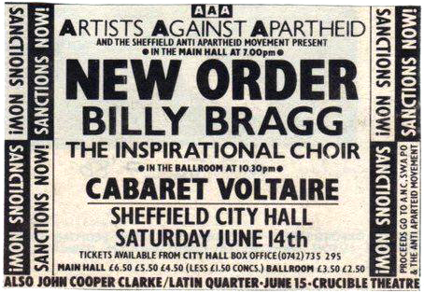
Correct order of cards: groups engaged and tactics used to end apartheid
1986, after the UN Resolution was passed, many music artists stayed away from performing in South Africa. Instead they gave their time; often free, to raise money to help the Anti-Apartheid campaign.
Notes:
Image: Sheffield Music Archives

Slide 21
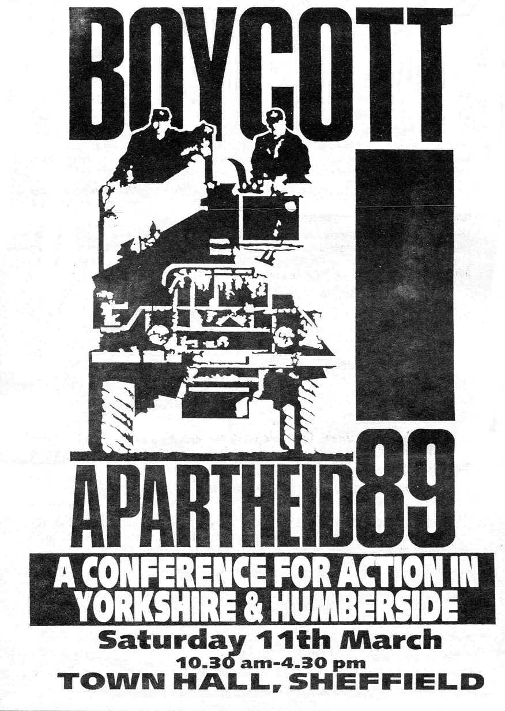
Correct order of cards: groups engaged and tactics used to end apartheid
Anti-Apartheid Conference, Sheffield, 1989.
‘party conferences… motions and seconding motions… to make sure people were all working towards the same thing, in the same direction, not off on a tangent.’ (Kath Harding, interview 2012)
Notes:
Image: Yorkshire and Humberside Anti-Apartheid Committee, AAM Archives Committee: Boycott Apartheid 89 conference.

Slide 22
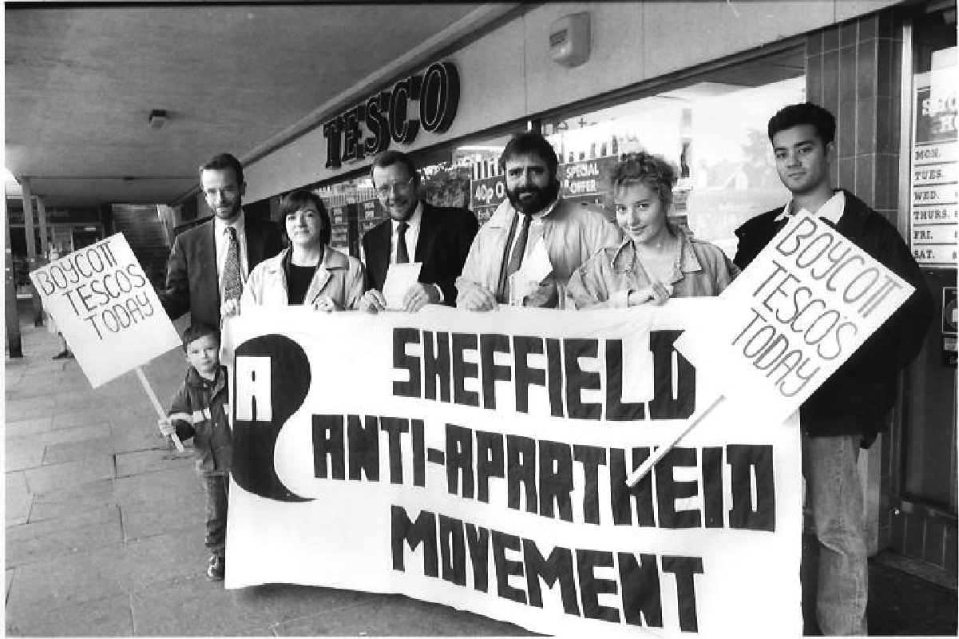
Correct order of cards: groups engaged and tactics used to end apartheid
1989, Anti-Apartheid protestors calling for a ban on South African products e.g. bananas being sold in Tesco.
‘We organised lots of protests outside of Tescos. We tried to persuade people not to buy South African goods.’ (Paul Blomfield, interview 2012)
Notes:
Image: Martin Jenkinson Image Library, AAM Archives: Picketing Tesco in Sheffield.

Slide 23
Find out the meanings of the following words or terms found on the cards:
Background | Key | Groups & Tactics
i. Natives, Coloured & Indians | A. resolution | 1. petition | 6. biased
ii. apartheid | B.‘inter-racial’ | 2. union | 7. resolution
iii. segregate | C. cabaret | 3. picket | 8. boycott
iv. pass book | D. injustice | 4. overseas | 9. campaign
v. Nelson Mandela, ANC | E. picket | 5. account | 10. delegate

Slide 24
Picture sharing
Choose one of your pack pictures which helped you to understand the following areas of the topic:
Background (South Africa): how does your picture give you an idea about the system of apartheid AND/OR how does your picture give you an understanding of what some in South Africa thought about the setting up of the apartheid system?

Slide 25
b) Key event (‘Funny Girl’ Sheffield)
How does your picture explain why Marti Caine or Sheffield Theatres wanted to be involved in the production of the musical comedy play ‘Funny Girl’. AND/OR Why do you think some people in Sheffield were either a) for or b) against the idea of Marti Caine being in the play?

Slide 26
c) Groups (who) and tactics used (how)
Choose a picture that shows how a group are supporting the cause of anti-apartheid. Could you give a reason why you think the group you can identify from the picture would have given their support to the anti-apartheid movement? AND/ OR Can you give a reason(s) using a picture, why you think their tactic (say what it is), would or would not have worked in attracting people from Sheffield to support the anti-apartheid cause?

