Slide 1
Non-violent Action: A Force for Change
Power: Lesson Plan 6
We Learn What We Live

Slide 2
I’m Glad I’m Me
https://socds.com/wp-content/uploads/2016/01/Poemsfor2014.pdf
Poem by Jack Prelutsky
Share in a pair/group:
3 things you like about yourself.
1 thing you like about the others in your group.
Notes:
Either read, have a learner
read or display 'I’m Glad I’m Me': https://socds.com/wp-content/uploads/2016/01/Poemsfor2014.pdf,

Slide 3
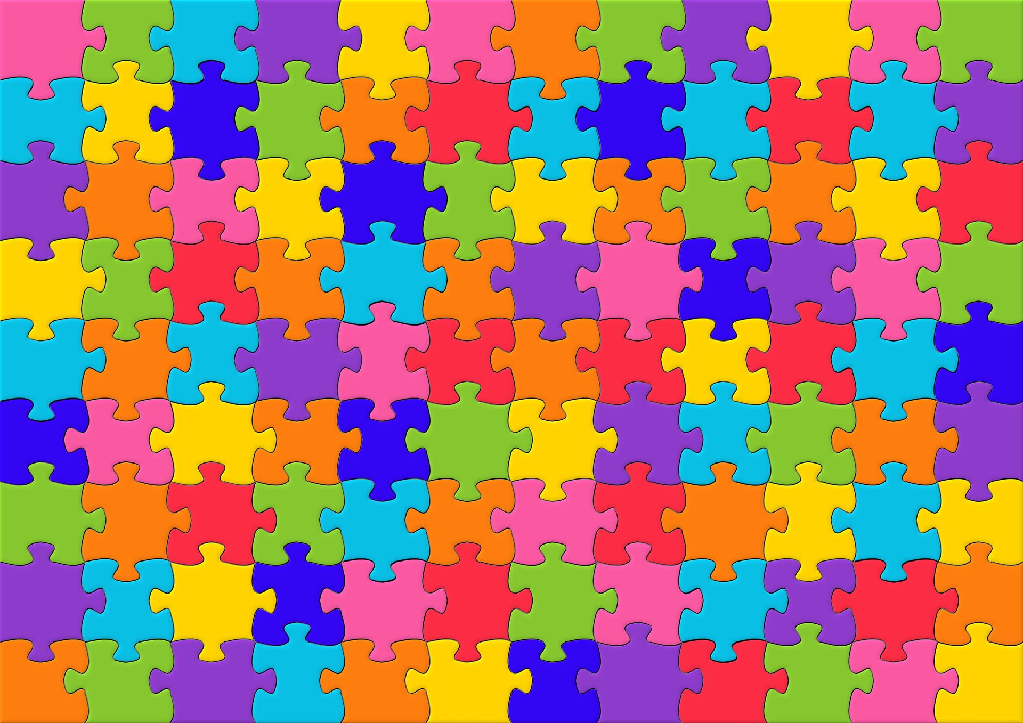
Fitting In and Belonging
Fitting in:
I have to be like you
Belonging:
I get to be me
Notes:
Image – CCO Public Domain –Rainbow colour jigsaw puzzle https://www.maxpixel.net/Rainbow-Color-Jigsaw-Puzzles-Mosaic-Puzzle-821171

Slide 4
Notes:
Introduce the ideas of Fitting In and Belonging and have a class discussion about what they think is the difference. Aim is to bring them to the understanding that with Belonging - I get to be Me whereas with Fitting In - I have to be like you.
Using RS94, ask learners to discuss how someone might Feel, Think and Behave when they feel they belong and when they feel they are trying to fit in.

Slide 6
Children Learn What They Live
In groups match up the Emotion/Behaviour pairs from the poem 'Children Learn What They Live' by Dorothy Law Nolte.
http://www.empowermentresources.com/info2/learnerslearn.html
Notes:
Introduce next activity – exploring and learning about how we are
treated by others creates our experience in the world; in turn this can affect how we feel, think and behave…. That we learn what we live.
Give out to each table/group copies of 6 Emotion/Behaviour pairs from the poem 'Children Learn What They Live'; ask the learners discuss which pairs go together…. If people live with…. They learn…
Class sharing of what they have come up with.

Slide 7
Children Learn What They Live
Discuss one of the pairs of cards in your group.
How might someone feel and think if they live with …
Share your thoughts with the whole class.

Slide 8
When we feel vulnerable we can end up 'reacting' without our thinking rather than 'responding' with our thinking and we can behave in ways that hurt others or ourselves.

Slide 9
How does what we have discussed relate to non-violent action?
Notes:
In order to act non-violently people need to feel safe, have self awareness and know how to act non-violently. This is why non-violent action training and a sense of people taking care of each other and themselves is important in movements for change.

