Slide 1
Non-violent Action: A Force for Change
Case study lesson:
WW2: Resistance to Nazis

Slide 2
Argument in Role
Who would make a better doctor? A frog or a cat?
Who would make a better teacher? A snake or an elephant?

Slide 3
1940 Map of Europe
Notes:
Key
Blue: Germany, Italy,(Axis powers)
Green: Britain, France (allies)
Red: Denmark, Poland (occupied)

Slide 4
Is your country large or small?
How far away is it from Germany?
What countries do you border?

Slide 5
In your country groups decide on your response to this question:
‘Should the Axis powers (Germany and Italy) be in control of Europe?’
Be ready to justify your position.

Slide 6
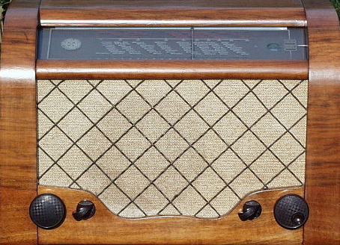
Germany invades your country!
Wireless radio announcement
Notes:
Image: Wikimedia commons
Creative Commons Attribution-Share Alike 3.0 Unported license
Voice: Rob Unwin, DECSY recording

Slide 7
Role play
Imagine you are a family that has just heard this news. Role play what happens when you hear it.
Create a freeze frame of part of your scenario and be prepared to answer questions about what you are doing, thinking and feeling.

Slide 8
Account by Fred Galliene of his experience of the invasion of Guernsey 30 June 1940
Write your own diary entry, imagining that what happened when your country was invaded. Describe what you did, how you felt and what you thought.

Slide 9
Nazi anti-Jewish Decrees
In your family groups read the list of anti-Jewish decrees made by the Nazis.
Discuss what you could do to resist the occupation and the anti-Jewish decrees.
Be ready to share one of your ideas with the rest of the class.

Slide 10
Danish Resistance 1940 – 10 Commandments of Arne Sejr
When the Germans invaded Denmark, Arne Sejr was a 17 year old schoolboy
He was shocked by how friendly people were being to the newly arrived soldiers.
The local newspaper carried the king’s message telling everyone to behave like good Danes and he wondered what a ‘good Dane’ was.
He asked himself ‘How does a good Dane behave in a situation like this, when his country is occupied by an enemy?’

Slide 11
Arne Sejr
Notes:
Image: DECSY
Actor: Dominic Unwin, DECSY recording

Slide 12
Ten Commandments for Danes
You must not go to work in Germany and Norway.
You shall do a bad job for the Germans.
You shall work slowly for the Germans.
You shall destroy important machines and tools.
You shall destroy everything which may be of benefit to the Germans.
You shall delay all transport.
You shall boycott German and Italian films and papers.
You must not shop at Nazis’ stores.
You shall treat traitors for what they are worth.
You shall protect anyone chased by the Germans
Join the struggle for the freedom of Denmark!
Notes:
Sejr typed this out 25 times and rode his bicycle to the homes of his town's most influential citizens (mayor, bankers, doctors, journalists) and stuffed the 10 Commandments into their letter boxes. Before long his Ten Commandments would be passed from hand to hand and eventually become sacred to the Danes as they waged their national resistance.

Slide 13
A Force More Powerful film
Danish Resistance
Notes:
If clicking on the link doesn’t work on your computer please copy and paste the link into your browser: https://www.youtube.com/watch?v=mD5xKALhnxg

Slide 14
Rosenstrasse Protest

Slide 15
Rosenstrasse is the true story of German women who rescued their husbands from deportation and death in early 1943.
Swept up from their forced labour jobs in what was meant to be the Final Roundup in the national capital, 1700-2000 Jews, mostly men married to non-Jewish women, were separated from the 6000 other victims of the Gestapo and SS and herded into Rosenstrasse 2-4, a welfare office for the Jewish community in central Berlin.

Slide 16
Because these Jews had German relatives, many of them highly connected, Adolf Eichmann hoped that segregating them from the others would convince family members that their loved ones were being sent to labour camps rather than to more ominous destinations in occupied Poland.
Normally, those arrested remained in custody for two days before being loaded onto trains for the East. Before that could happen in this case, however, wives and other relatives got wind of what was happening and appeared at the Rosenstrasse address, first in ones and twos, and then in ever-growing numbers.

Slide 17
Perhaps as many as six thousand participated in the protest, although not all at the same time. Women demanded back their husbands, day after day, for a week.
Unarmed, unorganized, and leaderless, they faced down the most brutal forces at the disposal of the Third Reich.
Goebbels was District Leader of Berlin and was anxious to have it racially cleansed. He was also in charge of the nation's public morale. On both counts he was worried about the possible repercussions of the women's actions. Rather than inviting more open dissent by shooting the women down in the streets and fearful of jeopardizing the secrecy of the Final Solution, Goebbels with Hitler's agreement, released the Rosenstrasse prisoners and also ordered the return of twenty-five of them already sent to Auschwitz.

Slide 18
To both men, the decision was a mere postponement of the inevitable. But they were mistaken. Almost all of those released survived the war.
The women won an astonishing victory over the forces of destruction.

Slide 19
Rosenstrasse Memorial

Slide 20
Rosentrasse runs between Hakescher Markt and Alexanderplatz in Berlin. It is one of these small roads and you walk by without knowing what happened there before. But this it the place where you can see the Block of Women where the Old Synagogue used to stand before the Second World War.
Block der Frauen, Block of Women in German, is the work of Ingeborg Hunzinger, a East German sculptor that created the memorial to those women who took a part in the Rosentrasse Protest. It was erected back in 1995 not far from the site of where the protest happened in 1943.

Slide 21
Block der Frauen
Notes:
Image: https://commons.wikimedia.org/wiki/File:Rosenstrasse_Denkmal_3.jpg
Manfred Brückels, CC BY-SA 3.0 <https://creativecommons.org/licenses/by-sa/3.0>, via Wikimedia Commons

Slide 22
Ingeborg Hunzinger first proposed the memorials to the city councils of East and West Berlin in the late 1980s. But, even though the councils agreed with the helping out with a portion of the construction cost, Ingeborg Hunzinger bore most of the expense herself.
And Ingeborg Hunzinger is glad that she did the memorial since the Rosentrasse Protest was such an important event in the history of Berlin and most people don’t even know it happened.

Slide 23
The strength of civil disobedience, the vigour of love overcomes the violence of dictatorship; Give us our men back; Women were standing here, defeating death; Jewish men were free.
This is what is written in German on this memorial made of reddish sandstone together with Jewish symbols and characters.
These portray not just desperation and fear but also the cohesion and unity of the remaining Jews against the Nazi Regime.

Slide 24
Holocaust Memorial Day 2020 Theme Vision 'Stand Together'
The theme for HMD 2020 is Stand Together. It explores how genocidal regimes throughout history have deliberately fractured societies by marginalising certain groups, and how these tactics can be challenged by individuals standing together with their neighbours, and speaking out against oppression.
In the years leading up to the Holocaust, Nazi policies and propaganda deliberately encouraged divisions within German society – urging ‘Aryan’ Germans to keep themselves separate from their Jewish neighbours. The Holocaust, Nazi Persecution of other groups and each subsequent genocide, was enabled by ordinary citizens not standing with their targeted neighbours.

Slide 25
Holocaust Memorial Day 2020 Theme Vision 'Stand Together'
Today there is increasing division in communities across the UK and the world. Now more than ever, we need to stand together with others in our communities in order to stop division and the spread of identity-based hostility in our society.
HMD 2020 marks the 75th anniversary of the liberation of Auschwitz – this is a significant milestone and is made particularly poignant by the dwindling number of survivors who are able to share their testimony. It also marks the 25th anniversary of the Genocide in Bosnia.

Slide 26
Holocaust Memorial Day 2020 Theme Vision 'Stand Together'
Rosenstrasse
Key concepts…

Slide 27
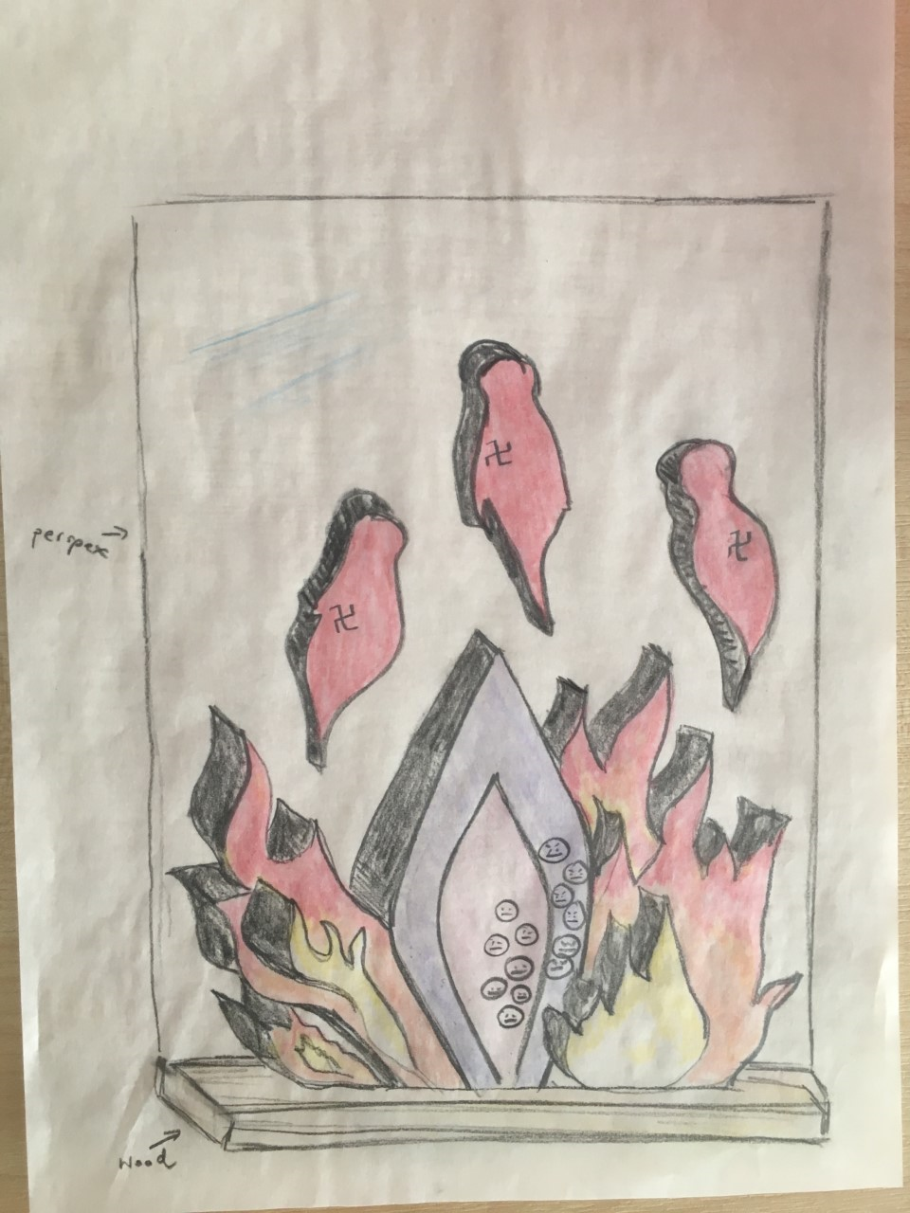
Example…
Notes:
Image: St Catherine’s RC Primary, Sheffield

