Slide 1
Non-violent Action: A Force for Change
Power: Lesson Plan 4
Understanding the Link between Vulnerability, Anger and Violence
Notes:
Film credit: Jaq Pixelwitxch, Pixelwitxch Pictures used with permission

Slide 2
'Anger' by Debbie Palphreyman
Notes:
Thanks to www.elsa-support.co.uk for this activity (with permission from Debbie Palphreyman)

Slide 3
'Anger' by Debbie Palphreyman
What is the poem about?
What triggers does the person in the poem have? (lines 1-4)
How does being angry affect the person’s body?
What is adrenaline?
What affects did the adrenaline have on the person’s body (lines 10-14)

Slide 4
Where’s Your Anger?
Notes:
Give each learner a copy of RS85 'Where’s your Anger in Your Body?' and invite them to spend 5 mins filling in where in their body their anger shows up? or comes out? or lives? what physical sensations to they notice and where?

Slide 5
What is anger and what is its purpose?
Inside Out ‘Disgust and Anger’ 1 min:
https://www.youtube.com/watch?v=k1oXx4delIY
OR
Inside Out ‘Anger Memorable Moments’ 3 min 33 secs:
https://www.youtube.com/watch?v=rnLg-1vE94k

Slide 6
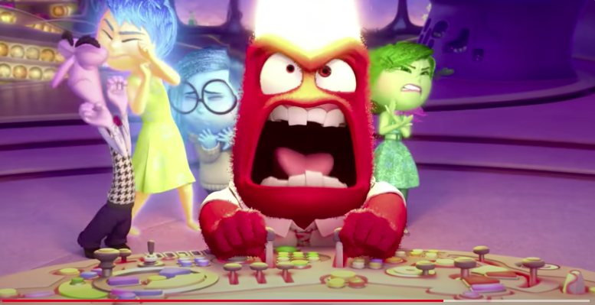
What is anger and what is its purpose?
Inside Out ‘Disgust and Anger’ 1 min.:
https://www.youtube.com/watch?v=k1oXx4delIY

Slide 7
What is anger and what is its purpose?
OR
Inside Out ‘Anger Memorable Moments’ 3 min 33 secs:
https://www.youtube.com/watch?v=rnLg-1vE94k

Slide 8
What is the purpose of anger?
What are the benefits of anger?
What are the costs of anger?
Discuss in groups

Slide 9
Anger – purpose, benefits and cost
It is a normal and vital emotion - it doesn’t need to be cured - AND what we do with it matters.
Anger is an emotion designed to alert us to something that needs our attention or needs to change. It is a coping mechanism against threats to things we value.
It is often an 'END' emotion that protects us when we feel vulnerable (you can refer back to triggers in the poem).
We can use it either PROTECTIVELY or DEFENSIVELY; SELF AWARENESS helps us recognise the difference.

Slide 10
The Person Who Had Feelings
Once there was a very small person who had feelings. They had many feelings and got them every day. Their family liked them when they showed their feelings, so… they started wearing them on their sleeve. One day one of the parents said they did not like to see the small person’s FEAR feeling anymore. The small person tried to pull it off. The parent said they would give the small person some TOUGH to cover their FEAR. It was very hard to cover the FEAR with TOUGH so the other parent and grandparents helped. It took many days.
'Now you look wonderful' the parents said when it was done. 'We’ve covered some of your feelings with TOUGH. You will grow into a good strong person.
When the small person was a little older they found a friend. The friend also wore their feelings on their sleeve. One day the friend said 'my parents want me to cover up my LONELY feelings and I will be different from now on.' And they were! The small person decided to cover their LONELY feelings too and they got ANGER from another adult. The small person put the big patches of ANGER on top of their LONELY. It was hard work trying to cover the LONELY feelings.

Slide 11
The Person Who Had Feelings ctd.
One day when the small person went to school some of their LONELY feelings started to show. SO… the teacher kept them later and gave them some GUILT to cover the LONELY feelings. Sometimes, alone at night the small person would look at their feelings. They would pull off the TOUGH and ANGER to look at their LONELY and FEAR. Then they would have to take a long time putting the TOUGH, ANGER and GUILT on again.
One night they noticed their LONELY and FEAR were growing, sticking out beyond the patches. The small person had to find more ANGER to cover the LONELY and get all the TOUGH their parents could spare to cover their FEAR.
This small person grew bigger and was very popular. Everyone said they could hide their feelings well. One day the person’s parents said they had a PROUD feeling as the person had so much TOUGH. But the person couldn’t find anywhere to put the PROUD feeling because there was so much TOUGH. The person had trouble finding any room on their sleeve for any other feelings. The TOUGH and the ANGER were all that showed.

Slide 12
The Person Who Had Feelings ctd.
Then one day they met another person and became friends. They thought that they were a lot alike because they both had only TOUGH and ANGRY feelings showing. But one day the friend told the person a secret. 'I’m not really like you… my TOUGH and ANGRY are really only patches to hide my FEAR and LONELY.' The friend then pulled back the edge of their TOUGH and showed the person FEAR. Just for a second.
The person sat quiet and did not speak. Then carefully they pulled back a little edge of their TOUGH and showed their FEAR. The friend saw the LONELY underneath. Then the friend gently reached out and touched the persons FEAR and then the LONELY… The friend’s touch was like magic. A feeling of ACCEPTANCE appeared on the person’s sleeves, and the TOUGH and ANGER were smaller. Then the person knew that whenever someone gave them ACCEPTANCE they would need less TOUGH and then there would be more room to show their REAL feelings whatever they were..... HAPPY...... LONELY...... PROUD...... SAD....... LOVING.......STRONG....... GOOD....... WARM...... HURT....... FEAR.........

Slide 13
The Person Who Had Feelings
Reflection
What do you feel in response to this story?
What do you think in response to this story?

Slide 14
Anger Iceberg
Icebergs are giant, floating pieces of ice found in the coldest parts of the ocean. What you can see from above is just a tiny part. Most of the iceberg is hidden under the surface.
When we are angry, there are often other emotions under the surface
Our emotions affect our body sensations, thoughts and behaviours.
What changes do you notice?
Mad
Enraged
Furious
Angry
Cross
Annoyed
Guilty
Scared
Anxious
Afraid
Sad
Grieving
Ashamed
Frustrated
Worried
Lonely
Disappointed
Hungry
Embarrassed
Jealous
Vulnerable

Slide 15
The Simple Model of the Brain
See separate PowerPoint (slides 1-8)

Slide 16
'Nobody makes you angry you decide to use anger as a response'
How does the link between vulnerability and anger relate to violent and
non-violent action and behaviour?

