Slide 1
Non-violent Action: A Force for Change Lesson Plan 2 Personal Power - Part 2
©2021
Notes:
For Lesson Plan 2: Personal Power - Part 2 – Use all slides except slides 2 & 8
For Lesson Plan 3: Understanding the link between Vulnerability, Anger & Violence – Use slides 1-8

Slide 2
Non-violent Action: A Force for Change Lesson Plan 3 Understanding the link between Vulnerability, Anger & Violence
©2021
©
Notes:
For Lesson Plan 3 - Understanding the link between Vulnerability, Anger & Violence

Slide 3
Triune Brain Model
This is a simplified model of the structure of the brain formulated by neuroscientist Paul D. MacLean in the 1960s.
©2021
Notes:
Triune Brain model:
Whilst the brain is one of the most complex of human organs the Triune Brain model gives us a quick and simple way to think about and understand the brain different functions. It also helps us understand the:
interconnection between our feelings and thoughts, and what happens inside us when we feel angry.
importance of feeling safe in all that we do and how feeling safe helps us develop our Personal Power
It does this by explaining the three different layers of the brain’s structure. (Each layer can be loosely associated with the reptile, mammal and primate/human phases of evolution.)

Slide 4
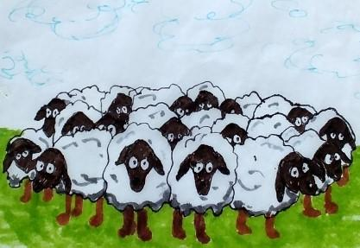
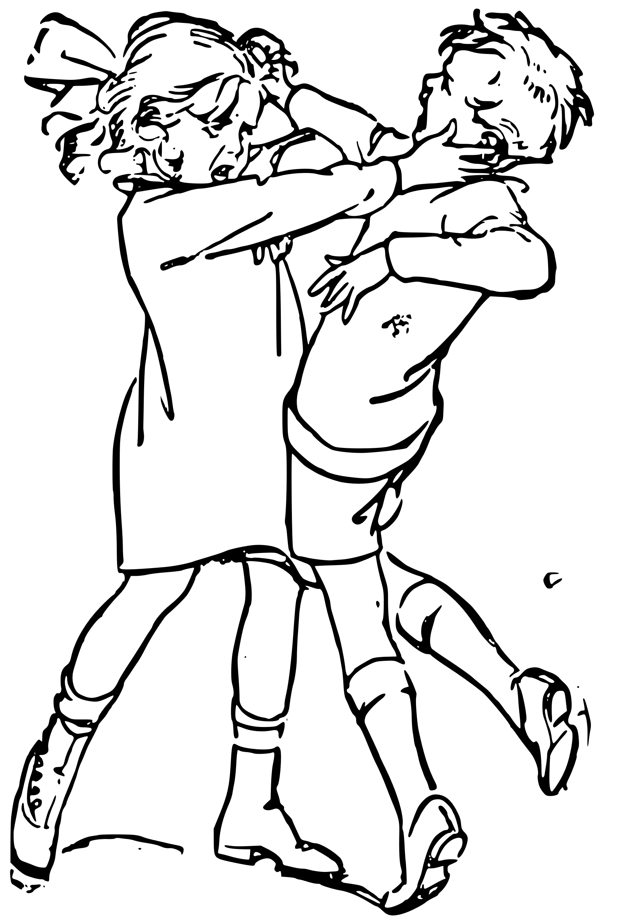
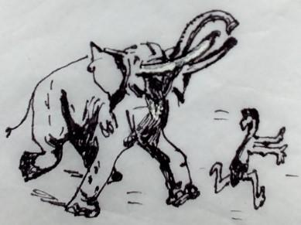
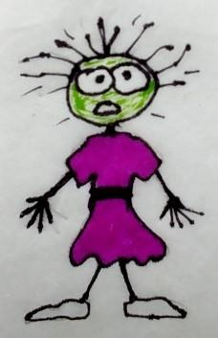
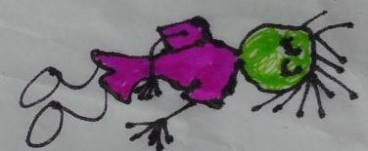
REPTILIAN SURVIVAL
BRAIN
SURVIVAL
Core functions heart & lungs
Energy States of Arousal
MAINTENANCE
Food, shelter, Safety, Reproduction
MOBILISING
Flock,
Fight,
Flight
BASIC “NEEDS”
Safety & Avoiding Harm
IMMOBILISING
Freeze, Flop & Drop
©2021
Notes:
In this model there are three different layers to our brain -
Firstly we have something called reptilian brain – oldest & fastest part which looks
after our survival and daily needs
ANM 1 Survival
ANM 2 Maintenance – daily needs
ANM 3 Basic Needs of Reptilian brain are….
We have a hierarchy 5 survival responses
ANM 4 Mobilising - flock/fight/flight
ANM 5 Immobilising – freeze/flop&drop
Because this part of the brain is concerned with safety and survival all we have going
on here is B – no conscious feeling or thinking

Slide 5
MAMMALIAN
OR FEELING BRAIN
EMOTIONS
Evokes Motion
BASIC “NEEDS”
Satisfaction & Reward
Learning,
Memory & Decision Making
Reward & Motivation
©2021
Notes:
Then we have the mammalian brain (which all mammals have) – or feeling brain. This
is responsible for
ANM 1 – our emotions…. It evokes our motion – whether we move either towards or
away from something
ANM 2 – Learning, etc
And the basic needs of this part of the brain are - ANM 3
The mammalian/feeling part of the brain works closely with the Reptilian/Survival
brain so here we have B & F going on.

Slide 6
INTEGRATION & REGULATION
Attention, Feelings, Desires, Empathy
NEO-CORTEX or THINKING BRAIN
MENTAL FUNCTIONS
Think, Reflect, Plan, Analyse, Imagine, Problem Solve
Self-Awareness, Moral Awareness & Insight
BASIC “NEEDS”
Connection & attachment to others
Language
©2021
Notes:
And finally we have the neo-cortex or THINKING Brain – This is the most recent part
evolutionarily and also slowest part of the brain because it interprets and makes
sense of our experience beyond bodily functions & survival reactions that Reptilian
and mammalian/feeling brain deal with.
ANM 1 - Key role of neo-cortex is INTEGRATION & REGULATION…. Integrating sensory input to regulate our attention, feelings, desires, empathy – supporting our Emotional Balance
It gives us our
ANM 2 Mental Functions of…. Which support our capacity to respond with flexibility to the situation
ANM 3 Self & Moral awareness & insight
ANM 4 Language – our ability to express ourselves, share our experiences and ask for help
ANM 5 Basic Needs of cortex are …..

Slide 7
80 millisecs
to register EMOTION
250 millisecs
to register THOUGHT
AMYGDALA
©2021
Notes:
An interesting discovery about our brains is that it takes our limbic or feeling brain only 80 milliseconds to register emotions, but it takes our cortex or thinking brain 250 milliseconds to register a thought; so in our brain we register feelings 3 x QUICKER than thoughts.
And reason for this is to do with our survival instincts - within limbic system is a small structure - amygdala, a storehouse for emotional memories & responsible for our survival instincts and our “fight or flight” reactions. All the information gathered from all our senses passes through the amygdala, which then directs it the limbic and cortex areas of brain.
When the information coming in from our senses has a big emotional charge, we experience “amygdala hijack”; a flood of hormones are released that cause physical and emotional alarm and overrides cortex, & our response comes directly through the limbic system causing the us to react without any thinking.
Be aware it typically takes 20 mins for stress hormones to disperse and for us to calm down. However, adrenaline can also be released & its impact can last for several hours to several days. If we get angry often what happens is we get repeated release of adrenaline so it takes us longer to calm down each time which lowers our anger thresh-hold so it takes less for us to be triggered.

Slide 8
Anger and Our Brain
The Amygdala - Handles emotions and stores emotional memories; when hijacked amygdala floods the body with stress hormones
Pre-frontal cortex - Handles judgement
With practice we can over-ride the “amygdala hijack” and calm it down. Any activity that creates “time-out space” allows time for these two responses to balance themselves out
©2021
Notes:
For Lesson Plan 3 - Understanding the link between Vulnerability, Anger & Violence
So two key things to keep in mind in relation to anger and our brain are that
The amygdala handles emotion,
the prefrontal cortex handles judgment.
Refer to the calming strategies in the poem again…
Two other simple calming strategies you can suggest are
3:5 breathing – breath in for the count of 3 and out for the count of 5 (activates the parasympathetic nervous system and calms us down)
Flower and Candle Breathing – breath in and smell the flower and then blow the candle out

Slide 9
©2021
©

Slide 10
FEELING SAFE MATTERS
HOW WE PROCESS OUR EXPERIENCES
Am I safe? What do I FEEL about this?
Have I experienced this before?
Can I CONNECT or must I PROTECT?
3. My THINKING - What are my options?
4. My BEHAVIOUR – what I choose to do
©2021
Notes:
FEELING SAFE MATTERS
The reason for this is because of [ANNIM 1] how we process our experiences in the brain. What happens is that in response to every experience we have our brain does a simple “risk assessment” which starts in the LIMBIC or FEELING brain (responsible for our emotional responses). In this risk assessment the brain is assessing
[ANNIM 2] Step 1 is: Am I safe? What do I feel about this?
[ANNIM 3] Step 2 is: Have I experienced this before? – do I have any memories of a similar experience I can draw on to decide what to do:
Essentially these 2 steps are about
does it feel safe enough for me to [ANNIM 4] CONNECT and move TOWARDS this experience
or does it feel uncertain or unsafe and I need to PROTECT myself from it and move AWAY from it”?
NB You can link this back to the Safety Continuum in Part 1 of this lesson plan
Only if the outcome of the risk assessment is “this experience is OK or safe enough” do I
[ANNIM 5] STEP 3: get access to the THINKING part of my brain where I can reflect on What do I think about this? What are my behaviour choices?
[ANNIM 6] So it is not until Step 4 – that I get to translate my Feeling and Thinking into action – my Behaviour
IF not OK/Safe Enough we stay operating from the Feeling brain, overwhelmed by emotion but unable to access our thinking to help us make sense of it; or if the experience is very intense or feels unsafe, our reptilian brain may get triggered and we will REACT with some version of Flock/Fight/Flight/Freeze.

Slide 11
FEELING SAFE MATTERS
What we Feel = gateway to our Thinking
Our Feelings are always ON
Feelings are simply messages about our internal state
©2021
©
Notes:
The fact that it is our feelings at the root of how we process our experiences this tells us that our Feeling & Thinking are not only interconnected, but it is actually [1] our FEELINGS that act as the gateway to our Thinking and the safer we feel the more likely we are to CONNECT & ENGAGE rather than PROTECT & DISENGAGE ourselves from an experience
We also now know that [2] our feelings are always on – whatever we are doing; so I view our Feelings as simply messages designed to tell us things –
So learning how to manage our feelings is KEY life skill – the more we can familiarise ourself with and thus normalise ALL feelings the more we can get access to our THINKING and thus respond & CONNECT & ENGAGE rather than react to PROTECT & DISENGAGE
Overcome strong UR in relation to F’s in our culture
So from all this we now know that Feeling Safe is pretty fundamental….

Slide 12
FEELING SAFE MATTERS
Feeling Safe underpins
Our well-being
Our ability to learn
Our capacity to RESPOND rather than REACT
We are FEELING animals that can Think
©2021
©
Notes:
[1] FEELING SAFE underpins
[2] Our well-being
[3] Our ability to learn
[4] Our capacity to RESPOND rather than REACT
In essence we are FEELING animals that can Think, not thinking animals that can feel!

Slide 13
HOW WE LEARN
We LEARN - by connecting brain cells or neurons
This happens through simple act of DOING
REPETITION turns learning into HABITS
The repetition can be REAL or IMAGINED as doing & thinking are same to the brain
©2021
©
Notes:
How we learn – our brains are very malleable – they have “plasticity” (ie we can rewire them over and over just like we can reshape plasticine.) Our brain can rewire itself and make new connections at any age
So [ANNIM 1] we learn (anything) by making new brain connections and we make new brain connections [ANNIM 2] simply through doing any action or activity.
[ANNIM 3] and REPITITON turns that learning into habits.
Use the metaphor of walking across long grass here – the first time we do it we flatten the grass and so we can see where we have walked; if we keep walking the same pathway over and over and over the grass will eventually wear away and that pathway becomes the one that everyone uses habitually.
[ANNIM 4] And what is even better is that the repetition we need to create new connections and HABITS can be both real – (actually doing something) – or imagined – (we imagine ourselves doing something) because to the brain Thinking is the same as Doing without the movement…

Slide 14
©2021
©

Slide 15
Feeling, Thinking & Behaviour for maximum personal power
STOP & NOTICE
MAKE A
CHOICE
Feelings
Thinking
Behaviour
REFLECT
BACK ON
FEELINGS
©2021
Notes:
[ANNIM 1] what I call our FTB circles – and these are key ingredients of our Personal Power and in order to work at our best we need to use these resources in a very specific way.
Firstly [ANNIM 2] in relation to our Feelings we need to “stop and notice” them … how safe do we feel? What Early Warning Signs are we having? Where are we on the safety continuum?
We then move to our Thinking circle [ANNIM 3]. There are 2 elements here – what options do I have? What will be the impact of these options on myself? And on others? (this is about remembering our behaviour always has an impact on us and others)
Once I have reflected about my options and their consequences both for myself and others I make choice about my behaviour
[ANNIM 4] Then I go and do behaviour I have chosen
[ANNIM 5] But I don’t stop there come need to checkout my feelings again. Has my choice in B achieved what I wanted? do I feel safe again? If not need to do more Thinking and go round the 3 circles again – I might need to Persist going round these 3 circles several times to make a choice of B that works best for me.
Although all of this might seem obvious, what happens is that much of the time we are following this sequence unconsciously and the danger in that is that we can easily miss out one aspect so only be operating on only two out of the three
Eg young children tend - F & B only;
professionals - T & B only (expectation is we’ll do our job and not let our emotions get in the way);
Someone who is depressed - F & T only (often overwhelmed with feelings and can’t decide what’s best option so get paralysed and can’t act).
However, we now know from research that our feelings and emotions are always “ON” and directing our brain; so we become much more powerful when we learn how to listen and understand the messages from our feelings and work with them rather than trying to ignore them in the hope they will go away. They don’t!
We can summarise our FTB Circles in the following way - next slide

Slide 16
Feelings, Thinking & Behaviour for maximum personal power
Feelings are messages from our body about our internal state
Thinking can help us with our F & B
Behaviour is choice with an effect on us and others
Equal amounts of Feelings, Thinking & Behaviour gives us maximum Personal Power
©2021

