Slide 1
Non-violent Action: A Force for Change
Case Study: Sheffield Street Trees Part 1

Slide 2
Trees and tree felling
Notes:
Film courtesy of Jaq Pixelwitxch, Pixelwitchpictures
Film is embedded but if this doesn’t work on your computer find it on YouTube here: https://youtu.be/Qt61QO3eZTM (copy and paste into your browser)

Slide 3
Commission
Dear Expert Tree Panel
As you will have heard from the local newspapers, the council had a lot of bad publicity following the tree felling on Pemberton Avenue. We misjudged the situation and probably shouldn’t have allowed the tree operatives in without notifying the residents first.
We would like you, as the expert tree panel, to advise us of what should be done with the trees earmarked for felling from now on. We have enclosed information about the designated trees.
We have a limited budget for the work in this area and we would like you to take this into account when advising us. We would also like you to consult the residents in this area to find out their views on the trees.
Please don’t hesitate to get in contact if you have any questions or need any more information.
Yours faithfully
Stacey Fielder
Cabinet Member for Environment
Marcastle City Council

Slide 4
Tree Information
Species | Description | Age (years)
Ash | Old diseased ash tree on the corner of a road – which has been surveyed and is a danger to the public | 300
Lime | Tree which is disrupting pavement and damaging kerbs | 100
Maple | Tall tree which is overgrown and overshadowing the road and houses near it | 200
Oak | Tree breaking curb with roots/trunk growing into the road and presents a danger to cars | 150
Cherry | Tree planted as a memorial for those killed in WW1, not appearing to be damaging anything | 90

Slide 5
Online map showing all the important trees in London
Notes:
https://www.treetalk.co.uk/map

Slide 6
Activity: Tree map
Draw a map of the area, showing the location and status of the trees
Make sure you include labels (or a key), showing:
Type of tree
Any issues with the tree
Any features that make that tree unique

Slide 7
What is the value of this plant?
Notes:
Photo credit: Jean Mottershead
https://www.flickr.com/photos/jeanm1/

Slide 8
Are there any disadvantages to having large trees in a city?
Do these disadvantages outweigh the benefits?

Slide 9
Top 10 Tree Benefits
Trees and other land plants produce 25% of the planet’s oxygen. It takes 7 or 8 mature trees to produce enough oxygen for each human every year.
Planting trees is an easy and cost effective way to remove carbon dioxide from the atmosphere. The carbon stored in trees can be locked away for decades, or even centuries, providing the timber is used to create lasting items such as building materials and furniture.
Trees can cool built-up areas during hot weather. Planting just 10% more trees in our cities could reduce urban temperatures by 3-4°C.
Trees reduce storm water run-off, easing the burden on drainage and cutting the number of pollutants entering rivers. For every 5% increase in tree cover storm water run-off is cut by 2%.
Trees can capture toxic vehicle exhaust gases and particulates. Well-positioned trees can cut the amount of roadside pollution entering homes by up to 50%. Larger trees have greater air-cleaning potential: ones with a girth of 77cm may be 70 times more effective at removing pollution than ones measuring 8 cm.
Notes:
From STAG website
References:
https://www.sciencefocus.com/planet-earth/how-many-trees-does-it-take-to-produce-oxygen-for-one-person/
3. Forestry Commission England ‘The case for trees’ https://assets.publishing.service.gov.uk/government/uploads/system/uploads/attachment_data/file/718033/eng-casefortrees.pdf
4. https://www.smartcitiesdive.com/ex/sustainablecitiescollective/why-we-need-trees-our-cities/1100050/
5. https://www.woodlandtrust.org.uk/media/1702/benefits-of-trees-outside-woods.pdf

Slide 10
Top 10 Tree Benefits (ctd.)
Easy access to trees and woodland is linked with better health and emotional wellbeing. A highly rated study has shown that living in a tree-lined street gives the same health improvement as being 7 years younger.
Noise from traffic and other artificial sources can be disguised by tree sounds. Rustling leaves and bird song have been shown to soften the impact of intrusive urban sounds and a well-situated tree can reduce noise nuisance by up to 40%.
Trees make streets safer, for people and for play. Trees slow down traffic and make roads safer for pedestrians, encouraging journeys on foot. Trees close to homes create better play opportunities for children.
A house’s market value is linked to the number of trees on the street. The presence of broadleaved trees has been found to add between 5 and 18% to a home’s value.
Shopping areas with trees get more sales and attract more investment. Streets with more trees encourage people to stay longer and spend more money, which helps the local economy.
Notes:
References: 6. https://www.theguardian.com/society/2015/jul/10/more-trees-on-your-street-means-fewer-health-problems-says-study
7. https://www.psychologytoday.com/gb/blog/minding-the-body/201107/the-birds-and-the-trees
8. https://www.theguardian.com/world/shortcuts/2016/feb/03/slow-down-traffic-ditch-kerbs-keep-potholes-plant-trees
https://naturalstart.org/sites/default/files/journal/6._gull_et_al.pdf
9. Forestry Commission England ‘The case for trees’ https://assets.publishing.service.gov.uk/government/uploads/system/uploads/attachment_data/file/718033/eng-casefortrees.pdf
10. Forestry Commission England ‘The case for trees’ https://assets.publishing.service.gov.uk/government/uploads/system/uploads/attachment_data/file/718033/eng-casefortrees.pdf

Slide 11
What are the benefits of trees in the urban environment?
People
Wildlife
Environment

Slide 12
Are there any downsides to urban trees?
People
Vehicles
Costs

Slide 13
Graph to show the benefits over time of the average tree
B
C
A
Benefits
D
0
50
100
150
200
250
300
350
Age of tree (years)
1) Why does the line go up at the beginning?
2) Why does it go down at the end?
3) The crosses represent options for when to fell the tree. Which one do you think is the best choice? A, B, C or D?
4) Why did you choose that option?

Slide 14
Challenge
The area (number of squares) under the line shows the total benefit over the lifespan of the tree. Example: If the tree is cut down where the X is, the total benefit is the amount of squares shaded in:
Benefits
0
50
100
150
200
250
300
350
1) How many squares are shaded in in this example?
2) Show the difference between felling the tree at A and felling it at C by shading the areas on your other graph.
Age of tree (years)

Slide 15
Problems with street trees
Notes:
Photo © Robin Stott (cc-by-sa/2.0) https://www.geograph.org.uk/reuse.php?id=3574491
Showing pavement damage

Slide 16
Notes:
Photo ©debs-eye
https://www.flickr.com/photos/debbcollins/3729286864/in/photostream/
Diseased elm

Slide 17
Notes:
Andy Beecroft / Cottingham Road (cc-by-sa.2.0)
https://upload.wikimedia.org/wikipedia/commons/6/6e/Cottingham_Road_-_geograph.org.uk_-_1472037.jpg
Showing some damage to curb

Slide 18
Notes:
Photo credit: Helen Griffin, DECSY
Showing house being shaded by tree

Slide 19
Possible Solutions: Thinner Curb
Replace a thick curb stone with a thinner one. This gives the roots of the tree more space to grow and stops the the curb from being pushed into the road.
Solves problem for around 1 year.
Cost: £300
Notes:
Photo credit: Helen Griffin, DECSY

Slide 20
Possible Solutions: Tree pit
Build a pit around the tree, with plenty of space for the roots to grow for many years.
Sometimes the pit sticks into the road, leaving less space for cars.
Solves problem for around 20 years.
Cost: £3000
Notes:
Photo credit: Helen Griffin, DECSY

Slide 21
Possible Solutions: Pruning
Trim off branches to make tree safer (and so light is not prevented from entering a house). It also slows down growth, which means that the roots grow less and cause less damage.
Solves problems for around 2 years.
Cost: £500
Notes:
Photo credit: Helen Griffin, DECSY

Slide 22
Possible Solutions: Felling
Cutting the tree down and removing the stump. Can be replaced by a very small, young tree.
Solves problem permanently.
Cost: £1000
Notes:
Image: Pixaby free photo: https://pixabay.com/photos/cut-tree-axe-wood-cases-strains-1716671/

Slide 23
Marcastle Trees
Species | Description | Age (years) | Cost | Proposed solutions
Ash | Old diseased ash tree on the corner of a road – which has been surveyed and is a danger to the public | 300
Lime | Tree which is disrupting pavement and damaging kerbs | 100
Maple | Tall tree which is overgrown and overshadowing the road and houses near it | 200
Oak | Tree breaking curb with roots / trunk growing into the road and presents a danger to cars | 150
Cherry | Tree planted as a memorial for those killed in WW1, not appearing to be damaging anything | 90

Slide 24
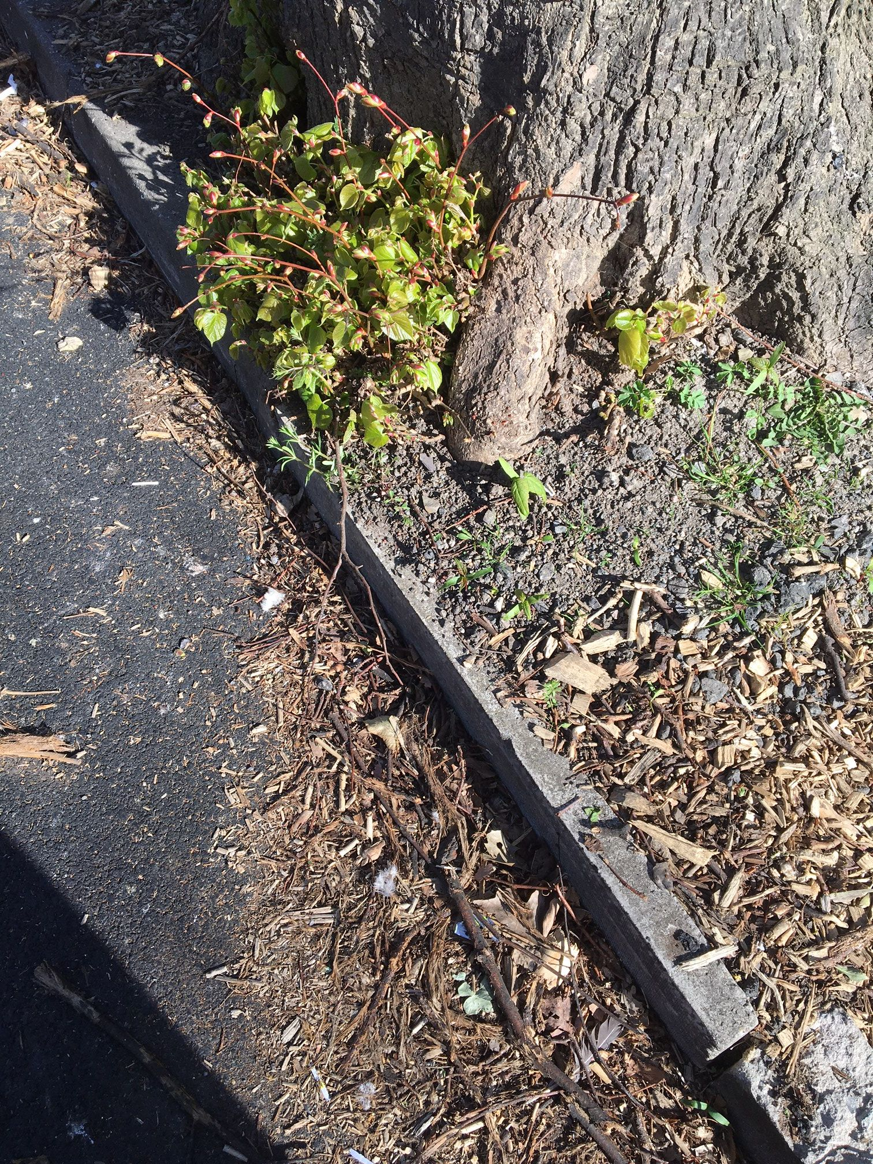
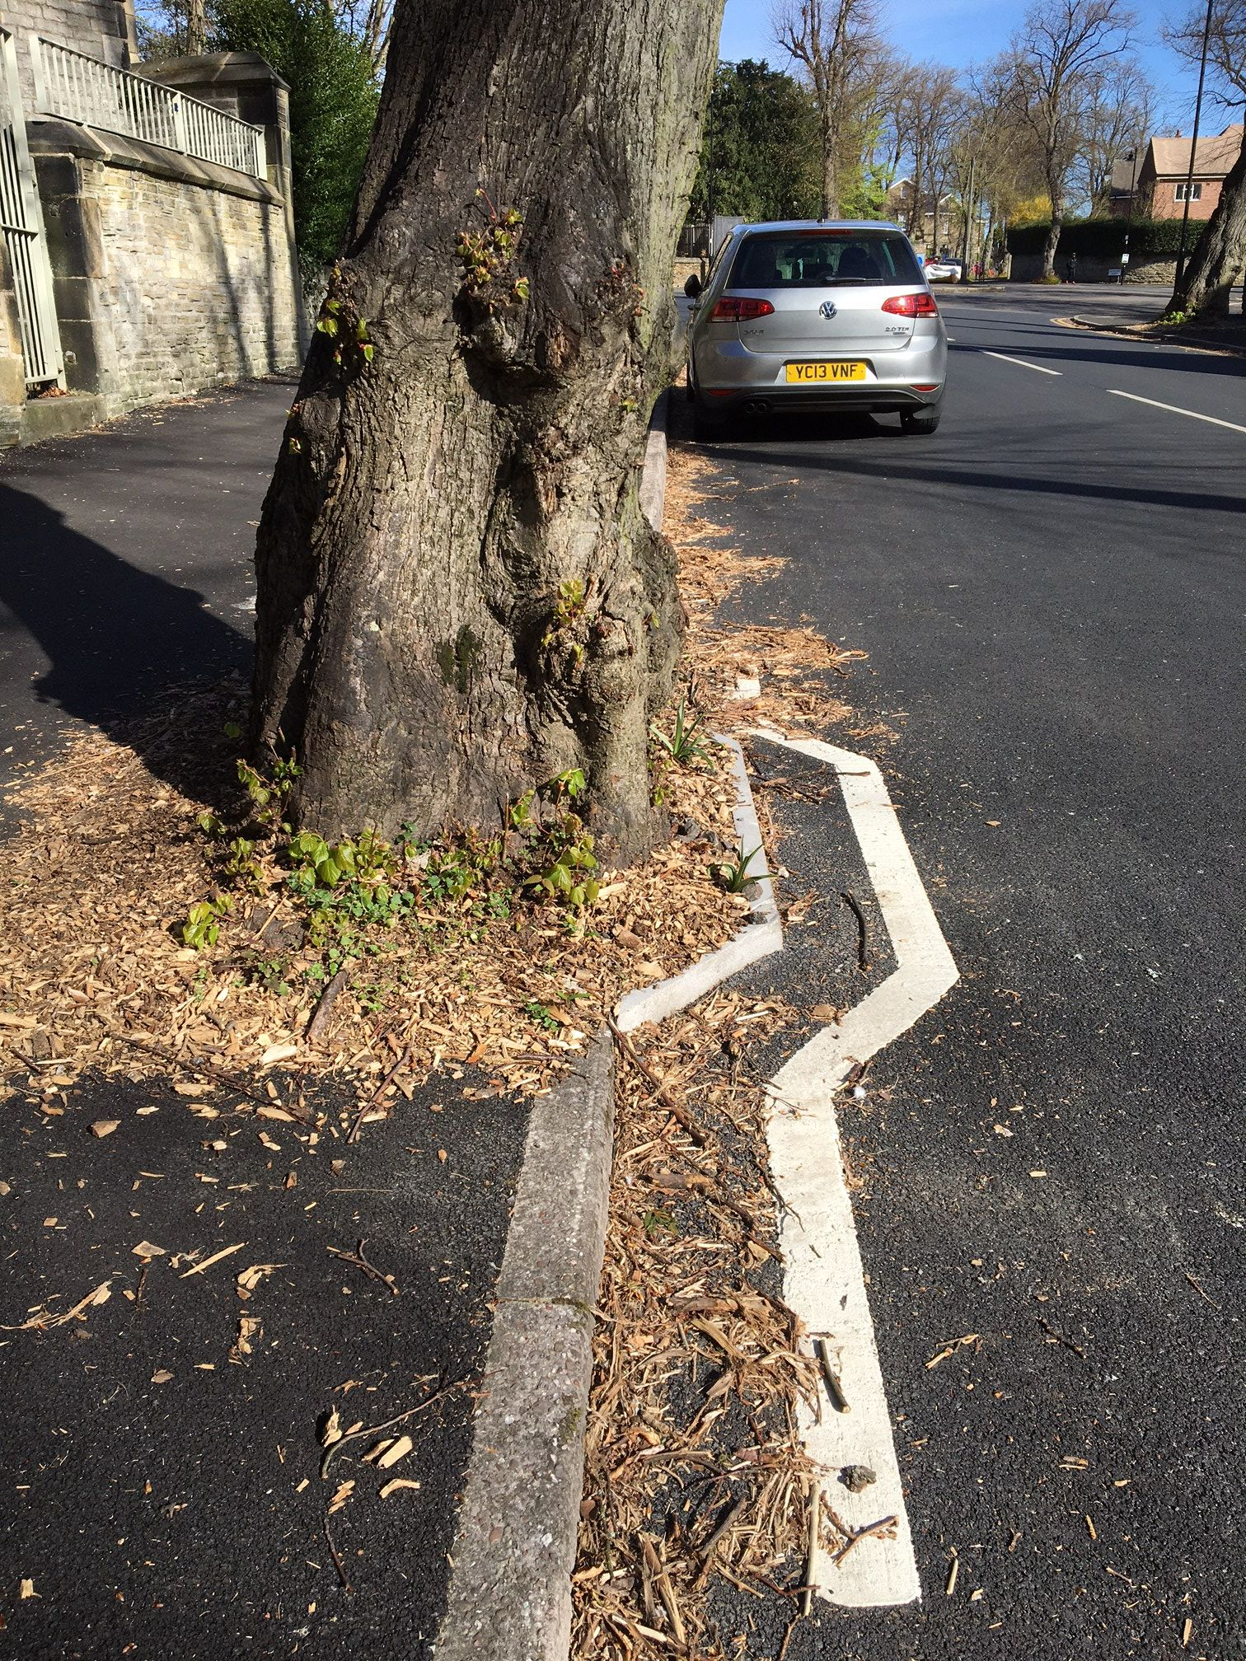
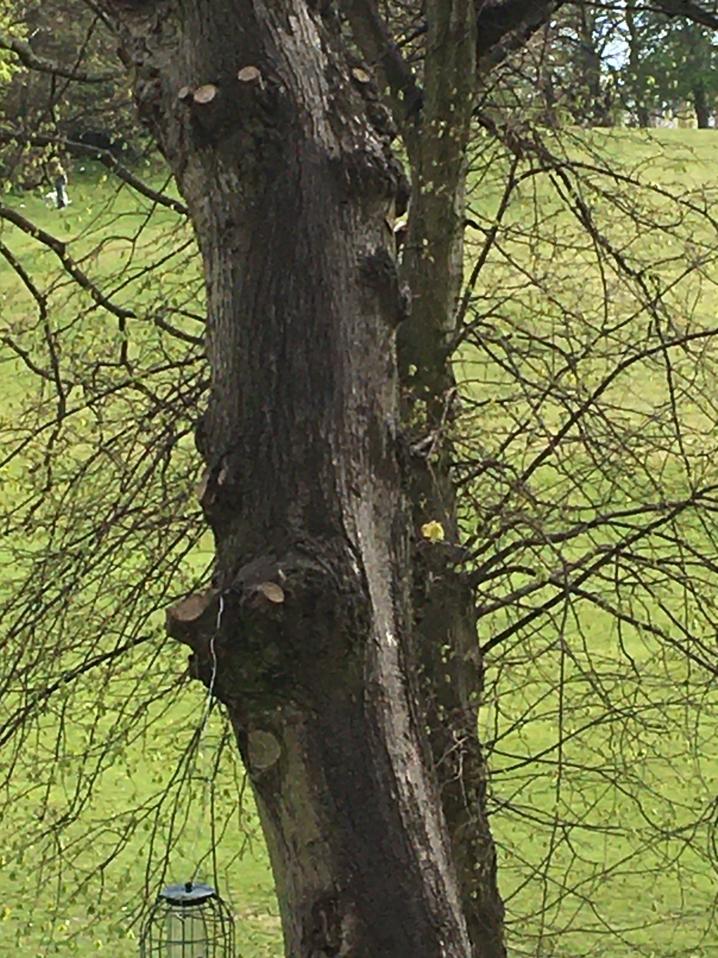
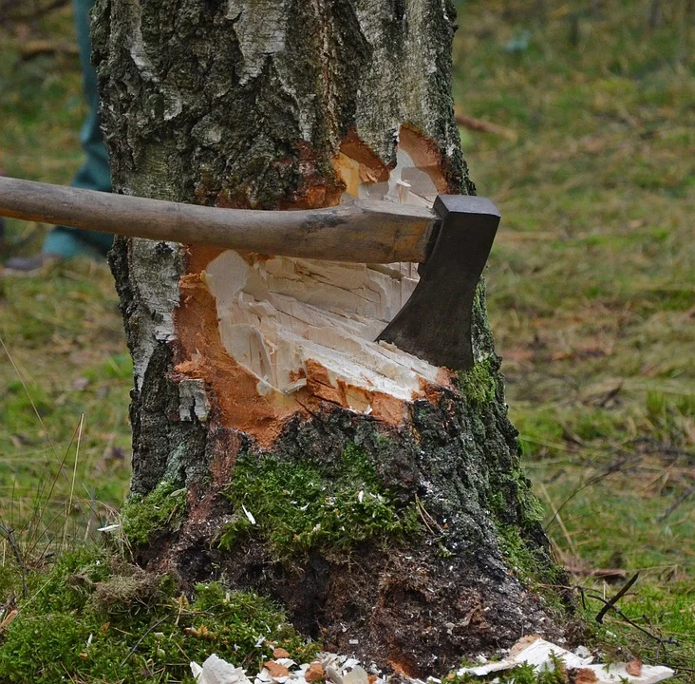
Engineering solutions and costs
1) Thinner curb
Replace a thick curbstone with a thinner one. This gives the roots of the tree more space to grow and stops the the curb from being pushed into the road.
Solves problem for around 1 year.
Cost: £300
2) Tree pit
Build a pit around the tree, with plenty of space for the roots to grow for many years.
Sometimes the pit sticks into the road, leaving less space for cars.
Solves problem for around 20 years.
Cost: £3000
3) Pruning tree
Trim off branches to make tree safer (and so light is not prevented from entering a house). It also slows down growth, which means that the roots grow less and cause less damage.
Solves problems for around 2 years.
Cost: £500
4) Felling tree
Cutting the tree down and removing the stump. Can be replaced by a very small, young tree.
Solves problem permanently.
Cost: £1000
Information about trees
Species | Description | Age (years) | Cost | Proposed solutions
Ash | Old diseased ash tree on the corner of a road – which has been surveyed and is a danger to the public | 300
Lime | Tree which is disrupting pavement and damaging kerbs | 100
Maple | Tall tree which is overgrown and overshadowing the road and houses near it | 200
Oak | Tree breaking curb with roots / trunk growing into the road and presents a danger to cars | 150
Cherry | Tree planted as a memorial for those killed in WW1, not appearing to be damaging anything | 90
Notes:
Photo credits: Image 1,2,3 Helen Griffin
Image 4 Pixaby free photo: https://pixabay.com/photos/cut-tree-axe-wood-cases-strains-1716671/

Slide 25
Find out views of stakeholders
Read role cards in small groups and prepare presentation and arguments.
As large group – take turns to say who you are and what your views are.
Discussion as large group in role (using P4C skills).
Tree panel meets again (in role) to discuss whether they now wish to change any of their proposed solutions before submitting them to the council.
Notes:
Using role cards (RS55) with several learners per role: conduct meeting with representatives with different views. Teacher chairs. Some learners take minutes in role as member of Expert Tree Panel.

Slide 26
Planning our email
Introduction Why are we writing? __________________________________ Why is it so important? ______________________________________ | Benefits to people _______________________________ _______________________________ __________________________________
Benefits to wildlife and climate ________________________________ ________________________________ ________________________________ | Problems caused by trees ________________________________ ________________________________ ________________________________
Proposed solutions Ash: __________________________________ Lime:__________________________________ Maple:_________________________________ Oak: __________________________________ Cherry:_________________________________ | Costs What will it cost? ____________________________________ Why is this a good deal? ________________________________________

Slide 27
Dear Expert Tree Panel
Thank you very much for your detailed recommendations in relation to the trees earmarked for felling.
Although we appreciate your efforts we have decided to go ahead with the felling of all the trees.
Yours faithfully
Stacey Fielder
Cabinet Member for Environment
Marcastle City Council

Slide 28
Example Poster
What’s going on?
Some of the most beautiful local trees are being cut down. Local tree experts have said there is no need to cut down most of the trees. Something needs to be done!
What’s the problem?
The council has a duty to look after street trees and prevent them from being a nuisance. However, they have started cutting down many more trees than ever before, even mature trees that are perfectly healthy and causing no problems for anyone.
Marcastle Council
Stop Felling Healthy Trees!
What can you do about it?
Let the council know that you are not happy with the plans by:
Writing to your local councillor
Writing to you local MP
Posting about it on social media
Putting up this poster in your window
What’s the alternative?
There are many effective solutions to the problems caused by trees that do not involve cutting them down, such as:
Pavement thinning
Creating tree pits
Regular pruning
DECSY 2021

