Slide 1

Non-violent Action: A Force for Change
Power
Personal Power Part 1

Slide 2
“Personal power is the the ability to take action”
Tony Robbins
Notes:
Hand out or project Personal Power quote: “Personal power is the ability to take action” by Tony Robbins for the learners to discuss in pair/table groups/as a class (depending on their age and capability) asking them to consider what they think “personal” and “power,” mean.

Slide 3
What do you think “personal” and “power” mean?

Slide 4
Personal Power
Our own ability to act or
I CAN

Slide 5

What are the people in the following photos feeling? How do you know?
Notes:
Image: https://www.flickr.com/photos/86624586@N00/1813455417
Kevin Walsh

Slide 6
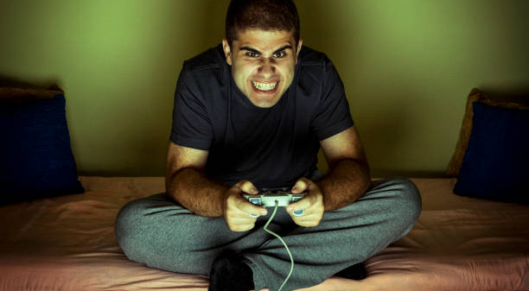
Notes:
Image:
https://www.flickr.com/photos/nodstrum/41509215220/

Slide 7
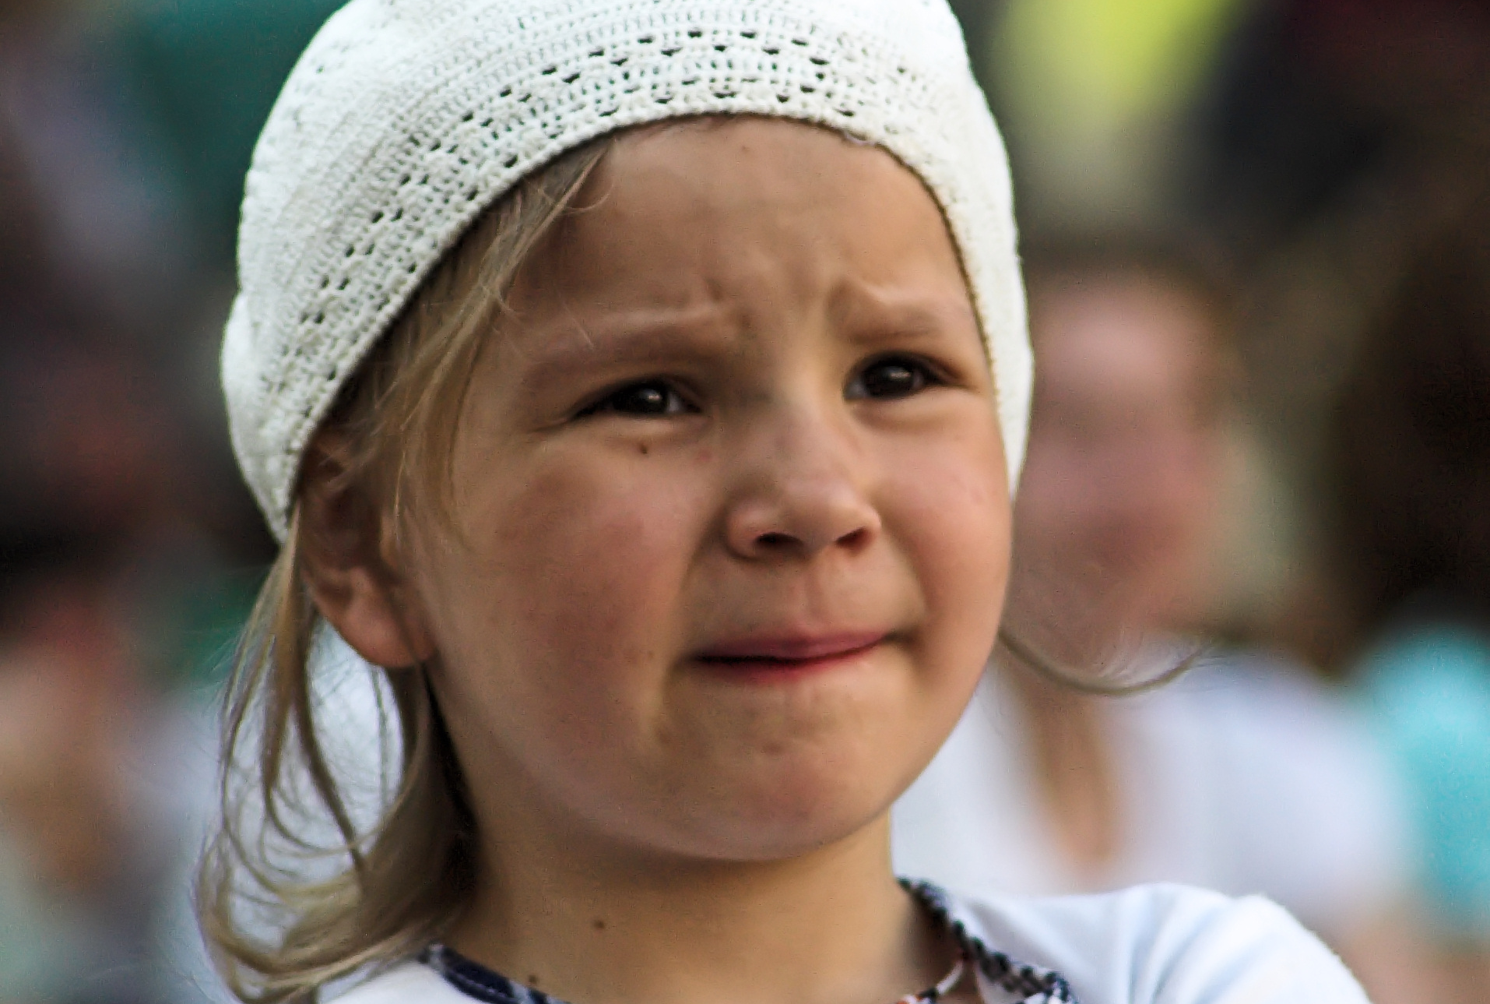
Notes:
Image: https://commons.wikimedia.org/wiki/File:Worried_little_girl.jpg
Ignas Kukenys from Vilnius, Lithuania, CC BY 2.0 <https://creativecommons.org/licenses/by/2.0>, via Wikimedia Commons

Slide 8
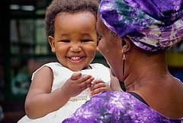
Notes:
Image: royalty free

Slide 9

Notes:
https://pixy.org/81485/ Free download

Slide 10
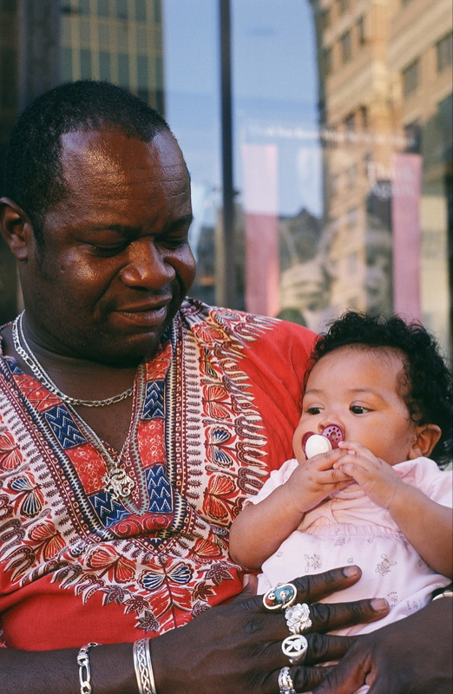
Notes:
Image: https://www.flickr.com/photos/57066639@N00/344731388/

Slide 11
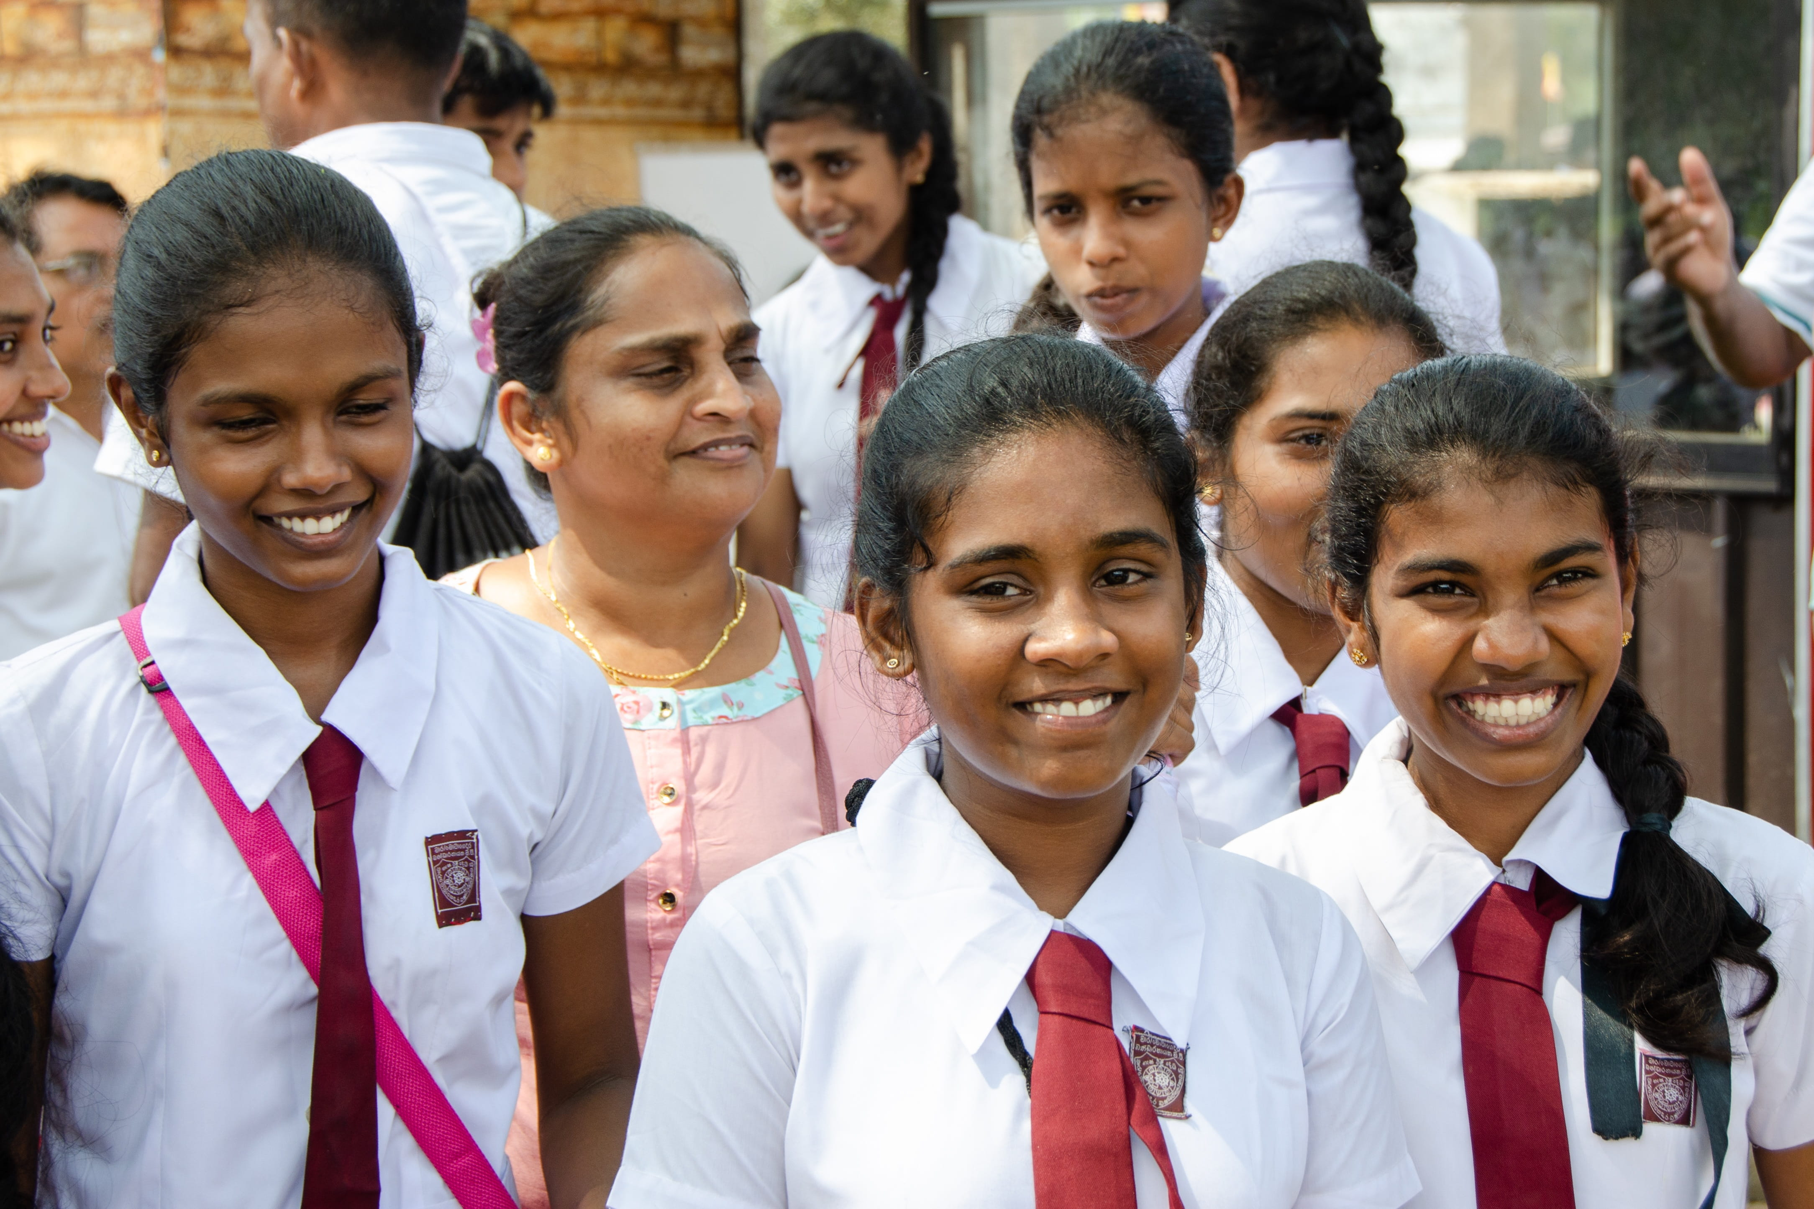
Notes:
Image:
https://www.piqsels.com/en/public-domain-photo-jqkkd

Slide 12

Notes:
Image: https://www.hippopx.com/en/beard-guy-happy-man-mustache-person-portrait-21493

Slide 13
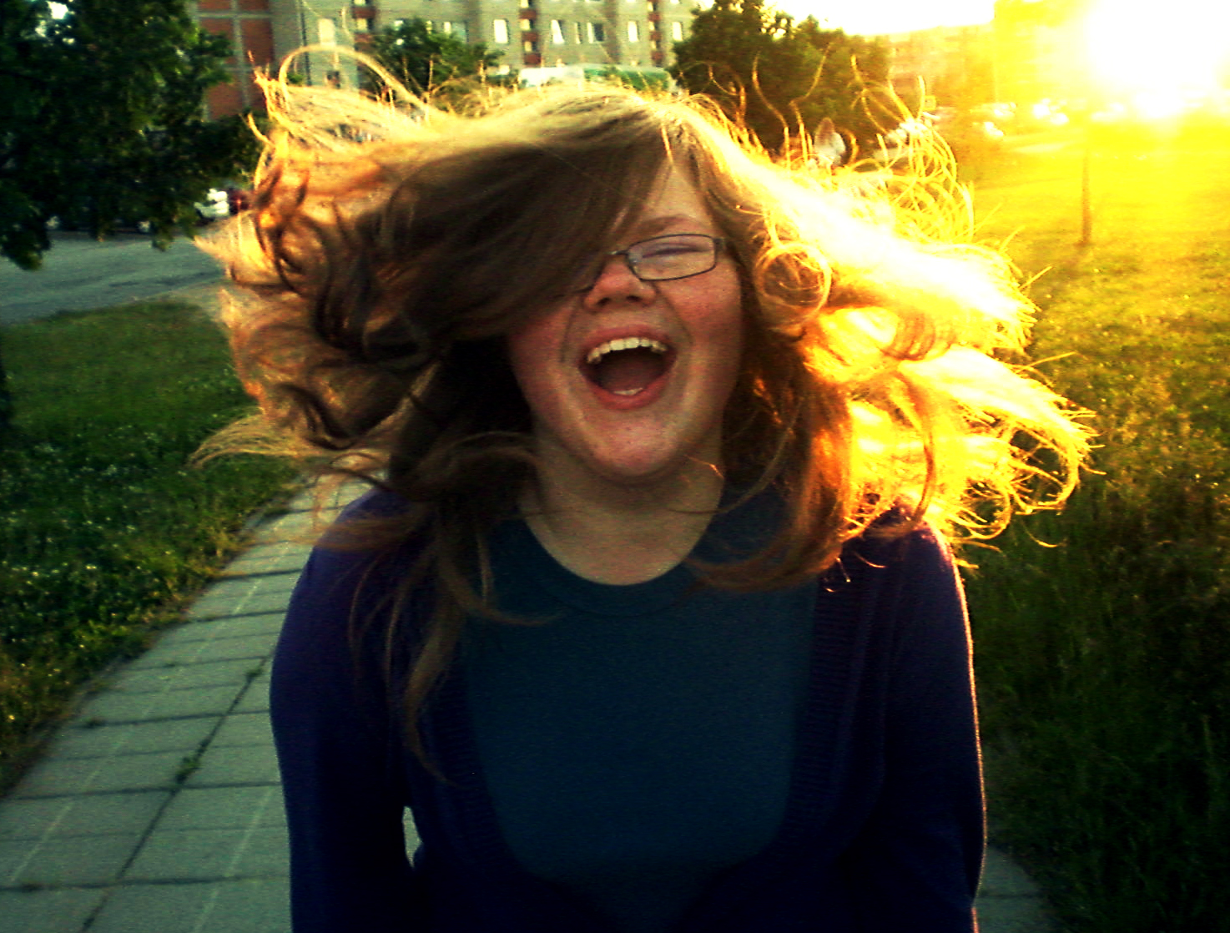
Notes:
Image:
https://www.flickr.com/photos/raminta_si/9632489556
Raminta Simkute

Slide 14
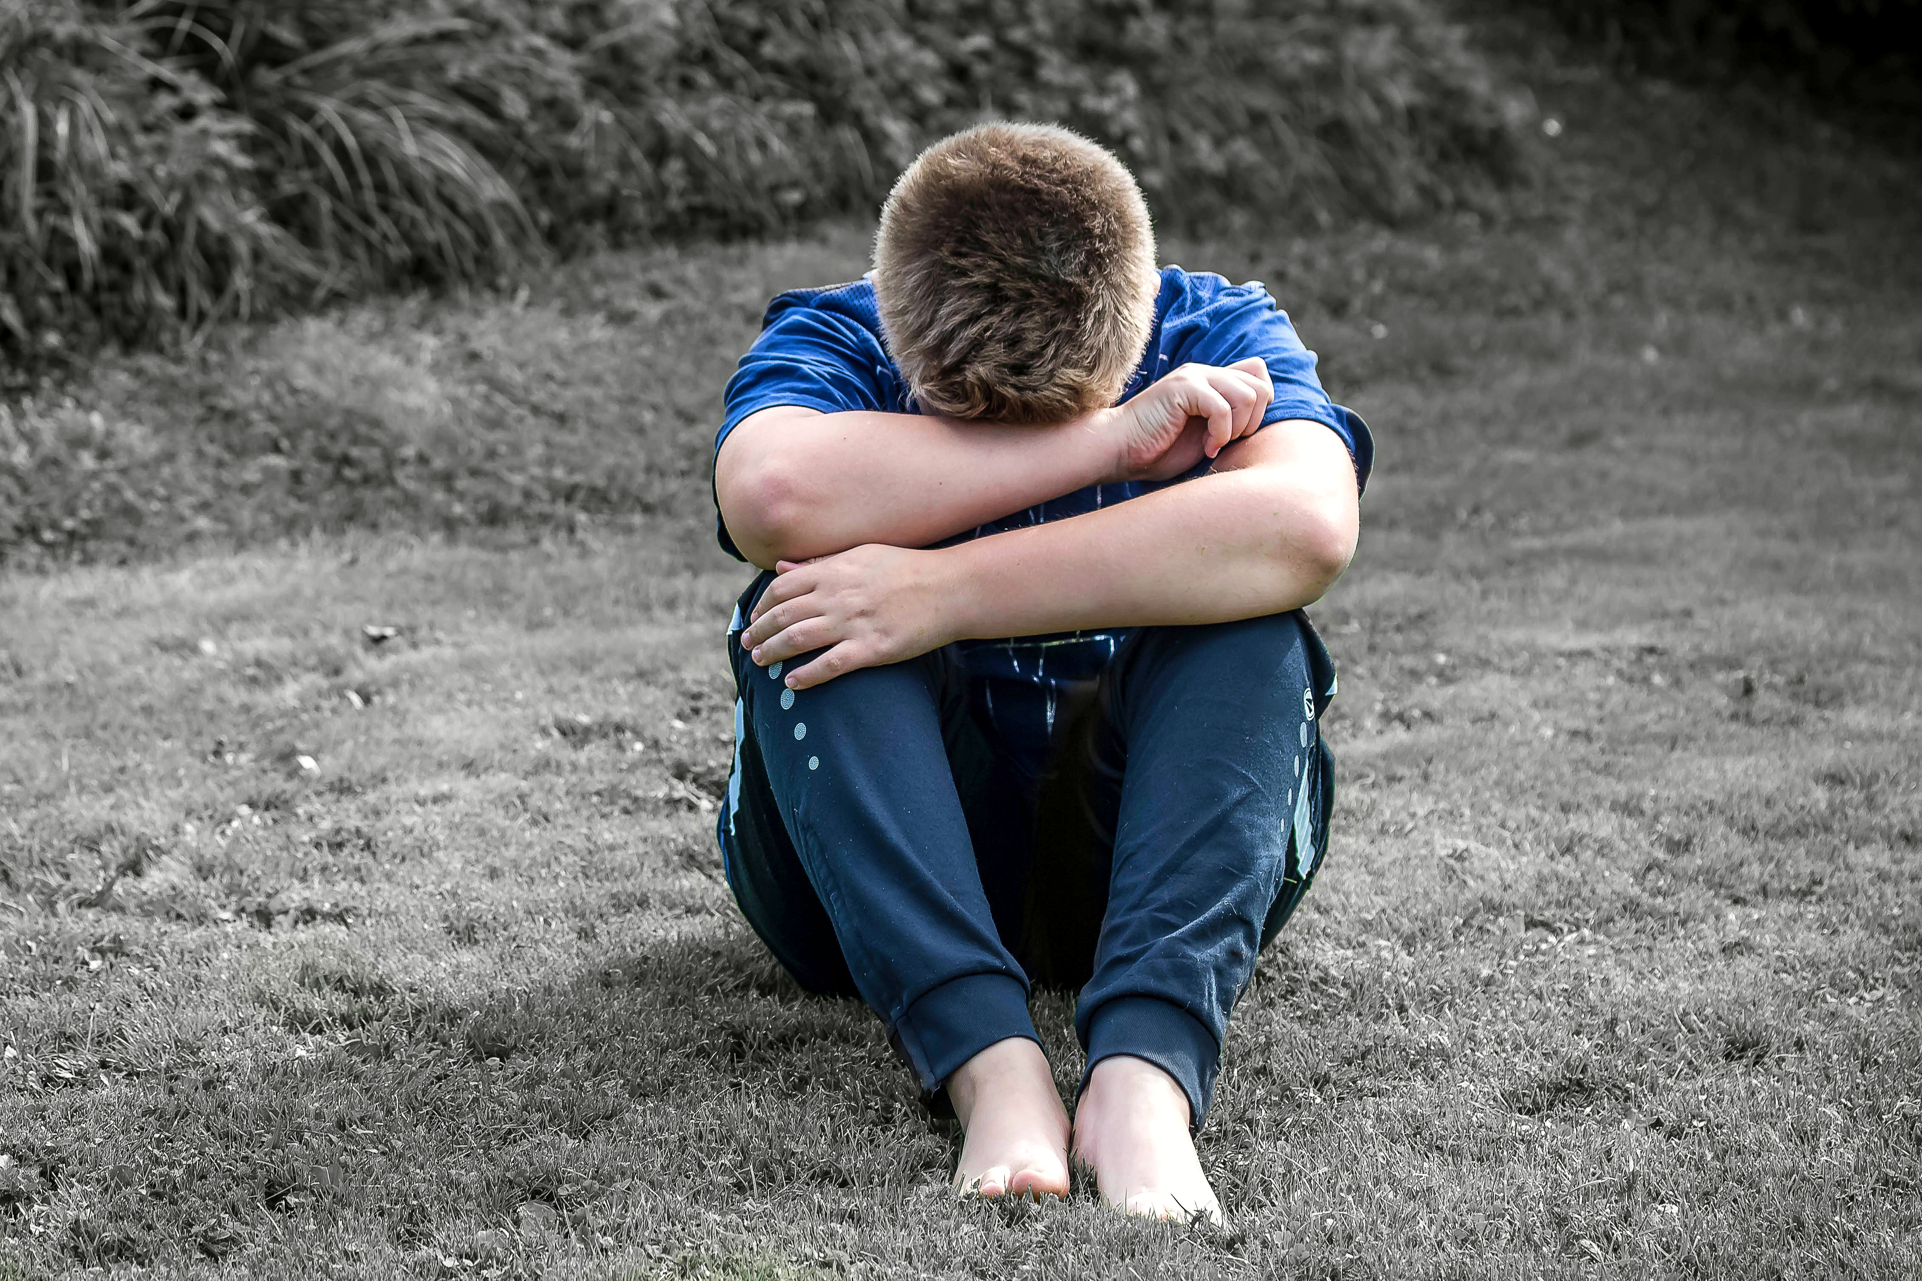
Notes:
Image: https://pixy.org/5784653/

Slide 15

Notes:
Image: https://pixabay.com/photos/face-worried-look-gesture-man-1742057/

Slide 16
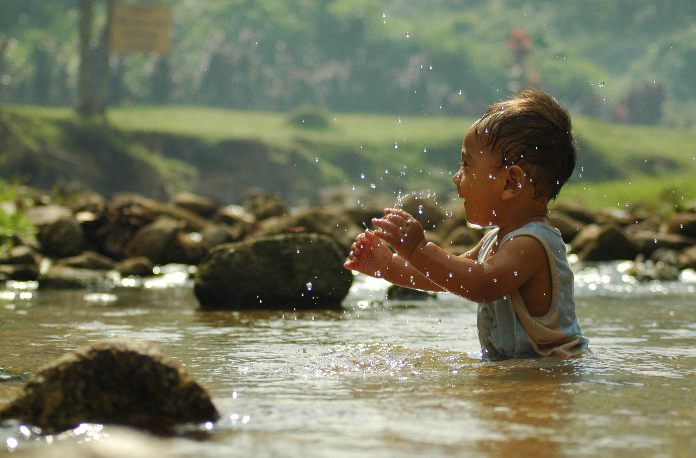
Notes:
Image: https://commons.wikimedia.org/wiki/File:I_Feel_Happy_Too.jpg
Fairuz Othman, CC BY 3.0 <https://creativecommons.org/licenses/by/3.0>, via Wikimedia Commons

Slide 17
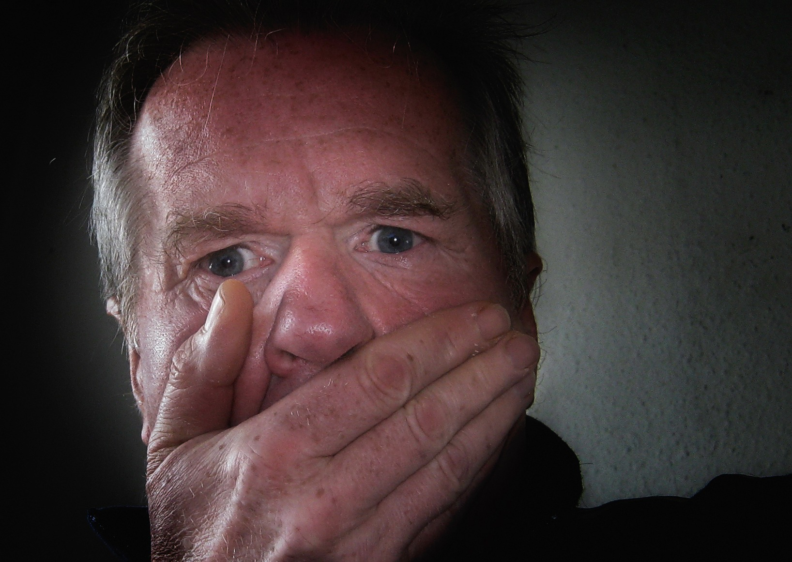
Notes:
Image: https://snappygoat.com/s/?q=bestof%3Aface%20panic%20symbol%20sign%20fear%20scared%20emotion%20expression%20surprise%20mouth%20terrified%20facial#d4565311a994143fa9e2553545eaee9d925bd54e,1,245.

Slide 18
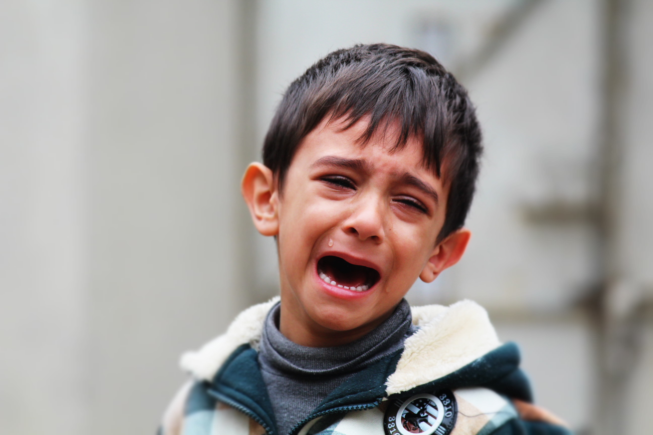
Notes:
Image: https://www.piqsels.com/en/public-domain-photo-fstit/download

Slide 19

Notes:
Image: https://www.piqsels.com/en/public-domain-photo-fzcjr/download

Slide 20
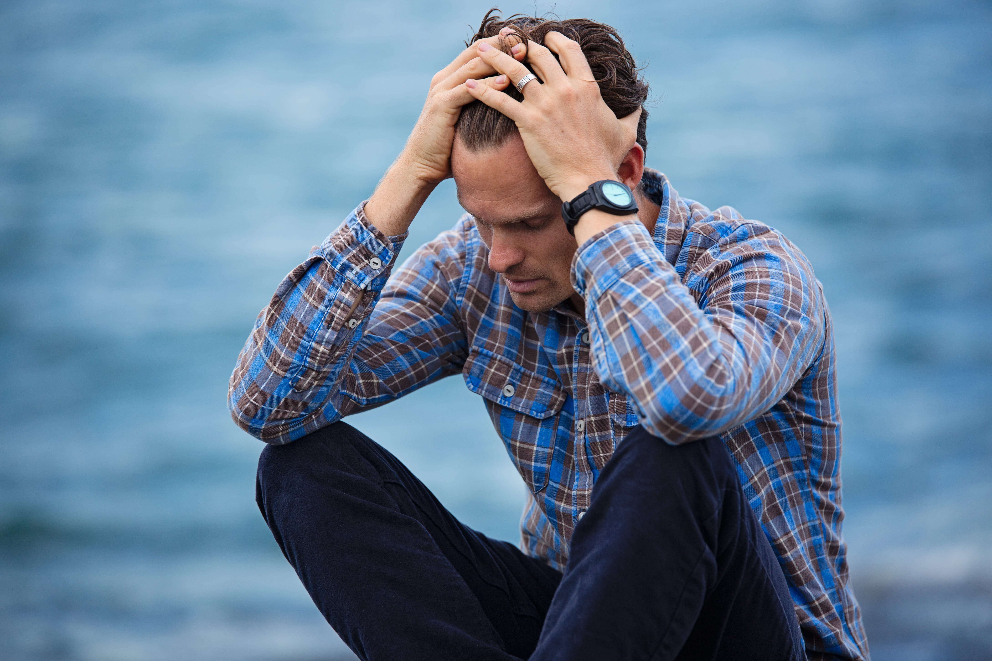
Notes:
Image: https://www.piqsels.com/en/public-domain-photo-jsktn

Slide 21

Notes:
Image: https://pixahive.com/photo/shocked-indian-girl/

Slide 22
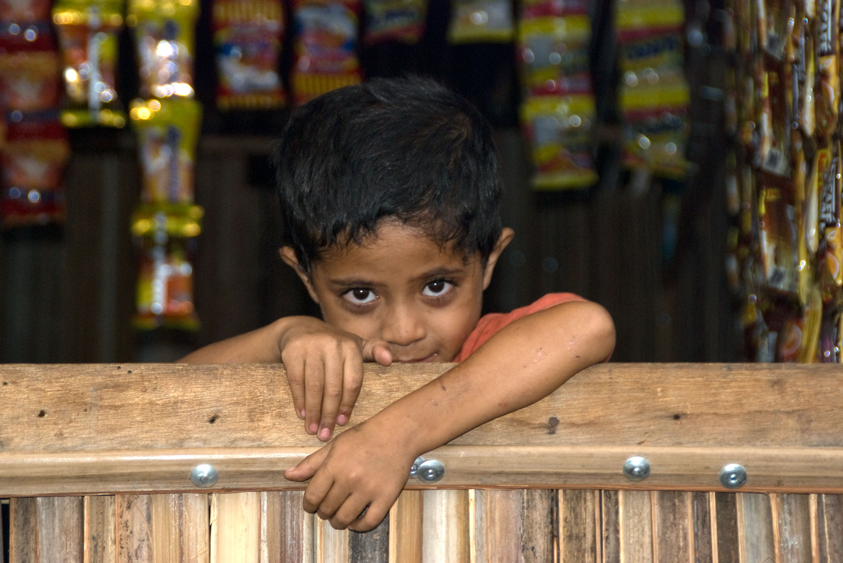
Notes:
Image: https://commons.wikimedia.org/wiki/File:Shy_Boy_(Imagicity_100).jpg
Graham Crumb/Imagicity.com, CC BY-SA 3.0 <https://creativecommons.org/licenses/by-sa/3.0>, via Wikimedia Commons

Slide 23
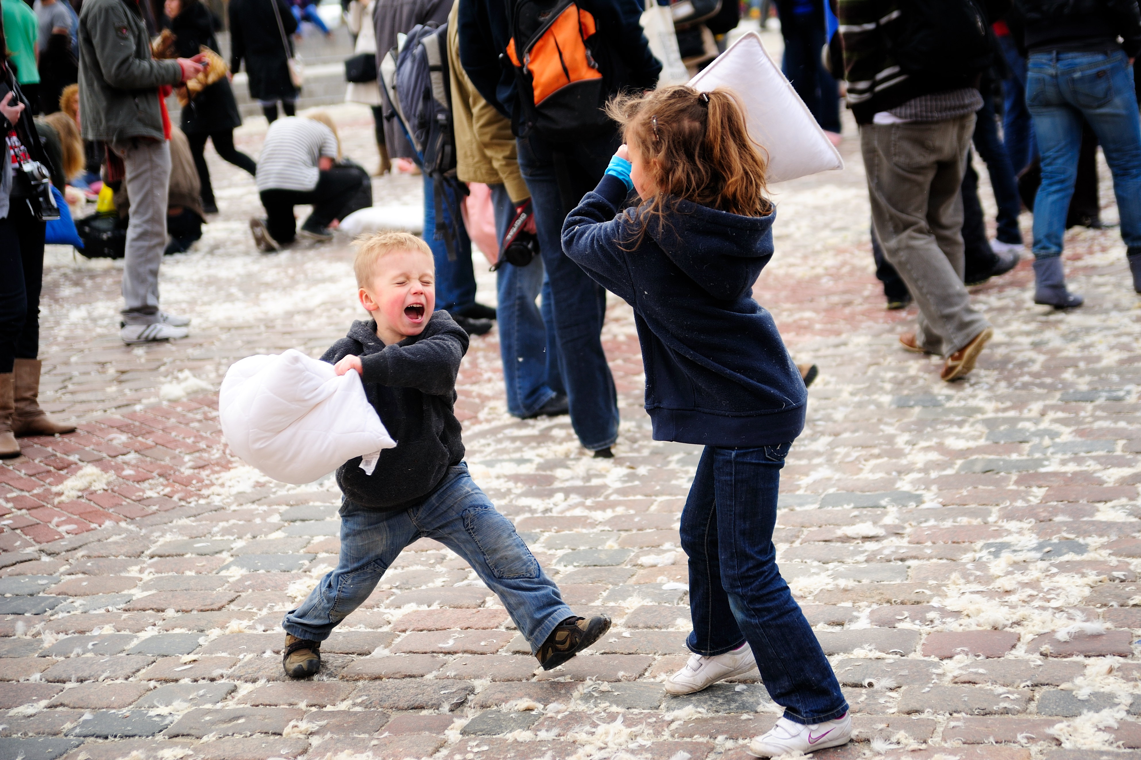
Notes:
Image: https://commons.wikimedia.org/wiki/File:Warsaw_Pillow_Fight_2010_(4487959761).jpg
Kuba Bożanowski from Warsaw, Poland, CC BY 2.0 <https://creativecommons.org/licenses/by/2.0>, via Wikimedia Commons

Slide 24
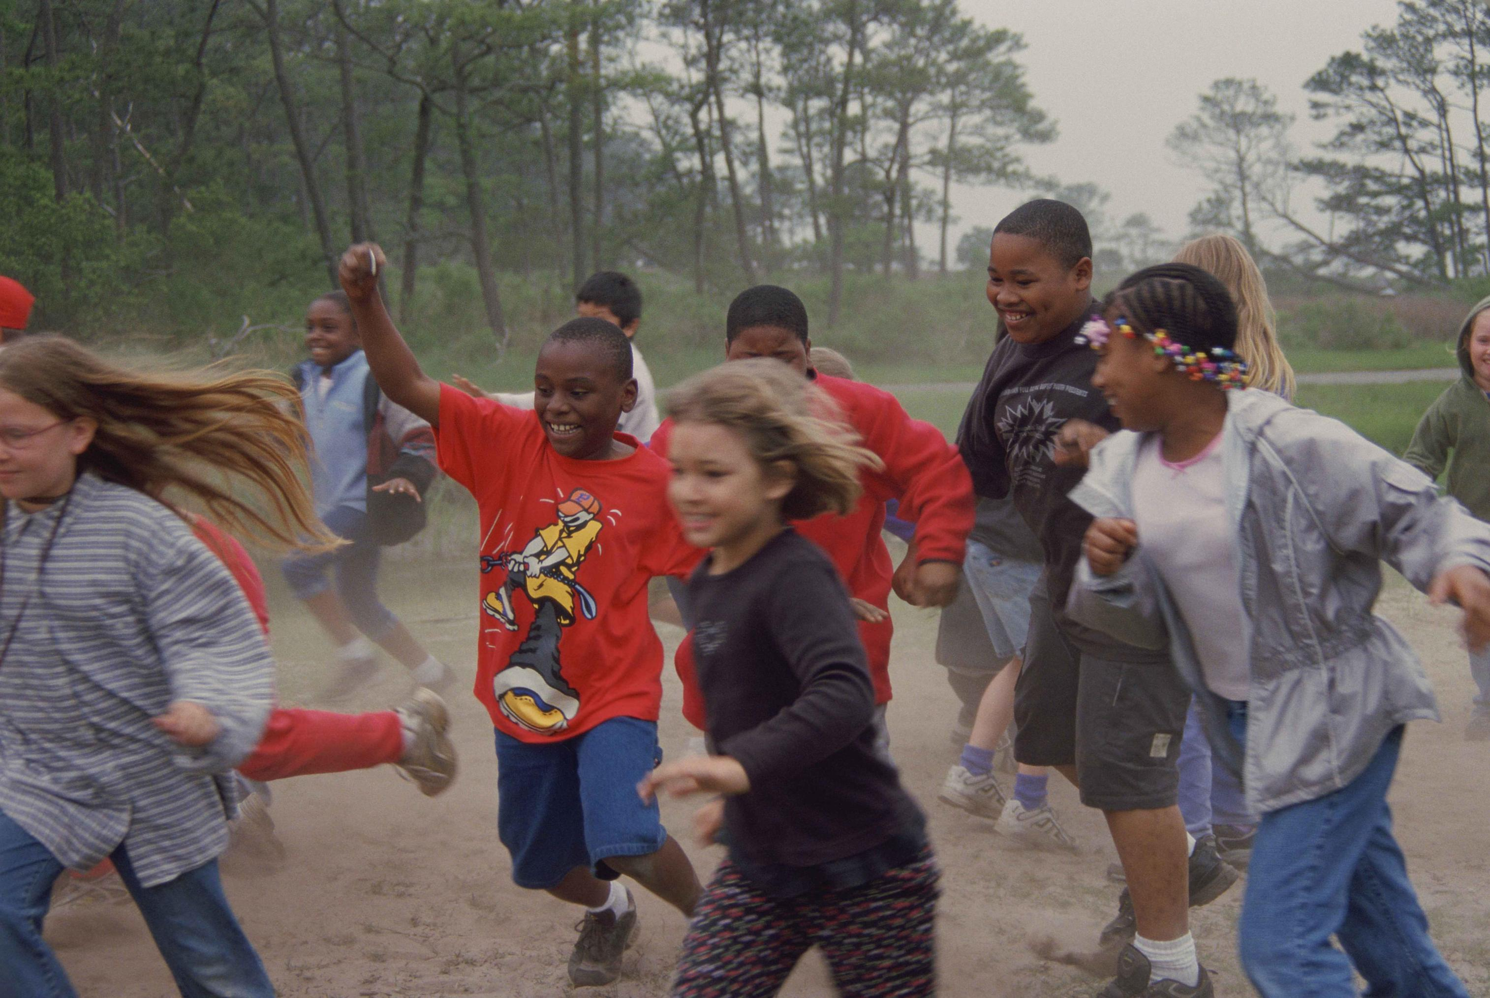
Notes:
Image: https://commons.wikimedia.org/wiki/File:Happy_group_of_children_playing_race.jpg
Jackson Elizabeth, U.S. Fish and Wildlife Service, Public domain, via Wikimedia Commons

Slide 25
How did you feel when you woke up today?
How did you feel when you arrived at school?
How did you feel at break, before lunch etc.?
How do you know what you are feeling?
Can we have more than one feeling at a time? Can you give any examples.

Slide 26
Feelings Continuum
angry
excited
happy
worried
sad
shy
confused
proud
afraid
Comfortable
Uncomfortable
frustrated
surprised
joyful
annoyed
shocked
upset
Notes:
Ask learners what feelings would they put where on this spectrum? and if so, what do they think?

Slide 27
We experience feelings on the inside and they show on the outside.
We can feel several feelings at once.
We can mask one feeling with another; this can be OK in short term to get us through, but typically not good long term … may lead to mental health issues.
Some feelings are more comfortable to experience than others.

Slide 28
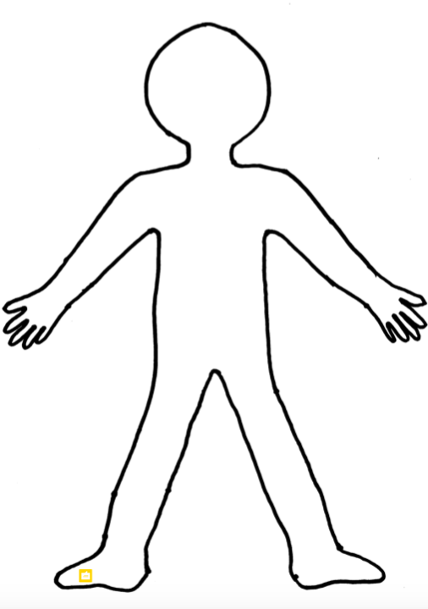
Blank fictional person
Notes:
Image: © Lucy Holbrook
Have learners draw on the image of blank person RS75 (not write the words) all the different ways they can think of that their bodies give them messages about what they are feeling. NB This can be done as individual, paired, small group or whole class activity.

Slide 29
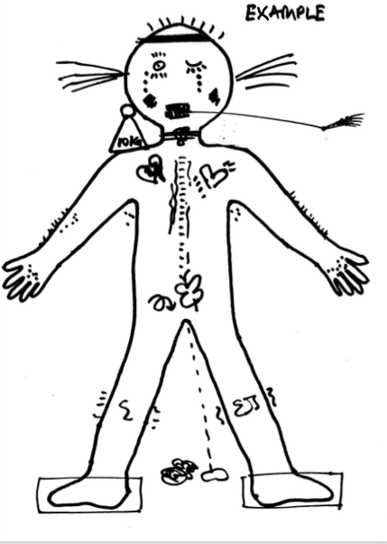
Example fictional person with feelings drawn on
Notes:
Image: © Lucy Holbrook

Slide 30
Early Warning Signs (EWS)
All the sensations that we get in our body are called our EARLY WARNING SIGNS (EWS).
Feelings are just feelings – they are what make us human.
ALL feelings are normal although we may find some comfortable and some uncomfortable to feel.
Notes:
Sum up by explaining that all these sensations that we get in our body are called our EARLY WARNING SIGNS (EWS). Explain that feelings are just feelings - they are what make us human and ALL feelings are normal although we find some comfortable and some uncomfortable to feel.
Feelings are simply helpful messages from our body about what’s going on inside us, so it’s a useful thing to pay attention and notice what we are feeling and learn the names for all the different feelings we have. (May be helpful to show image of the Feelings Wheel – next slide- here to illustrate how many different feelings we can have).
Also stress that we feel what we feel – no one makes us feel anything as our feelings belong to us – and we can choose how to respond to our feelings.

Slide 31
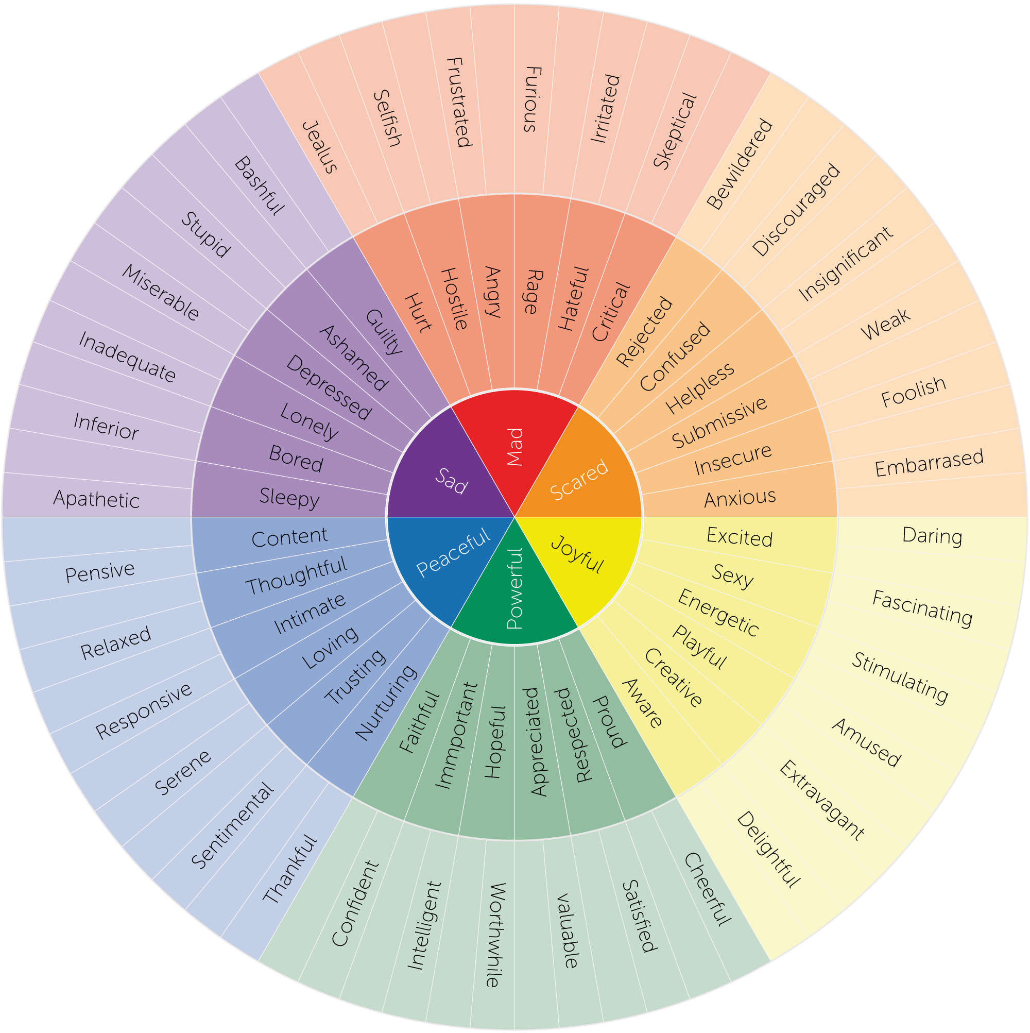
The Feelings Wheel
Notes:
Image: Feeling Wheel, CC BY-SA 4.0 <https://creativecommons.org/licenses/by-sa/4.0>, via Wikimedia Commons

Slide 32
The Safety Continuum
Feeling Fun to Feel Scared
Risking on Purpose
Feeling Safe
Feeling Unsafe
Notes:
From the Protective Behaviours Process ©Lucy Holbrook March 2018 and Inner Learning First
Introduce the idea of the safety continuum by explaining that everything we do, we feel more or less safe about it and we can think about this by using the image of a continuum of safety with Feeling Safe at one end and Feeing Unsafe at the other end. Also share that when we feel safe we can be at our best – we can think clearly, we can learn and we can use our personal power more effectively. Having CHOICE, CONTROL & KNOWING HOW LONG SOMETHING WILL LAST helps us avoid Feeling Unsafe
NB ensure that you make it clear that you are talking about FEELING safe, not being safe. Feeling safe is our internal reality that we can control or learn to control; being safe is about our environment which we may not always be able to control.

Slide 33
Safe Place Activity
Imagine your own special safe place (visualisation)
Notes:
Visualisation (RS77) that invites learners to imagine their own special safe place – to give them a personal reference point for what they feel like inside when they feel safe.
Summarise learning to this point: (can use RS73 Feelings Fact sheet for reference here).
We know what feeling safe feels like and feeling unsafe is when we have lots of EWS going on in our body.

Slide 34
Fun to Feel Scared (FTFS)
Do you think it is good to feel totally safe all of the time?
Does it help us learn or try new things?
Look at the Safety Continuum (slide 32) – can you think of examples of Fun to Feel Scared (FTFS) activities?
Notes:
Ask the learners if they think it is good to feel totally safe all of the time? Does it help us learn or try new things?
What do we do when we want to learn something new – if new not done it before so unfamiliar, unsure how to do it, we need some way of dealing with all the feelings we might be feeling.
Return to your image of Safety Continuum and introduce idea of Fun to Feel Scared activities (FTFS). Ask learners for some examples? E.g. rollercoaster, scary movie, holding a snake, etc. Anything where it is fun to feel a little bit scared, “butterflies” type excitement.

Slide 35
Risking on Purpose (ROP)
Look at the Safety Continuum (slide 32) – can you think of examples of Risking on Purpose (ROP).
What is the different between FTFS and ROP activities?
What might help you to stay away from Feeling Unsafe?
Notes:
Then introduce idea of Risking on Purpose (ROP) activities. Ask learners for some examples? E.g. going to dentist, entering a competition, going to Outdoor Ed centre.
Ask what might be the difference between FTFS and ROP activities?
Can link to case studies here.
(It links to the amount of and intensity of our EWS; ROP is as the words suggest – there is a purpose to our risking, we want the outcome, even if we have to stretch our comfort zone to achieve it.)

Slide 36
Things that help us to feel safe or safe enough to risk on purpose
Choice
Control
Time limit
Notes:
There are 3 things that typically help us feel safe or safe enough to risk on purpose – Choice, Control and Time Limit (knowing how long something will last – think rollercoaster ride).

Slide 37
The Safety Continuum
Seeing a large snake
Holding a large snake
Having an injection
Eating ice cream
Feeling Fun to Feel Scared
Risking on Purpose
Feeling Safe
Feeling Unsafe
Learning something new for the first time
Going to the dentist
Break time at school
Playing football
Going to the beach
Notes:
From the Protective Behaviours Process ©Lucy Holbrook March 2018 and Inner Learning First
Create a Safety Continuum on the wall or floor of the classroom with enough space for the learners to move along it. Give them some examples of different activities and ask them where they would be on the Safety Continuum if they were doing those activities.
Going to the dentist.
Playing in the playground / break time at school.
Doing an exam.
Learning something new for the first time.
Playing football.
Going to the beach.
Seeing a large snake.
Holding everyone feels differently about the same activities – what is fun for someone is a risk on purpose for someone else etc.
Also reinforce the idea that the safety continuum is a dynamic i.e. we can move along it in both directions; our mood might change where we would place ourselves, we can practice something so we get better and more confident and therefore feel safer.

