Slide 1
Nonviolent Action: A Force for Change
Case study lesson:
Otpor: How did a bunch of students use humour to bring down a dictator?

Slide 2
Mystery: What happened?
Look at the information and pictures on your table – take turns to read the information slips out.
What do you think happened?
Can you put the events in the order in which they happened?
Notes:
Teacher notes: Divide class into 6 groups around tables. Give each table its different information (RS8/9 & RS10, text and pictures) about Otpor. (Could put pictures out first so that these are looked at closely).
Looking at their information, each group thinks about what might have happened. (This could be carried out as a reciprocal reading task).
Learners could start putting the information into a possible order.

Slide 3
Elect 2 people in your group to be the ‘reporters’. They will stay at your table and answer other people’s questions so will need to know the information well.
The rest of the group are the ‘detectives’ who will go round the classroom collecting information from the other groups.
Notes:
Teacher notes:
Roles
Reporter: To inform all detectives coming to their table of the information they have gathered - answering any questions they can. The reporters must be honest and only give out information that they have discovered initially.
Note: This is a collaborative activity and therefore the students should be encouraged to give out information to their detectives.
Detective: The group decides what questions they want to ask i.e. by looking at what information is missing from their table. They divide the questions up amongst their detectives who record them on their Detective’s recording sheet (RS13).
They are given 5 minutes to go around the class and look and ask for information they need.
Note: Offer one or two questions per group to help them get started with question making if they need support.

Slide 4
Decide what information you would like your detectives to find out. Divide your questions between your detectives.

Slide 5
Detectives go round the other groups asking the reporters their questions.
Reporters answer the questions of all visiting detectives. They must be honest and only give out information from what they already found out.
This is a collaborative activity but you need to be quick

Slide 6
All detectives now return to their groups and share what they have found out.
Do you know what happened?
Read the full case study together, helping each other to understand and checking if you managed to solve the mystery.

Slide 7
Timeline of events
1997: Elections
1998: Otpor! formed, march from Belgrade to Novi Sad
Otpor!’s logo started appearing throughout the country
March – June 1999: NATO bombing against Yugoslavia
July 1999 onwards: Otpor! staged humorous protests across the country and worked on gaining more and more supporters
Notes:
Teacher notes: Give learners summary of the case study.
Encourage learners to ask questions and answer each other’s on their tables.
Come back as a class to share information and fill in gaps verbally to create a clearer timeline.
Share slide on the PowerPoint of timeline of events.

Slide 8
Timeline of events continued
June 2000: Milosevic passed law to allow him to stand again in elections
September 24th 2000: election where Kostunica the opposition won 50.24% of votes compared to Milosevic’s 37.15%
September 2000: Major demonstrations to support Kostunica’s victory. Coal miners went on strike. General strikes across country
October 5th 2000: massive rally in Belgrade. Milosovic lost his power.

Slide 9
Show Otpor! YouTube film:
https://www.youtube.com/watch?v=kv9R6kn2Pcc
0.00-4.35
Notes:
Teacher notes: Otpor being presented with ‘Free your Mind’ award by MTV in 2000
Discuss anything interesting and surprising and address misconceptions.
If clicking on the link doesn’t work on your computer try Control click or pasting the link into your browser: https://www.youtube.com/watch?v=kv9R6kn2Pcc

Slide 10
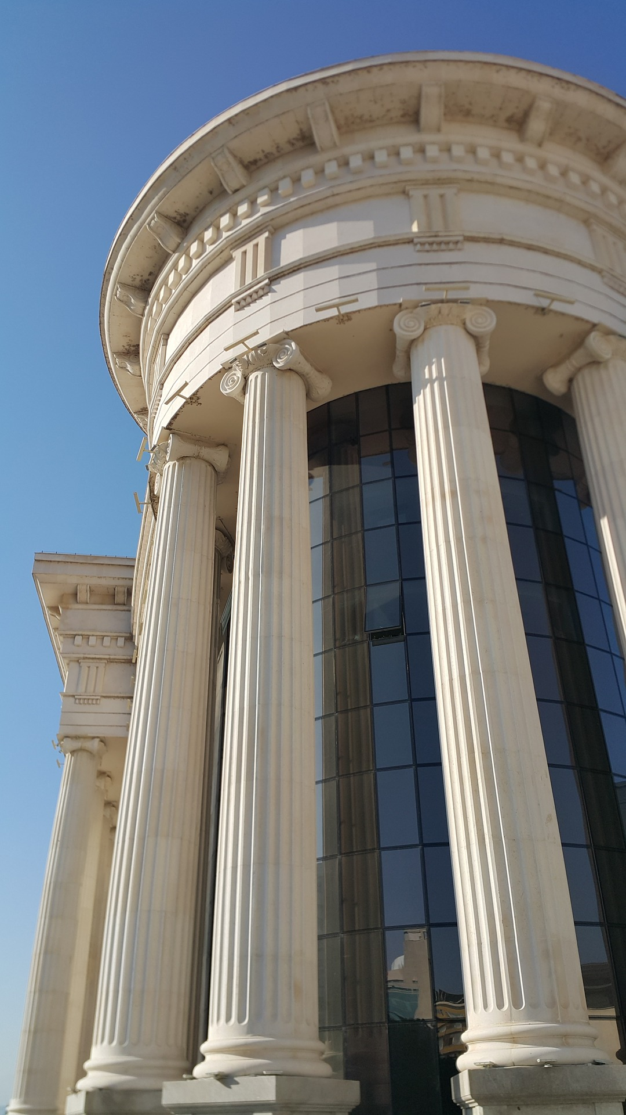
Pillars of support
Notes:
Source: Parthenon in Athens, Steve Swayne
https://commons.wikimedia.org/wiki/File:O_Partenon_de_Atenas.jpg
Other image – pixaby no attribution required
Teacher notes: Introduce slides 10 and 11 if this OTPOR is the first case study (i.e. Bristol Bus Boycott hasn’t been introduced) Ask - What are the pillars doing for the buildings? Explain that pillars do not always have to be physical.

Slide 11
What are the pillars of support that hold up the school?
Notes:
Teacher notes: E.g. governors, teachers, parents, resources, pupils, money
What would happen if we took any of them away?
Ask: If we take the teachers away what happens to the school?
Option to go into groups and discuss what would happen if each pillar were taken away. One pillar per group.

Slide 12
What was Otpor! trying to change?
What were the pillars of support?
How did Otpor! weaken or remove these pillars?
Which pillars were Otpor! most effective at weakening?
Notes:
Teacher’s notes:
Otpor’s aim: Remove Milosevic from power, free and fair elections, free university, free and independent media
Pillars – military, police, universities, media, church, industries (e.b. mining) local communities
Most effective – e.g. some of the police and military became allies

Slide 13
Reflection/evaluation
Did Otpor! do the right thing?
Could they have done anything differently?
Which words have we used today for the vocabulary wall/bank?
Generate definitions for new words covered today.

