Slide 1
Non-violent Action: A Force for Change
Introduction to
Non-violent Actions
Version for one-off lesson, KS3
Notes:
With thanks to Bob Banks
Introduce the session, and the idea of change in society/in the world.
Ask the class - what changes would they like to see in the world?

Slide 2
Bulletin of Atomic Scientists : January 2020.
“Climate change that could devastate the planet is undeniably happening.
(Awareness of this crisis grew over the course of 2019, largely because of mass protests by young people around the world.)”
Notes:
Ask – How many of you think you can make a difference? – do anything that can help bring about positive change in the world? (Hands up.)
Then show the slide – showing that “global experts” agree with those students who do think they can make a difference.

Slide 3
Fridays for Future
Notes:
You will be aware of contemporary examples such as this: the Youth Strike for Climate (Fridays for Future)
Image: Glasgow COP26 summit, Nov 2021, Helen Griffin

Slide 4
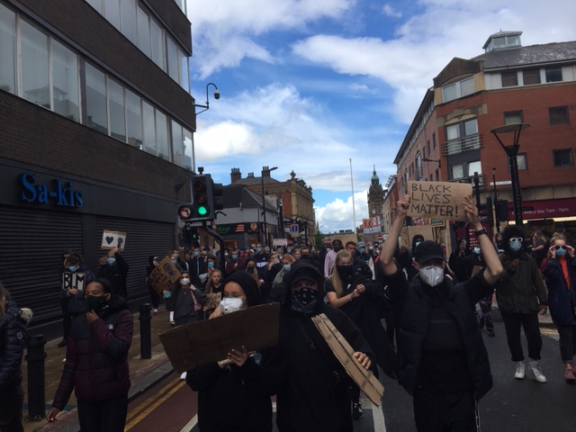
Black Lives Matter
Notes:
This – Black Lives Matter –
Image: BLM action in Sheffield 2020, Helen Griffin

Slide 5
Some methods of action for change
Letter-writing
Voting
Petitions
Slogans
Symbols
Social media
Speeches
Singing
Marches
Taking-the- knee
Boycotts
Silence
Stay-at-home
Mock funerals
Theatre
Humour
Clowning
Vigils
Occupation
Sit down protests
Blocking roads
Strikes
Walk-outs
Hunger strikes
Notes:
Changes for better are possible, and have happened throughout history. But they don’t “just happen” – they need people to come together to take action – to campaign for change.
What sorts of action might this be?
Could “brainstorm” some types of action that can be used to campaign for change – writing their suggestions down on a whiteboard.
Then, this slide presents a more extensive list’
Note – generally campaigns work best when lots of different methods are used, alongside each other.
There are many different ways to protest non-violently and this is also a key to success – here are a few of them.

Slide 6
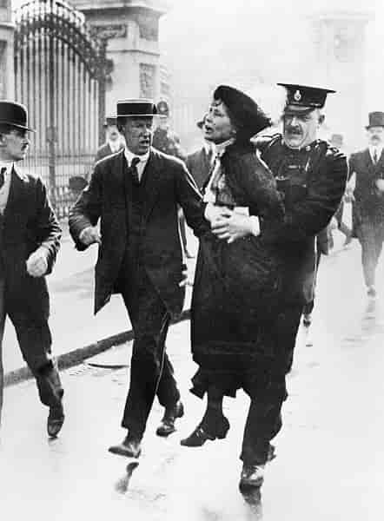
Notes:
Two famous campaigns:
Suffragettes, and the boycott of South African goods during Apartheid
Images: Suffragette public domain
Boycott South African Goods: Djembayz, CC BY-SA 3.0 <https://creativecommons.org/licenses/by-sa/3.0>, via Wikimedia Commons

Slide 7
Storyboards
Look at your storyboard. Decide what outcome you want.
As a group, decide what actions you would take, to achieve this.
Are your actions
Violent or non-violent ?
Notes:
Teacher notes: Place the 4 different cartoon storyboards on each table, one per person (all with potential to turn violent), and everyone on same table should have same storyboard. The learners fill in the next two blank boxes with their version of what might happen next.

Slide 8
Notes:
Illustrations: Brogan Nicholl

Slide 9
Notes:
Illustrations: Brogan Nicholl

Slide 10
Notes:
Illustrations: Brogan Nicholl

Slide 11
Notes:
Illustrations: Brogan Nicholl

Slide 12
Who do you need to persuade to change?
What will persuade them?
How? What Methods?
Notes:
Optional prompts to encourage some strategic thinking about the action storyboards.

Slide 13
Some methods of action for change
Letter-writing
Voting
Petitions
Slogans
Symbols
Social media
Speeches
Singing
Marches
Taking-the- knee
Boycotts
Silence
Stay-at-home
Mock funerals
Theatre
Humour
Clowning
Vigils
Occupation
Sit down protests
Blocking roads
Strikes
Walk-outs
Hunger strikes
Notes:
There are many different ways to protest non-violently and this is also a key to success – here are a few of them
To refer to whilst “storyboarding”.

Slide 14
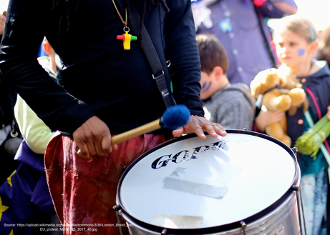
Pictures of objects/actions
Notes:
Learners look at their storyboards and decide how any of the objects / actions pictured here could be introduced (and following 3 slides) Easier to have these images printed out to refer to.
Image credits from top left clockwise:
DECSY’s own photo
Extinction Rebellion logo (public domain https://www.flickr.com/photos/50079371@N08/15474433797/) and Otpor fist (By Created by User:KeithTyler. It is a variant of the clenched fist motif which has been widely used by leftist, workers, and liberationist groups since the nineteenth century. The motif itself is not under copyright. - Uploaded by User:KeithTyler, who created this image., Public Domain, https://commons.wikimedia.org/w/index.php?curid=1682523)
Mobile phone public domain, no attribution required
Drummer https://upload.wikimedia.org/wikipedia/commons/3/36/London_Brexit_pro-EU_protest_March_25_2017_45.jpg English: The pro-EU march from Hyde Park to Westminster in London on March 25, 2017, to mark 60 years since the EU's founding agreement, the Treaty of Rome.

Slide 15
Questions to think about
Could the object help change the situation?
Would it be violent or non-violent?
Notes:
Learners discuss these questions as a group then feed back ideas to the class.

Slide 16
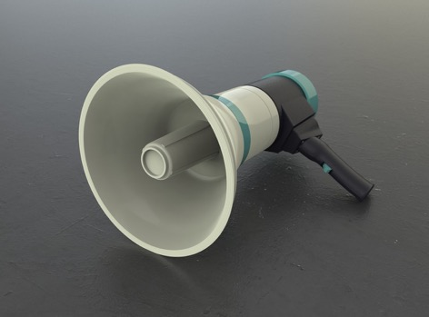
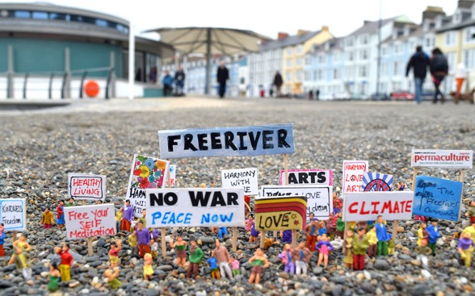
Pictures of objects/actions
Notes:
Image credits from top left clockwise:
Protected Banksy artwork, Cleveland Street, London W1 cc-by-sa/2.0 - © Julian Osley - geograph.org.uk/p/4469000
Gun – public domain, no attribution required
Loudspeaker - public domain, no attribution required
Miniature people (use of humour) Pixaby Licence Free for commercial use No attribution required

Slide 17
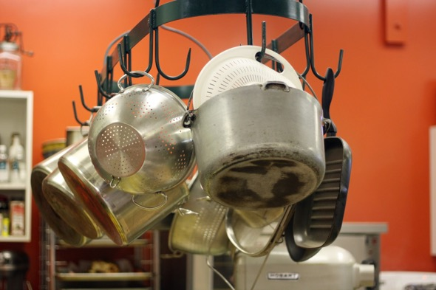
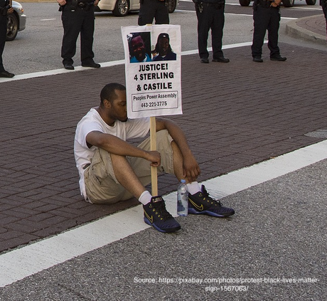
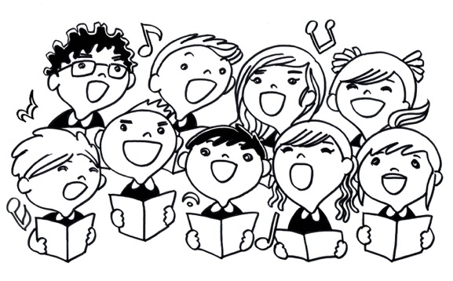
Pictures of objects/actions
Notes:
Image credits from top left clockwise:
E-petition - https://www.flickr.com/photos/wheatfields/446145795 photographer allispossible.org.uk https://creativecommons.org/licenses/by-nc-sa/2.0/
Pots and pans – public domain, no attribution required
Singing children - public domain, no attribution required
Black Lives Matter sit down protest https://pixabay.com/photos/protest-black-lives-matter-sign-1567063/ Free download

Slide 18
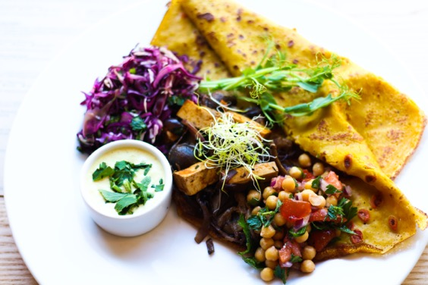
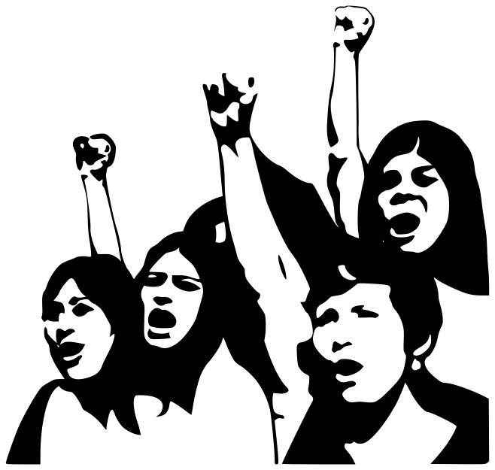
Pictures of objects/actions
Notes:
Image credits from top left clockwise:
Social Media logos, public domain, no attribution required
Picture of meal, public domain, no attribution required
Fight Demonstration Girls Fists Protest Communism Creative Commons commercial use https://www.maxpixel.net/Fight-Demonstration-Girls-Fists-Protest-Communism-155927

