Slide 1
Non-violent Action: A Force for Change
Introduction to
Non-violent Actions
Version for one-off lesson 2
Notes:
This lesson explores the idea of non-violent action to make changes in the world. We will look at some examples of young people trying to change things in relation to the climate crisis and then think about methods for making change before moving onto an activity where we decide which actions we think are violent and which non-violent.

Slide 2
Notes:
Link on picture: https://www.unicef.org/stories/young-climate-activists-demand-action-inspire-hope
Show Maria from Mexico (subtitled but includes different actions)
Mitzi from Phillipines
Nkosi from Zimbabwe
(7 minutes total)

Slide 3
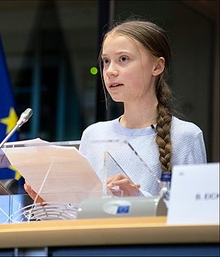
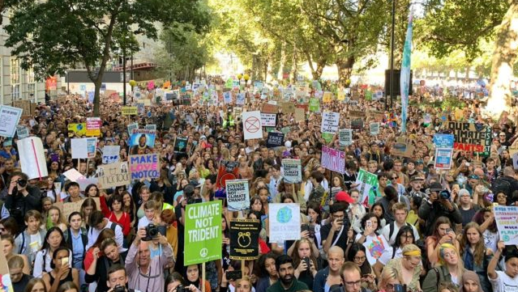
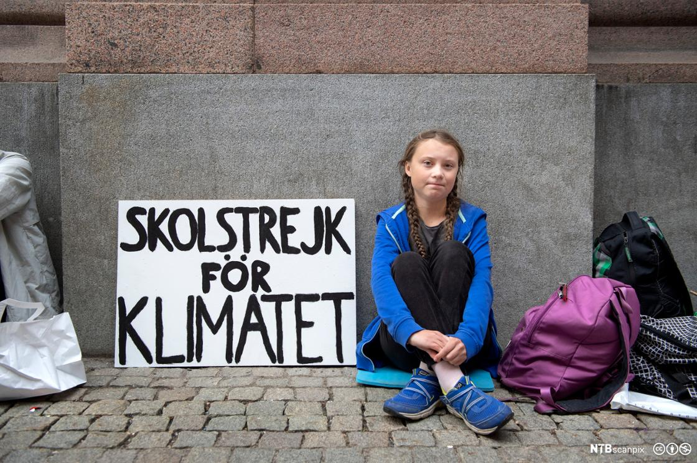
Youth Strike 4 Climate
“People are suffering, people are dying, entire ecosystems are collapsing. We are at the beginning of a mass extinction and all you can talk about is money and fairytales of eternal economic growth.”
Greta Thunberg speaking to UN Climate Summit 23/9/19
Notes:
You will be aware of other examples such as this: the Youth Strike for Climate and BLM
Images (top right,then clockwise) Greta Thunberg European Parliament from EU, CC BY 2.0 <https://creativecommons.org/licenses/by/2.0>, via Wikimedia Commons
Greta Thunberg school strike for climate CC BY-NC Bilete: Jessica Gow
@GretaThunberg, Sept 26, 2019, Youth Climate Strike demonstration

Slide 4
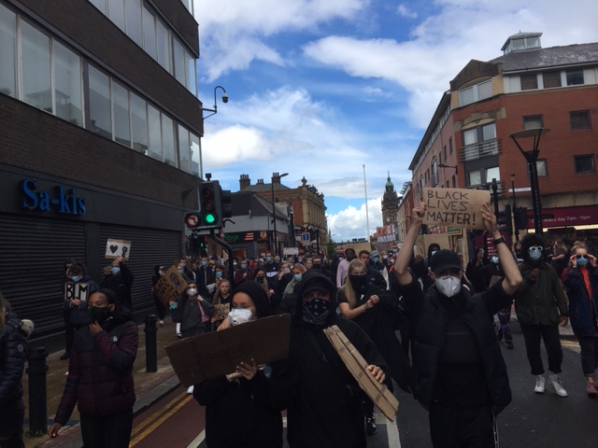
Black Lives Matter
Notes:
This – Black Lives Matter – Pictures from action in Sheffield (Helen Griffin)

Slide 5
Some methods of action for change
Letter-writing
Voting
Petitions
Slogans
Symbols
Social media
Speeches
Singing
Marches
Taking-the- knee
Boycotts
Silence
Stay-at-home
Mock funerals
Theatre
Humour
Clowning
Vigils
Occupation
Sit down protests
Blocking roads
Strikes
Walk-outs
Hunger strikes
Notes:
Changes for the better are possible, and have happened throughout history. But they don’t “just happen” – they need people to come together to take action – to campaign for change.
What sorts of action might this be?
Could “brainstorm” some types of action that can be used to campaign for change – writing their suggestions down on a whiteboard.
Then, this slide presents a more extensive list. (More “direct” types of action to the right.)
Note – generally campaigns work best when lots of different methods are used, alongside each other.
There are many different ways to protest non-violently and this is also a key to success – here are a few of them. More “Direct” methods on the right, less “Direct” on the left.

Slide 6
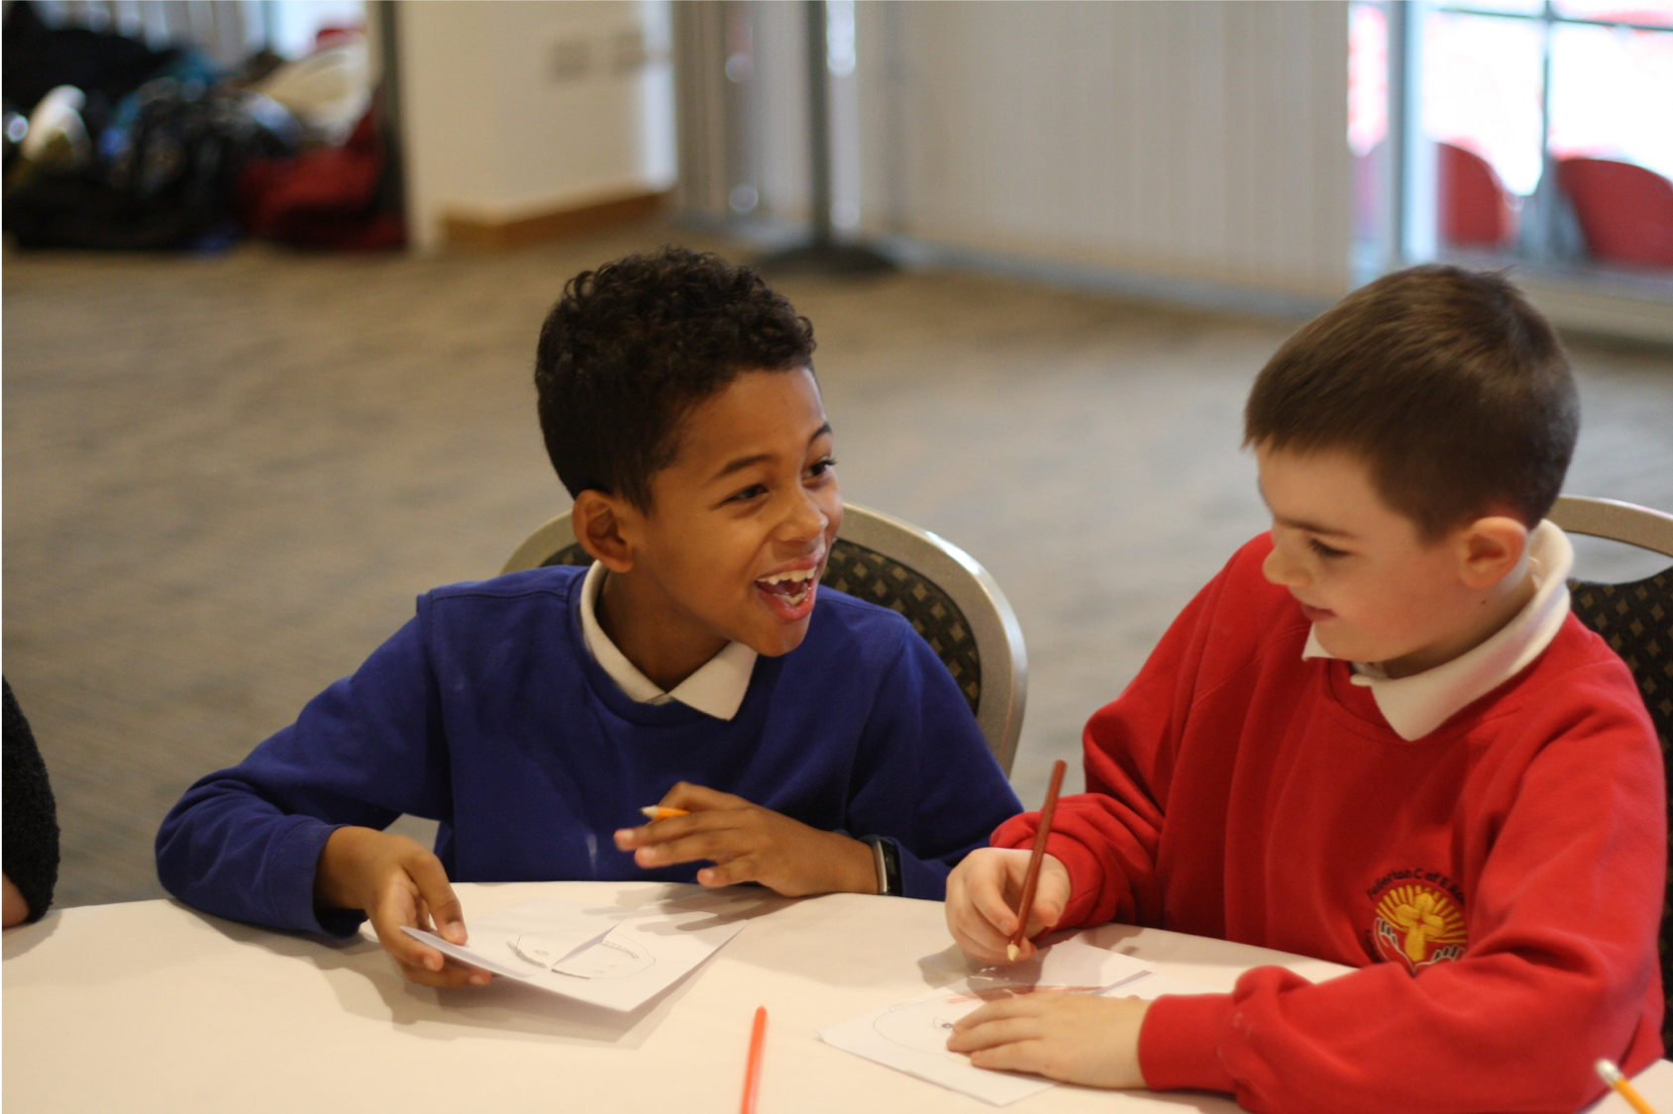
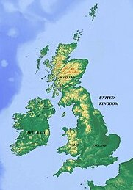
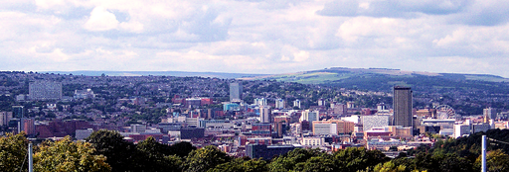
What would you like to change?
In your school?
In your local area?
In the UK?
In the world
Notes:
Discuss in pairs
Image credits (clockwise from top right):
School: DECSY
Sheffield city skyline: DonkeyHotey, CC BY 2.0 <https://creativecommons.org/licenses/by/2.0>, via Wikimedia Commons
UK map: physicalmap.org, CC BY-SA 4.0 <https://creativecommons.org/licenses/by-sa/4.0>, via Wikimedia Commons
Earth: DonkeyHotey, CC BY 2.0 <https://creativecommons.org/licenses/by/2.0>, via Wikimedia Commons

Slide 7
One definition of non-violence
“Without violence
+ against violence
= non-violence”
Notes:
Vinthagen, S. 2015, A Theory of Nonviolent Action, London, Zed
An example to illustrate this is, if someone was walking down a road, on the pavement, on their way to the shops without being violent, this wouldn’t be called ‘non-violence’. But if this person was walking down a road, on the pavement, with a placard protesting against racism, for example, without using any violence, this would be called ‘non-violence’.
(The definition of against violence used here includes ’structural violence’ not just physical violence- so protesting against injustice, inequality etc. would count)

Slide 8
Hitting someone back
Killing animals for sport
Swearing at someone on social media
Killing animals to eat
Breaking a window of a house to steal the TV
Breaking the window of a bank investing in the arms trade
Getting hold of somebody to stop them hurting someone else
Shouting on a march to protest against racism
Shouting at someone you are angry with
Swearing at someone in real life (face to face)
Violent
Non-violent
Handing out leaflets that say things that are not true to persuade people to act against climate change
Handing out leaflets that say things that are true to persuade people to act against climate change
Blocking a road to stop traffic to protest against pollution
Bombing a weapons depot
Blocking a road to stop traffic to protest against pollution which might stop ambulances from getting to a hospital
Putting a bomb through a letterbox in an unoccupied house as part of a campaign to win votes for women
Bombing a city
Notes:
Read out examples (reduce the number if necessary) one by one and ask learners to move to somewhere on the spectrum between violent and non-violent. Discuss with person nearest why you are there and then take turns to share in the whole group. Encourage learners to respond to each other and move if they change their minds.
What are the key issues that we have disagreed on?
Points of disagreement might be about:
Property damage vs damage to living beings
Deception vs openness
Intention vs outcome
Perception of audience vs aim of protest (quite often people define whether something is non-violent based on what popular perception might be and this may vary between countries for example – in the UK property damage is often seen as a violent act)
Potential distinction between ‘principled non-violence’ and ‘pragmatic non-violence’.

Slide 9
The principles of non-violence (used as a basis for Turning the Tide’s https://turningtide.org.uk/ work in the UK and in East Africa) are (simplified version):
We respect and care for everyone in a conflict, including the people we are against.
We take action to make things fairer without using violence.
We will not harm people, living things or the earth.
We will not make other people suffer but be willing to suffer ourselves if necessary.
We believe that everyone can change and it’s possible to reach anybody’s humanity.
We know that there is not always one right answer to problems and that we may be mistaken.
We believe that the way we do something should be consistent with what we want to achieve (e.g. not behaving violently to bring about peace).
We try to be open in what we do rather than keeping secrets.
We know it is important to learn and practice how to be non-violent so that non-violence can become part of everyday life.
Notes:
These are the principles of non-violence used by one organisation that works in the UK and East Africa supporting people to take non-violent action for change.
What would it be like to apply them to your school, home, community? Which are particularly challenging? What might be the consequences?

