Slide 1
Non-violent Action: A Force for Change
Lesson 1: Introduction to
Non-violent Actions

Slide 2
Storyboards
Look at your storyboard. Decide what might happen next and draw this in the blank boxes.
As a group share your storyboards and choose one of the outcomes that is negative and one that is positive to share with the rest of the class.
Notes:
Teacher notes: Place the 4 different cartoon storyboards on each table, one per person (all with potential to turn violent), and everyone on same table should have same storyboard. The learners fill in the next two blank boxes with their version of what might happen next. Ask each table to pick one of their outcomes that is negative or one that is positive (aiming for an equal negative/positive outcome across the class per story) and share with rest of class.
i.e. “Table 1 choose one of your positive outcomes and one negative outcome for your story. Table 2 choose one positive and one negative outcome for your story etc.”

Slide 3
Notes:
Illustrations: Brogan Nicholl

Slide 4
Notes:
Illustrations: Brogan Nicholl

Slide 5
Notes:
Illustrations: Brogan Nicholl

Slide 6
Notes:
Illustrations: Brogan Nicholl

Slide 7
As a group, choose one of the storyboards to act out.
Create the drama piece together ready to perform to the rest of the class.
Notes:
Teacher notes: Ask each group to choose a storyboard on their table that they would like to act out (you can prompt in order to get a balance of negative and positive outcomes).
Ask each group to create a drama piece and pause at different points during the performance to ask the class the following questions:
What do you think might happen?
How do the characters feel?
What would make a good ending / bad ending etc…?
What would you change about what just happened?
What consequences might this action/decision have?
Can you relate this point in the story to your personal experience?
Was what happened violent or nonviolent?

Slide 8
Picture activity
Chose one picture of an object or action and decide as a group how the object/action could be introduced to the storyboard.
Notes:
Teacher notes: Laminated pictures
Banner
Symbols (XR, Otpor)
Mobile Phone
Drum
Graffiti/artwork
Gun
Megaphone
Humour (miniature people)
Petition
Pots and pans
Children singing
Sitting peacefully/peaceful protest
Social media symbols
Food
Gesture
Ask each group to bring one picture back to their table. Ask learners to look at their storyboard again and then look at how the object/action could be introduced.

Slide 9
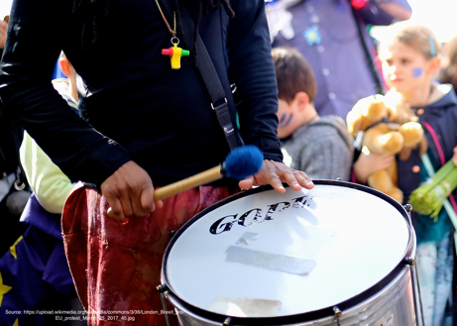
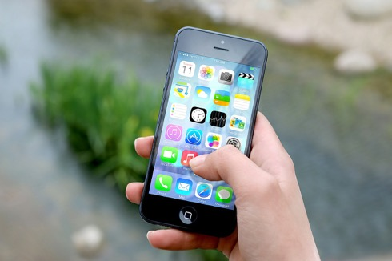
Pictures of objects/actions
Notes:
Image credits from top left clockwise:
DECSY’s own photo
Extinction Rebellion logo (public domain https://www.flickr.com/photos/50079371@N08/15474433797/) and Otpor fist (By Created by User:KeithTyler. It is a variant of the clenched fist motif which has been widely used by leftist, workers, and liberationist groups since the nineteenth century. The motif itself is not under copyright. - Uploaded by User:KeithTyler, who created this image., Public Domain, https://commons.wikimedia.org/w/index.php?curid=1682523)
Mobile phone public domain, no attribution required
Drummer https://upload.wikimedia.org/wikipedia/commons/3/36/London_Brexit_pro-EU_protest_March_25_2017_45.jpg English: The pro-EU march from Hyde Park to Westminster in London on March 25, 2017, to mark 60 years since the EU's founding agreement, the Treaty of Rome.

Slide 10
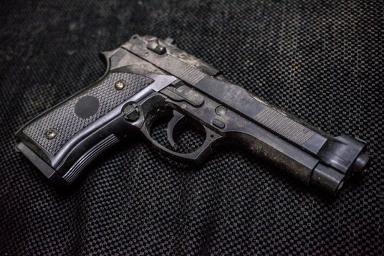
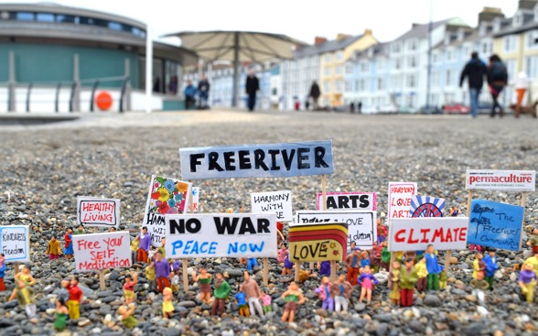
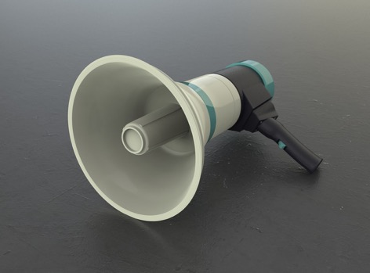
Pictures of objects/actions
Notes:
Image credits from top left clockwise:
Protected Banksy artwork, Cleveland Street, London W1 cc-by-sa/2.0 - © Julian Osley - geograph.org.uk/p/4469000
Gun – public domain, no attribution required
Loudspeaker - public domain, no attribution required
Miniature people (use of humour) Pixaby Licence Free for commercial use No attribution required

Slide 11
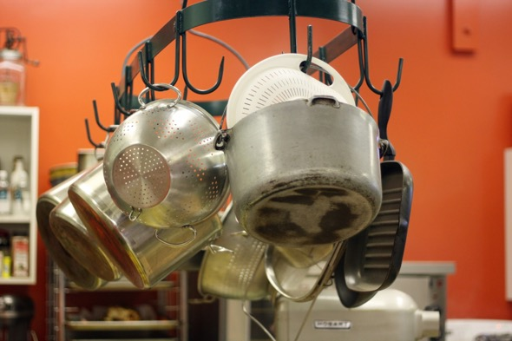
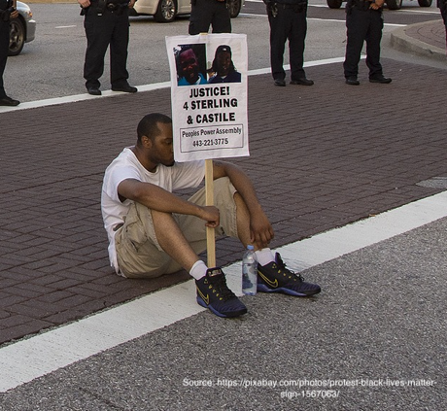
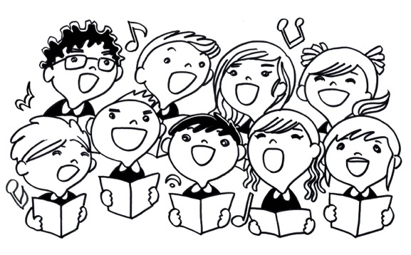
Pictures of objects/actions
Notes:
Image credits from top left clockwise:
E-petition - https://www.flickr.com/photos/wheatfields/446145795 photographer allispossible.org.uk https://creativecommons.org/licenses/by-nc-sa/2.0/
Pots and pans – public domain, no attribution required
Singing children - public domain, no attribution required
Black Lives Matter sit down protest https://pixabay.com/photos/protest-black-lives-matter-sign-1567063/ Free download

Slide 12
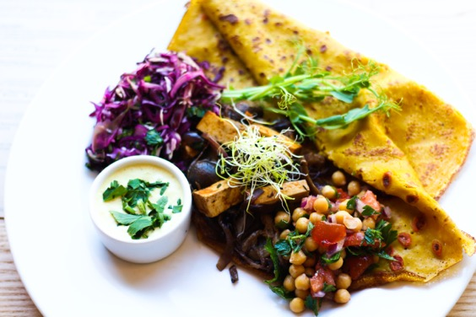
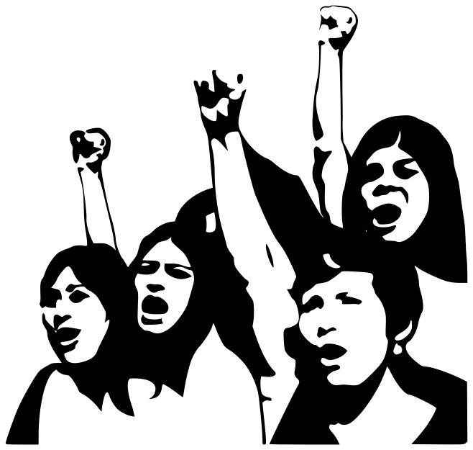
Pictures of objects/actions
Notes:
Image credits from top left clockwise:
Social Media logos, public domain, no attribution required
Picture of meal, public domain, no attribution required
Fight Demonstration Girls Fists Protest Communism Creative Commons commercial use https://www.maxpixel.net/Fight-Demonstration-Girls-Fists-Protest-Communism-155927

Slide 13
Discuss these questions in your group
Would it be violent or non-violent?
Could the object/action help change the situation?

