Slide 1
Non-violent Action: A Force for Change
Case study lesson:
WW2: Resistance to Nazis

Slide 2
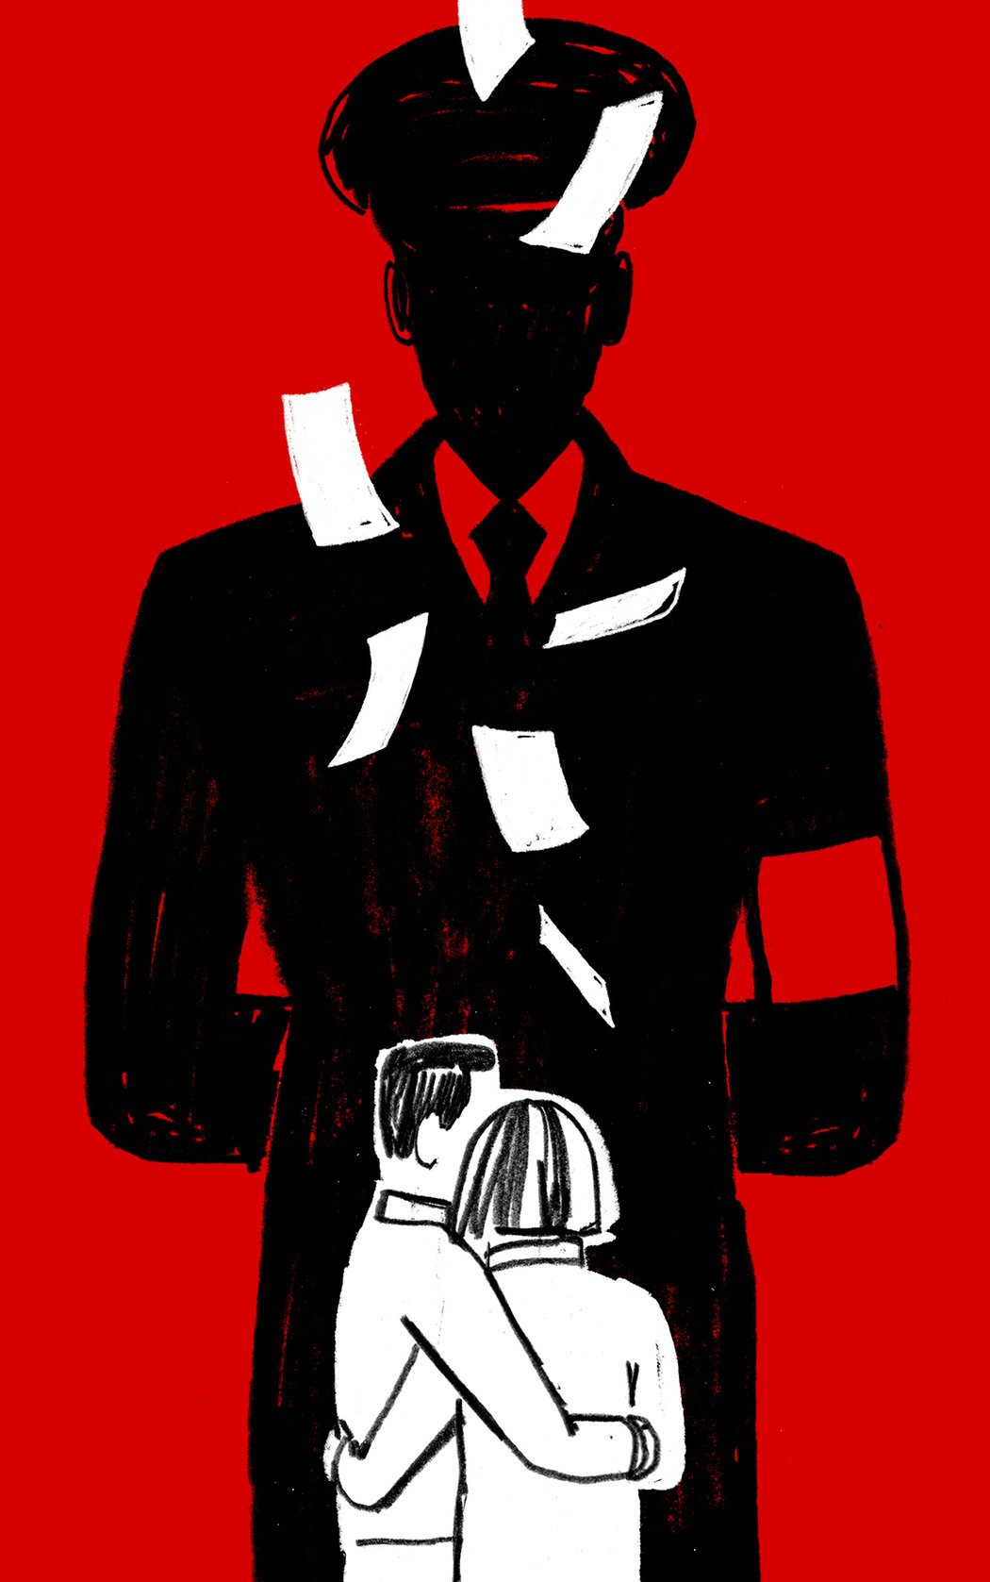
How did the German people
respond to Nazism?

Slide 3
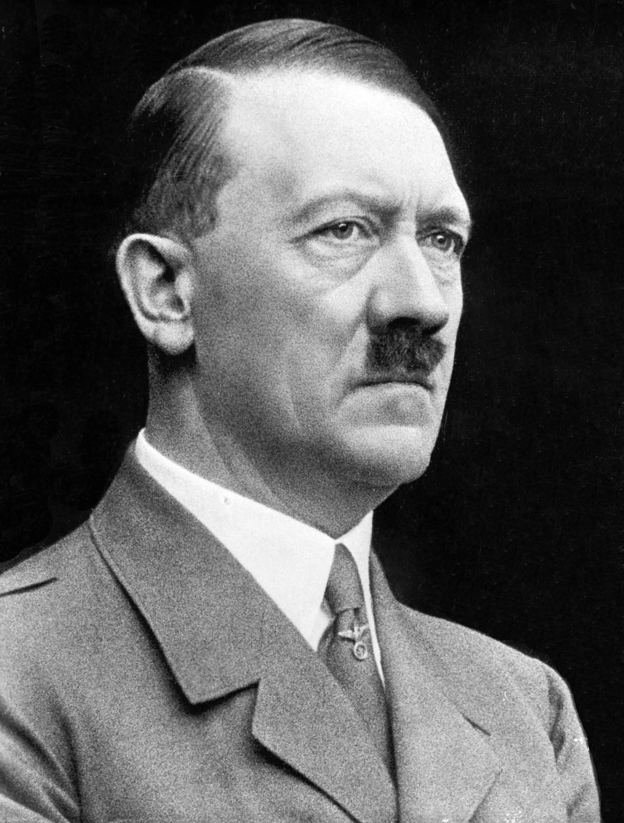
Aims of the lessons
Lesson Objective: To explore how and why some Germans resisted the Nazis.
You will be examining the question:
‘How did the German people
respond to the Nazis?’
Firstly, what do we learn about
what some people thought
about Nazi ideas.
ATTITUDES
Secondly, we will be looking at
How some German people
responded to Nazi policies/
beliefs. ACTIONS
What did the Nazis believe?
Taken from ‘Mein Kampf’ or ‘My Struggle’, Hitler’s autobiography
Single strong ruler (Führer) with total power (Dictator).
German Empire (Reich) with powerful armed forces.
‘Pure’ (Master Race) Germans only (Aryan) – minorities treated differently e.g. anti-Semitism (against Jewish people).
Tear up Versailles Treaty (the hated end to WW1 or Diktat).
Other peoples/border nations under Nazi control – colonies (Living space or Lebensraum).
Adolf Hitler – leader of Germany
Notes:
Image: Bundesarchiv, Bild 183-S33882 / CC BY-SA 3.0 DE, CC BY-SA 3.0 DE <https://creativecommons.org/licenses/by-sa/3.0/de/deed.en>, via Wikimedia Commons
https://commons.wikimedia.org/wiki/File:Adolf_Hitler_cropped_restored.jpg

Slide 4
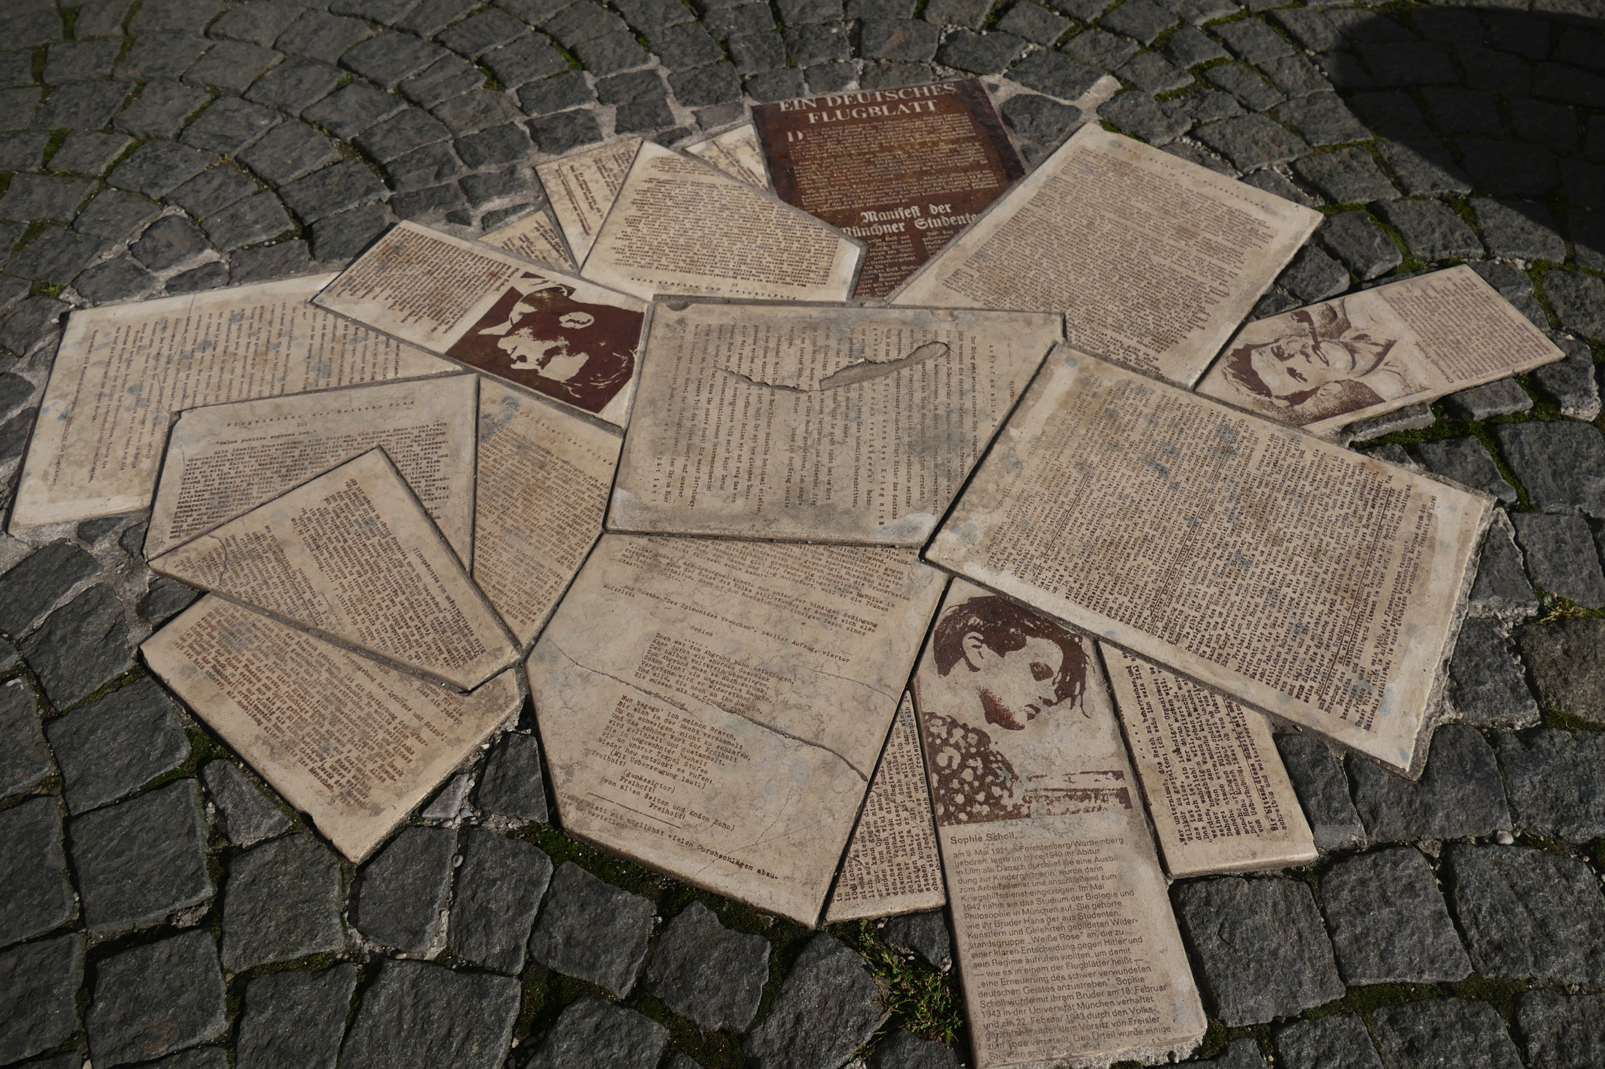
Outcomes hoped for from the lessons.
Lesson Objective: To explore how and why some Germans resisted the Nazis.
You will be expected to know in answer to the question:
‘How did the German people respond to the Nazis?’
All: to know what the key method used by the White Rose
Movement was and to be able to give some examples of how, from the lives of Hans and Sophie Scholl.
Most: to be able to give a reason(s) as to whether the White Rose
Movement was a success or failure. In particular to use examples from the lives and the legacy of its members.
A few: to assess whether the White Rose Movement was a ‘key moment’ in answering further: ‘Can a small group make a difference and why?’
The White Rose Movement produced 6 completed pamphlets, see examples above
Notes:
Image: By Amrei-Marie - Own work, CC BY-SA 4.0, https://commons.wikimedia.org/w/index.php?curid=51775768

Slide 5
DISCUSSION POINT: Are these examples of a) democratic or b) extremist attitudes and/or actions? Which of these should be allowed? Which banned? And why?
1. Read a banned book author or write/draw
Ideas that might cause offence* to others.
*images/words: racist, sexist, gender/faith hate
2. Join a political party that openly hates another group of people.
3. Watch civilians/citizens being killed, who have not been brought before a court of law.
4. Attend meetings rallies where openly expressed views blaming others are aired.
5. Teach others that one group of people are better than another group of people.
6. Call for the overthrow of your elected government.
7. Demonstrate – e.g. march/hold rallies against your government, during a time that your country is at war with others.
8. Give or receive money to carry out illegal acts against your own country.
Notes:
Share any troublesome words or terms depending on age/ profile of your class e.g. citizen, democracy, elect or rally

Slide 6
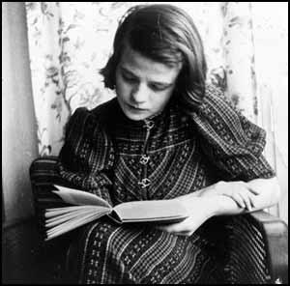
What do you think we learn from source 1 about how some Germans responded to Nazism?
1. Members of the League of German
Maidens (Girls or BDM – the female youth organisation set up by the Nazis.
Sophie is top left.
Aged 17, Sophie was chosen to be a group leader.
Sophie
Scholl,
BDM -
Group
leader
1. What do you
notice about…
hairstyles? dress?
2. What more would you ask Sophie, to find out more about German attitudes to Nazism?
Below: School prom, 1939
What might
we
learn
about
Sophie from
Source, right?
Sophie Scholl joined the BDM in 1933 at
the age of 11, above.
Notes:
School prom - https://spartacus-educational.com/GERschollS.htm
Sophie Scholl reading - https://spartacus-educational.com/ExamRHU11.htm

Slide 7
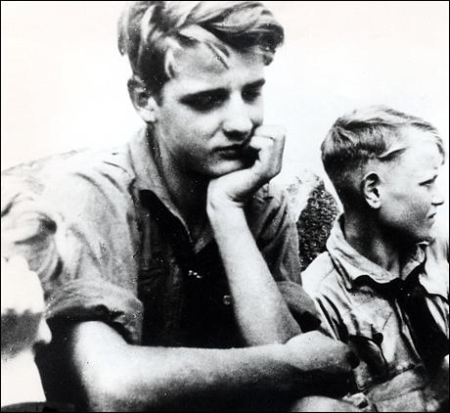
By 1936, what do you think we learn from A and B, about what the Nazis demanded from Germany’s youth?
A. Members of the Hitler Youth (right) – the largest youth organisation acted as flag-bearers at the Nazi rally in Nuremberg of 1936.
1. What is
happening?
2. What do you think
is the purpose of the flags? standards?
1. How is
Hans
dressed?
2. What do you think Hans is thinking?
B. Hans Scholl above was a
member of the Hitler Youth in 1933 at the age of 15. He was a flag – waver at the Nuremberg Rally, in 1936.
3. What impression does the source
give of Nazism e.g. clothing?
Notes:
Mention that Hans is the sibling to Sophie. Did anyone raise this as a possibility and/or the fact that he was the elder of the two.
Image of Hans and his brother: available here: https://spartacus-educational.com/GERschollH.htm
Image of Hitler Youth flag bearing:
Bundesarchiv, Bild 183-E12089 / CC-BY-SA 3.0, CC BY-SA 3.0 DE <https://creativecommons.org/licenses/by-sa/3.0/de/deed.en>, via Wikimedia Commons
https://commons.wikimedia.org/wiki/File:Bundesarchiv_Bild_183-E12089,_Posen,_Amtseinf%C3%BChrung_Arthur_Greiser.jpg

Slide 8
Spotlight on Hans & Sophie Scholl
Lesson Objective: To explore how and why some Germans resisted the Nazis
After the WW2 a number of Germans were put on trial and questioned for their attitudes/actions of:
Being a Nazi sympathiser e.g. joining the Party (minor)
Being a Nazi supporter e.g. making war goods (medium)
Carrying out a Nazi war crime e.g. killing civilians (serious)
Write down your initial thoughts based on the photograph of Hans/Sophie:
a) Hans Scholl – 1. I think Hans Scholl was 1, 2 or 3… because …
b) Sophie Scholl (sister) – 2. I think Sophie Scholl was 1, 2 or 3…. because…
What punishment (sentence) do you think Hans and Sophie should face, if charged and found guilty of either 1, 2 or 3 3. I think Hans (Sophie) should be… OR
What (attitudes/words/actions) might make either Scholl seem to be ‘innocent’? 3. It seems to be that Sophie (Hans) is innocent because…
Notes:
Learners keep their answers brief and to focus on just the picture. Ask a few to share their answer especially if you can get varied opinions and reason why on the siblings being put on trial.

Slide 9
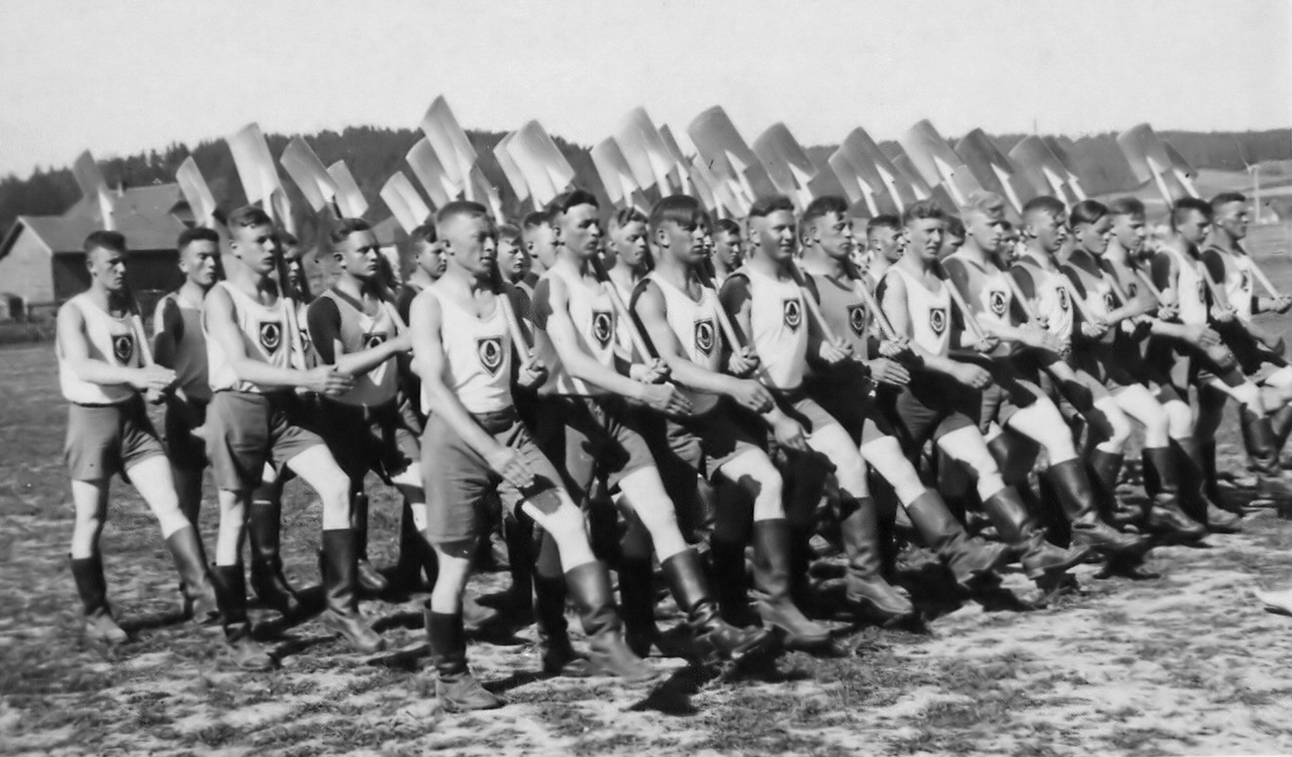
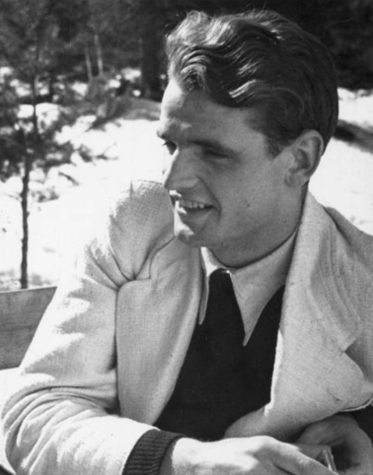
From the photographs below, what do you think is Hans’s story? Do his actions show him to be a supporter or critic of Nazism? Explain your opinion with examples What further evidence would help you decide? (use the photo cards to get new information about him)
1937, national service, Hans worked building motorways (autobahns).
1937, Hans, medical student,
enrolled at Munich University
1937, Hans, Nazi Youth Camp
https://bit.ly/3jFBN2i
1940 May, German invasion of
France. Hans and friends.
Notes:
Useful if learners look at the other photo cards (RS43) on Hans. Especially if they note his growing moving away from Nazism, if he was ever a whole-hearted follower. When and how did this occur in his life.
Images 1937 national service: Father of de:user:Philipendula. Philipendula has herited the rights on this image., CC BY-SA 3.0 <http://creativecommons.org/licenses/by-sa/3.0/>, via Wikimedia Commons
https://commons.wikimedia.org/wiki/File:Arbeitsdienst.jpg
1937 Hans medical student: Author: unknown Source: Stadtarchiv Crailsheim URL: https://www.stadtarchiv-crailsheim.de/projekte/weisse-rose-erinnerung/ Fair use rationale: Low resolution picture of deceased person, in article about that person, Hans Scholl. Obtaining a free close substitute is not reasonably likely.
https://en.wikipedia.org/wiki/File:Hans_Scholl_roi.tif
1940 May –copyright AKG images https://www.akg-images.co.uk/CS.aspx?VP3=SearchResult&VBID=2UMESQJSOMHX8H&SMLS=1&RW=1280&RH=715&POPUPPN=10&POPUPIID=2UMDHU32TL2R1937
Nazi youth camp – available here: https://spartacus-educational.com/GERschollH.htm

Slide 10
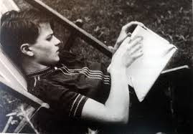
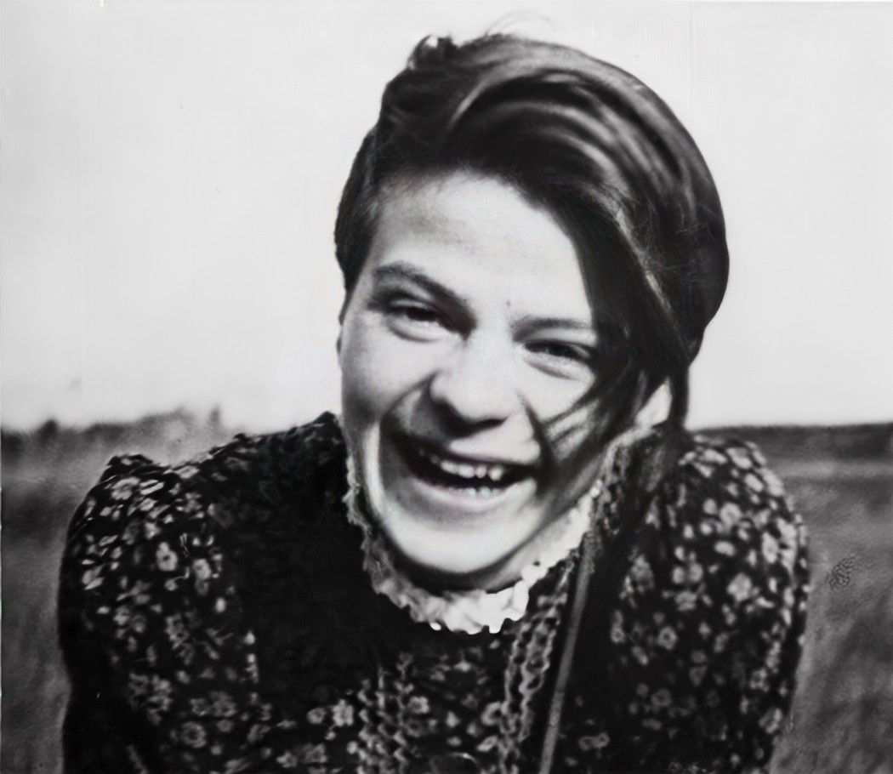
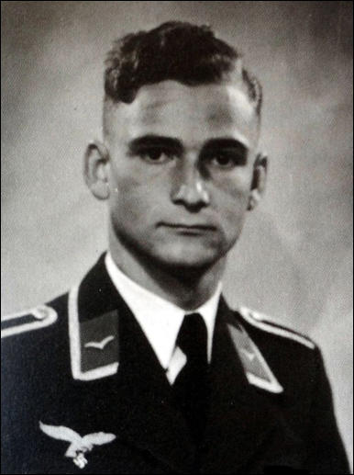
From the photographs below, what do you think was Sophie’s story? Do you think she was a supporter or a critic of Nazism? Explain your opinion with examples. Look at the photo cards for further evidence that would help you decide. Add to your notes about her.
Sophie enjoyed reading literature
Sophie became a nursery school teacher as part of her National Service in 1942
Sophie faced being expelled from school
Fritz Hartnagel, Sophie’s
steady boyfriend, 1941-3.
Notes:
Give learners time to read the other cards (RS43) and fill in details about Sophie. Note, went through troubled teenage years and or how she struggles to develop her own outlook on life, which can seem like many of others contrary e.g. love of Jewish writer but has a ‘patriotic’ boyfriend.
Images: Sophie reading: available here: https://thewisdomdaily.com/german-refused-nazi/
Sophie expelled:
Unknown authorUnknown author, Public domain, via Wikimedia Commons
https://commons.wikimedia.org/wiki/File:Sophie_Scholl_1938_in_Blumberg_(restored).jpg
Fritz Hartnagel -https://spartacus-educational.com/Fritz_Hartnagel.htm
Sophie nursery teacher: https://spartacus-educational.com/GERschollS.htm

Slide 11
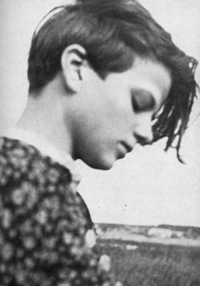
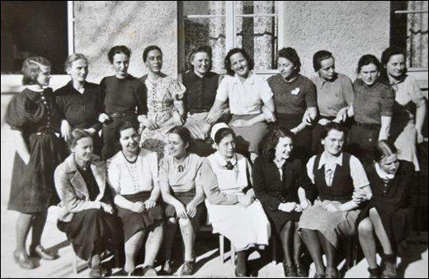
So, in 1939 what action should Sophie take to show her opposition to Nazism?
1
2. Sophie became, in 1936, a group leader in the BDM. However, she was unhappy that her favourite author Heinrich Heine, who was a
pacifist and Jewish, was banned by the Nazis.
3
2
1. In 1933 aged 11, Sophie Scholl joined the BDM. Her sister, Inge also a member, said, about Sophie joining the BDM,“Her joy was great.” Despite their pacifist father, Robert Scholl’s opposition to it, and the Nazis.
They felt “He was too old” to understand how exciting it was going to be.
3. In 1939 , Sophie told her best friend Susanne Hirzel: “Whoever does not know Heine, does not know German literature.”
Her friend later claimed that Sophie stated: “Hopefully someone will stand up to Hitler.”
BDM – League of German Maidens
Pacifist – someone against war
Notes:
The photo cards (RS43) give more detail about each of the siblings. Get learners to consider why her initial willingness to join the BDM had tapered off. You may wish the learners to consider the more straightforward question: Was Sophie Scholl a Nazi? Give a reason(s) for your opinion.
Images: Sophie Scholl reading - https://spartacus-educational.com/ExamRHU11.htm
School prom: School prom - https://spartacus-educational.com/GERschollS.htm
1939: https://commons.wikimedia.org/wiki/File:Sophie_Scholl_in_Blumberg_1942.jpg#filelinks

Slide 12
Explain what action the Scholls could have taken in 1939 to show their opposition towards Nazism?
TASK – In groups, choose and present to the rest of the class, one of the case studies below, use info on right to help
Background Information: German society under the Nazis. By 1939…
What might be the outcome of these case study examples, if Hans and Sophie Scholl wanted to:
1. Take a legal civil case against the Nazi party e.g. against its willingness for women to become SS ‘baby machines’.
2. Write a series of newspaper articles critical of the Nazi party sending Jewish people and other minorities to ‘work’ camps.
3. Organise a ‘work’ demonstration to demand people are not forced to do National Service in an arms factory.
4. Write to the President about the Chancellor’s actions.
5. Produce a film about ‘war crimes’ by the German army, especially on the Eastern Front.
Elections stopped and the Führer told the Reichstag’s members what laws to pass.
Post of President & Chancellor combined for life in one person – Adolf Hitler (Führer).
Nazis only political party allowed.
Women were sacked from professional jobs e.g. as teachers, doctors or lawyers.
Newspapers/radio stations banned.
Nazi newspaper and radio broadcasts only.
Nazi Censor Office to control the media.
Courts and judges chosen only by the Nazis.
Synagogues burnt, Jehovah Witnesses sent to ‘camps’, Reich Christian Church set up.
Gays & Lesbians were outlawed.
Secret police arrest, torture and hold, without trial, ‘suspects’, under Nazi control.
Notes:
A good place to consider the wider context of Germany becoming a dictatorship and how this might affect individual freedoms and liberties. if you also include the next slide and discuss the slide from democracy to a dictatorship being established in Germany.

Slide 13
How German society changed under Nazism
German civil society in 1933 | Germany society in 1939
A. Reichstag was the elected parliament and decided laws of the government. | A. Elections stopped and the Führer told the Reichstag’s members to pass his laws.
B. 2 key posts: President, who could sack the Chancellor. Both time-limited in office. | B. Post of President & Chancellor combined for life in one person – Adolf Hitler (Führer).
C. Several political parties. | C. Nazis only political party allowed.
D. Men & women could vote, freely. | D. Women were sacked from professional jobs e.g. as teachers, doctors or lawyers.
E. Many/free newspapers with various political views and opinions. | E. Newspapers/radio stations banned. Nazi Censor Office to control the media.
F. Law Courts were free. Judges chosen on merit. | F. Courts and judges chosen only by the Nazis.
G. Religious freedom of worship and belief for all. | G. Synagogues burnt, Jehovah Witnesses sent to ‘camps’, Reich Christian Church set up.
H. Sexual identity and behaviour tolerated. | H. Gays & Lesbians were outlawed.
 | I. Secret police arrest, torture and hold, without trial ‘suspects’, under Nazi control.
Notes:
Possible discussion of how (why) German society changed between 1933 – 1939 i.e. once the Nazis had achieved power and began to change society operated via laws and decrees

Slide 14
RESEARCH – Find out more about the White Rose & the Scholls
Choose one person and find out what they did (actions) connected to the White Rose.
Can you suggest a motive (reason) for them being involved?
Sophie Scholl Hans Scholl
Inge Scholl Elisabeth Scholl
Christoph Probst Kurt Huber
Jürgen Wittenstein Fritz Hartnagel
Marie –Luise Jahn Hans Leipelt
Alexander Schmorell Werner Scholl
Robert Scholl
Notes:
Research work. May get learners to work in a group and present back their findings next lesson. Use Spartacus Education and other internet sites e.g. whiterose.neocities.org
Image:
Unknown authorUnknown author, Public domain, via Wikimedia Commons
https://commons.wikimedia.org/wiki/File:Sophie_Scholl_1938_in_Blumberg_(restored).jpg

Slide 15
Indicate which of the following are examples of a democracy
A. Laws obeyed by all | B. Freedom of speech | C. No elections | D. Free press e.g. newspapers | E. Trade Unions allowed
F. Torture and prison camps | G. No religious freedom | H. Secret Police | I. Control of press, radio and newspapers | J. Votes for all

Slide 16
Inge and Elisabeth Scholl, fellow BDM and later White Rose Movement members | Christoph Probst, wrote the 7th and unprinted White Rose leaflet | Kurt Huber & Jürgen Wittenstein, White Rose members
 | White Rose Movement June 1942 – February 1943 6 -9,000 leaflets printed 6 printing-run pamphlets sent out Distributed to many towns e.g. Munich, Berlin, Vienna & Stuttgart Written Hans & Prof. Kurt Huber
Sophie Scholl, born 1921. and Hans Scholl, born 1918 | White Rose Movement key Points | Fritz Hartnagel, Sophie’s boyfriend and a soldier. Who did he marry?
Marie –Luise Jahn and Hans Leipelt White Rose members | Alexander Schmorell – best friend and fellow officer in the German army | Werner Scholl, youngest sibling Family patriarch Robert Scholl.
Notes:
Majority of he lesson get learners to share their findings about the named person they have researched.

Slide 17
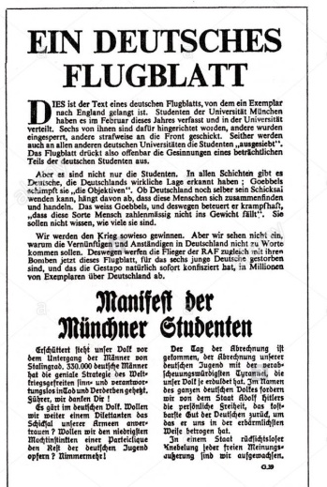
The White Rose Movement: Which of the points raised in the leaflets would have caused the Nazis concern? Why? (Discussion)
2nd Leaflet – June 1942
“Since the conquest of Poland, 300,000 Jews have been murdered in … the most bestial crime against human dignity, a crime that is unparalleled in the whole of history. For Jews, too are human beings”.
Third Leaflet - July 1942
“The meaning and goal of passive resistance is to topple National Socialism”.
5th leaflet – January 1943
“Freedom of speech, freedom of religion, the protection of individual citizens from the regime’s* vile abuses… these will be the bases of the New Europe”.
*Regime: government
Set up by Hans and his
friends who saw what
the army were doing.
https://bit.ly/3hoicRN
White Rose worn
by Sophie, middle
Hans, left and Alexander
Schmorell, right.
Sophie and Inge joined
because of the Nazis banning of ‘others’ and the Party’s desire for women to breed babies for the State.
Notes:
Get learners to share where these comments might have come from. e.g. 2nd leaflet from the experiences of Hans Scholl at the Russian Front and especially his encounter with the Jewish girl during his train journey East. Consider 5th leaflet as a manifesto for a new European way of life. It was written when the prospect seemed far from possible???
Images – link to Picture of Hans and Sophie School with other members of the White Rose movement; https://www.akg-images.co.uk/CS.aspx?VP3=SearchResult&VBID=2UMESQJSOMHX8H&SMLS=1&RW=1280&RH=715&POPUPPN=10&POPUPIID=2UMDHU32TL2R#/SearchResult&VBID=2UMESQJSOMHX8H&SMLS=1&RW=1280&RH=715&POPUPPN=13&POPUPIID=2UMEBMHEETTV

Slide 18
PLENARY 1: Indicate which of the following are examples of democracy How many did you get right?
A. Laws obeyed by all | B. Freedom of speech | C. No elections | D. Free press e.g. newspapers | E. Trade Unions allowed
F. Torture and prison camps | G. No religious freedom | H. Secret Police | I. Control of press, radio and newspapers | J. Votes for all

Slide 19
PLENARY 2: What do you know about the German response to Nazism?
A. Can you give the names of at least
3 members of the Scholl family?
B. Can you give the names of 2
other members of the White Rose?
C. Can you state how many pamphlet
runs were printed by White Rose?
D. Give 2 arguments used by the White
Rose against the Nazis.
E. Can you give at least one argument for the
success or failure of the White Rose Movement?

Slide 20
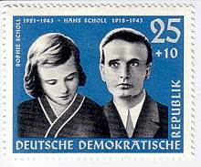
Last words… Was the White Rose Movement a success or failure? Where should the ‘spotlight’ be… Hans? Sophie? The Group?
“Such a fine sunny day and I have to go but what does my death matter, if through us, thousands of people are awakened and stirred into action.”
Sophie Scholl
“Long live Freedom.”
Hans Scholl
Notes:
Is it right to focus on these two? Should we consider how they are portrayed and by whom? Why? What is the legacy of the movement on German society? Is there any relevance in the lives and actions of the individuals or collectively the group?
Images: Deutsch: Deutsche Post der DDR.English: GDR post office, Public domain, via Wikimedia Commons
https://commons.wikimedia.org/wiki/File:Geschwister_Scholl_stamp,_GDR,_1961.jpg
https://commons.wikimedia.org/wiki/File:Sophie_Scholl_in_Blumberg_1942.jpg#filelinks

