Slide 1
Non-violent Action: A Force for Change
Evaluation Lesson

Slide 2
Pictures of objects/actions
What does this object make you feel?
What case studies does this object relate to?
Is this a violent object?
What would make this a violent object?
How could this object be used in non-violent resistance?

Slide 3
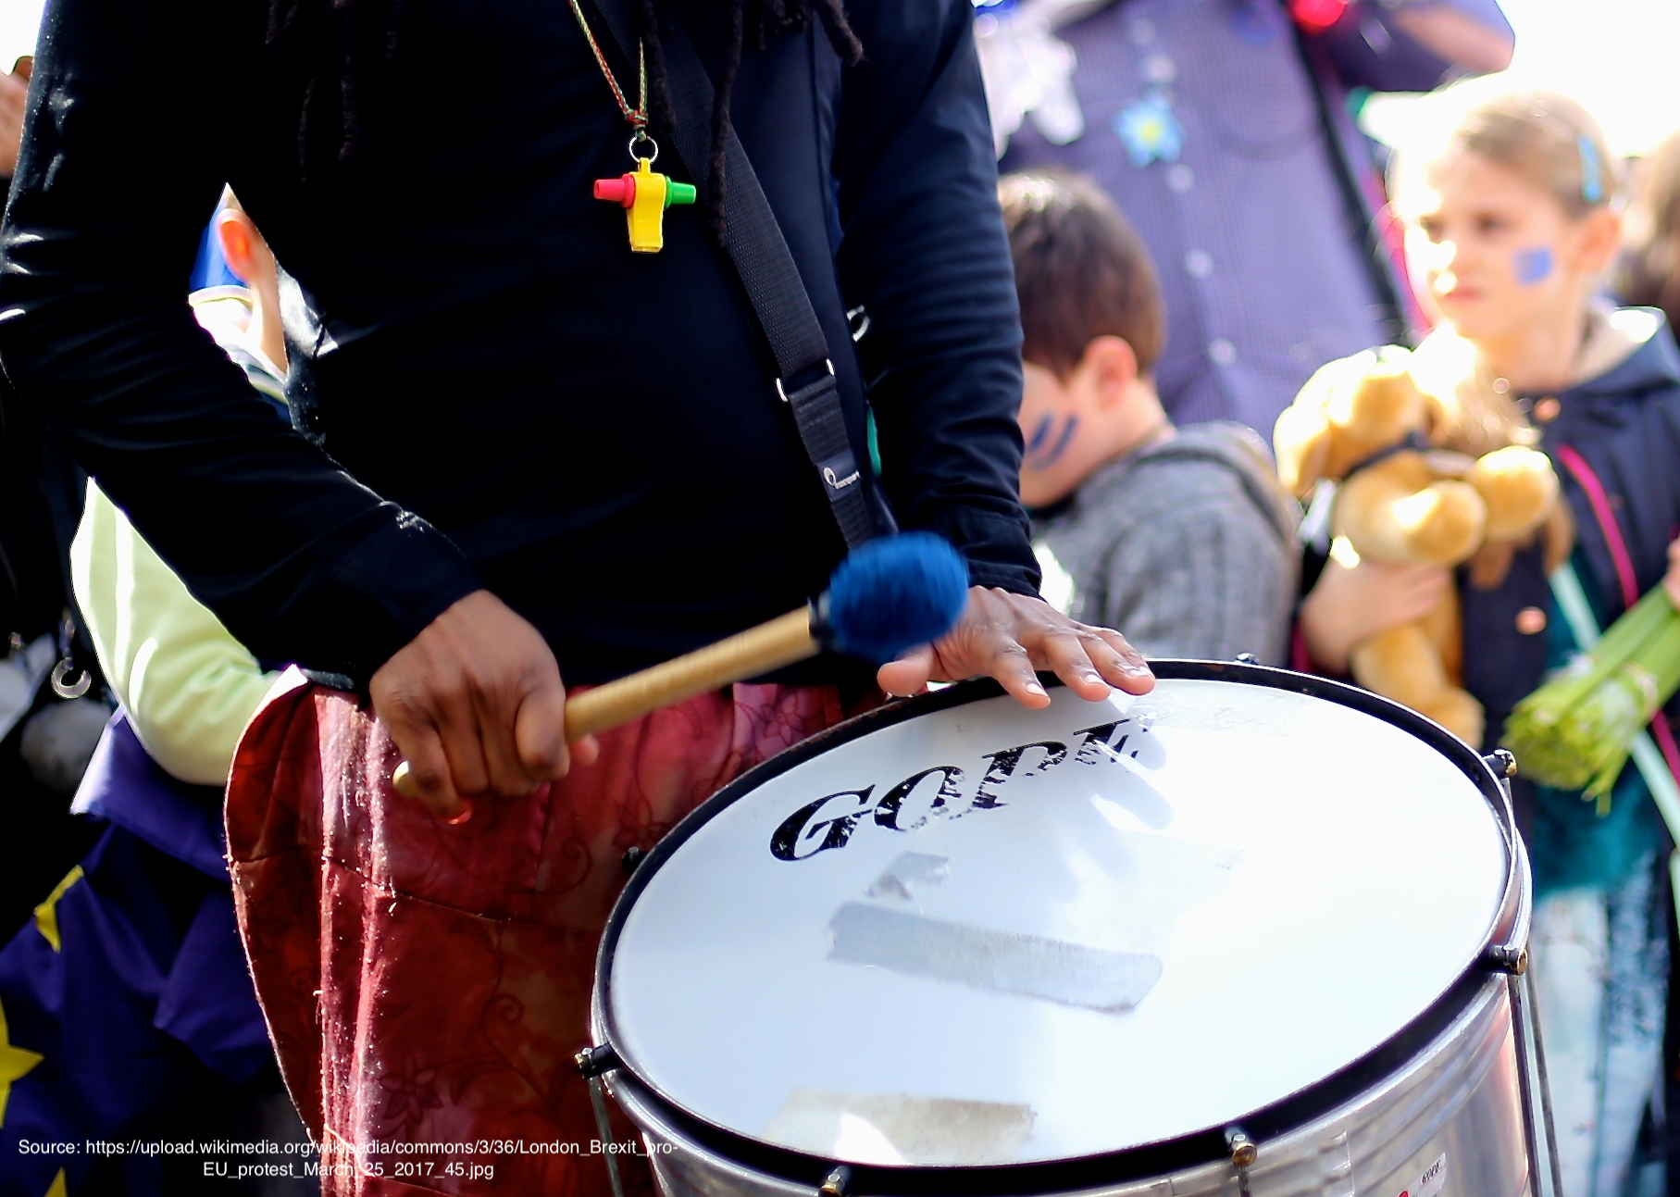
Pictures of objects/actions
Notes:
Image credits from top left clockwise:
DECSY’s own photo
Extinction Rebellion logo (public domain https://www.flickr.com/photos/50079371@N08/15474433797/) and Otpor fist (By Created by User:KeithTyler. It is a variant of the clenched fist motif which has been widely used by leftist, workers, and liberationist groups since the nineteenth century. The motif itself is not under copyright. - Uploaded by User:KeithTyler, who created this image., Public Domain, https://commons.wikimedia.org/w/index.php?curid=1682523)
Mobile phone public domain, no attribution required
Drummer https://upload.wikimedia.org/wikipedia/commons/3/36/London_Brexit_pro-EU_protest_March_25_2017_45.jpg English: The pro-EU march from Hyde Park to Westminster in London on March 25, 2017, to mark 60 years since the EU's founding agreement, the Treaty of Rome.

Slide 4
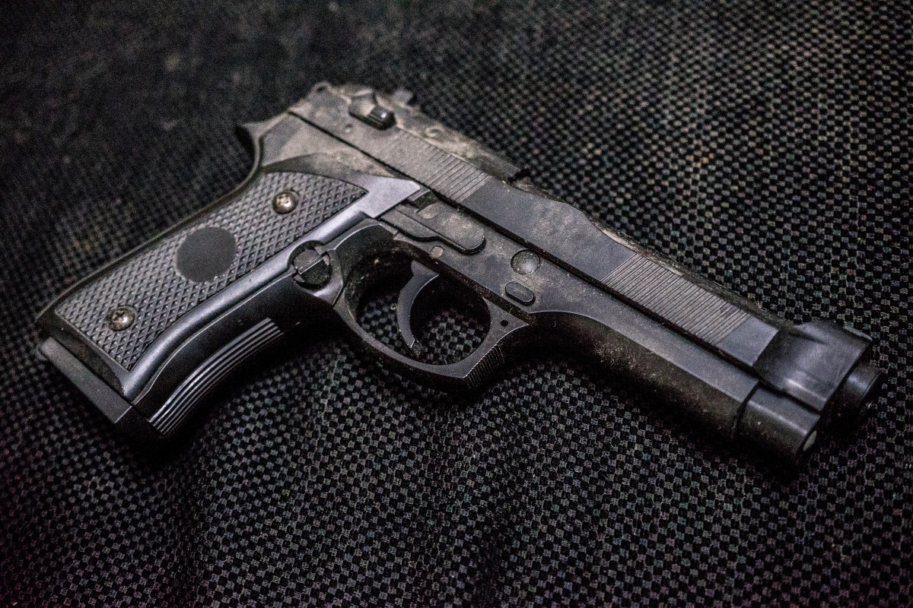
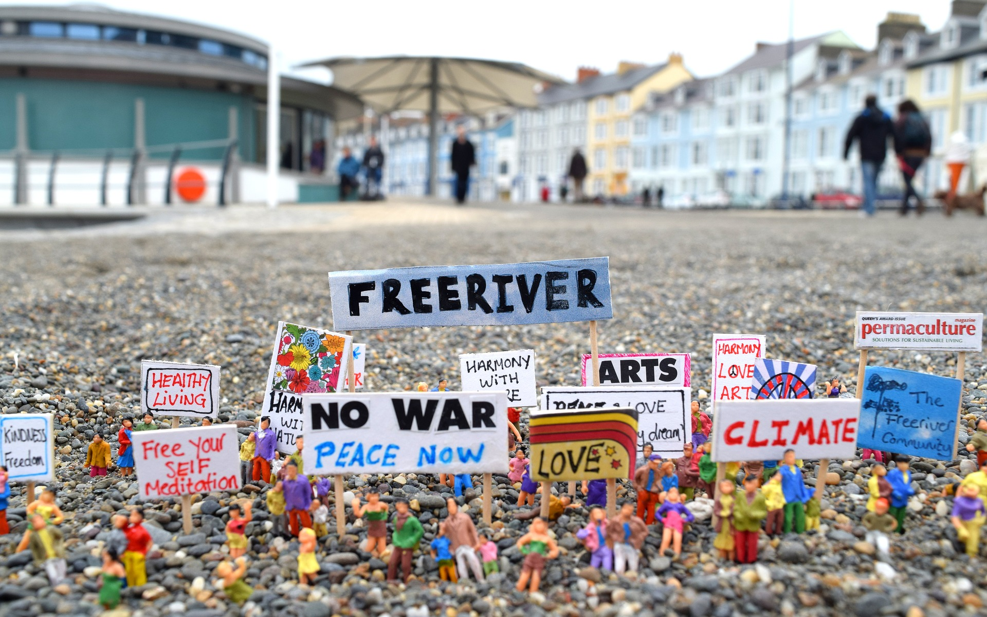
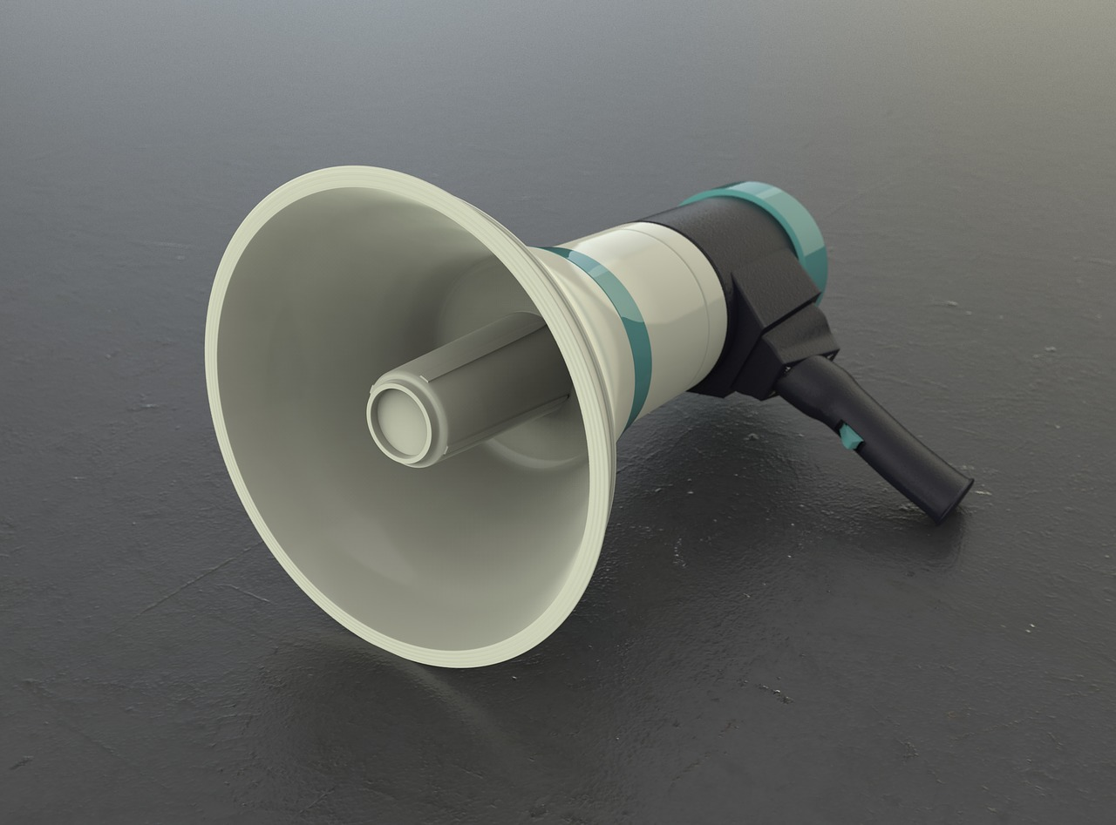
Pictures of objects/actions
Notes:
Image credits from top left clockwise:
Protected Banksy artwork, Cleveland Street, London W1 cc-by-sa/2.0 - © Julian Osley - geograph.org.uk/p/4469000
Gun – public domain, no attribution required
Loudspeaker - public domain, no attribution required
Miniature people (use of humour) Pixaby Licence Free for commercial use No attribution required

Slide 5
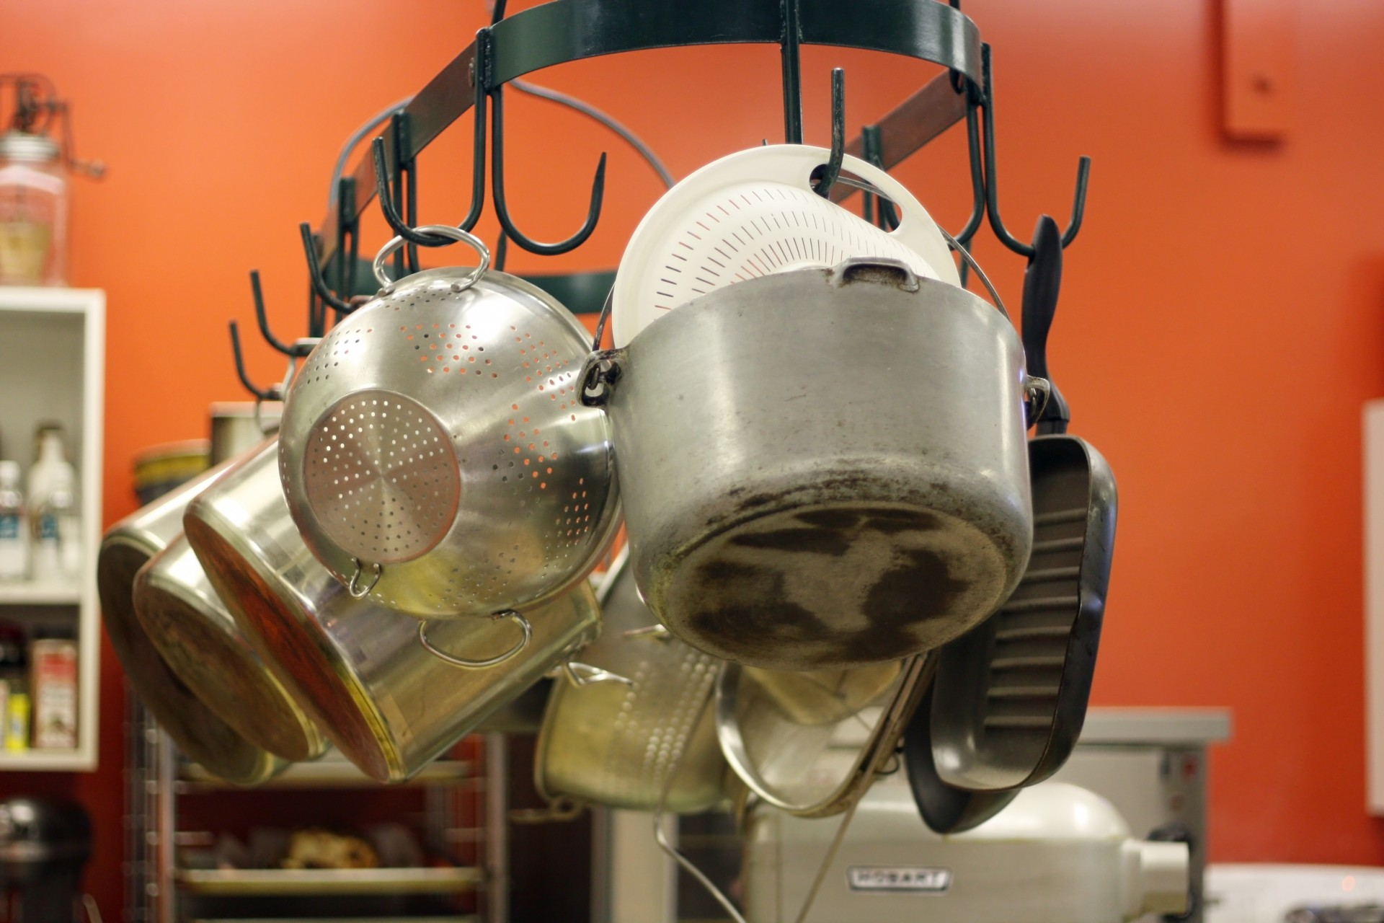
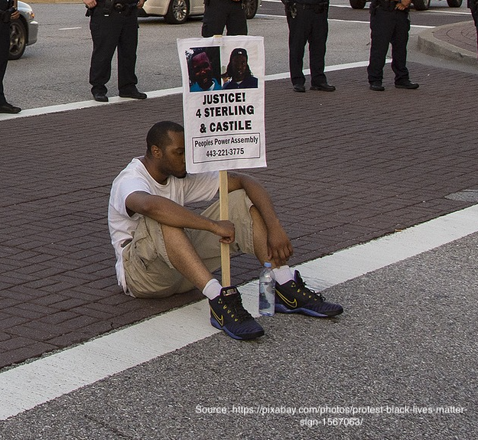
Pictures of objects/actions
Notes:
Image credits from top left clockwise:
E-petition - https://www.flickr.com/photos/wheatfields/446145795 photographer allispossible.org.uk https://creativecommons.org/licenses/by-nc-sa/2.0/
Pots and pans – public domain, no attribution required
Singing children - public domain, no attribution required
Black Lives Matter sit down protest https://pixabay.com/photos/protest-black-lives-matter-sign-1567063/ Free download

Slide 6
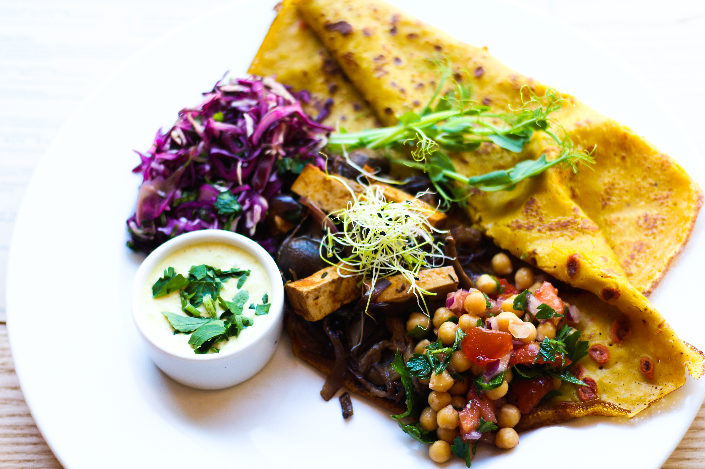
Pictures of objects/actions
Notes:
Image credits from top left clockwise:
Social Media logos, public domain, no attribution required
Picture of meal, public domain, no attribution required
Fight Demonstration Girls Fists Protest Communism Creative Commons commercial use https://www.maxpixel.net/Fight-Demonstration-Girls-Fists-Protest-Communism-155927

