Slide 1


Nonviolent Action: A Force for Change
Case study lesson:
Contemporary Issue

Slide 2

Archery Target
Town/city
School
World
Country
Community
Notes:
https://commons.wikimedia.org/wiki/File:WA_80_cm_archery_target.svg
Alberto Barbati / CC BY-SA (https://creativecommons.org/licenses/by-sa/2.5)
Green arrows appear on clicks to signify how all levels, school, community, town, country, world are connected with each other
Key question: “Is there anything that you know about that is happening now that you don’t think is OK?”
Learners to provide ideas and decide where it would go within the archery board. (e.g. a park being built on would fit in the local community area)
Discussion on how local issues could affect things globally how global issues can affect the local area.

Slide 3
local
national
global
Notes:
(Another way of showing the overlapping of issues between local, national and global)
Can you think how your examples might connect at other levels (locally, nationally or global). E.g. park being built on would also contribute to habitat loss which might be part of a national problem linked to a global problem.

Slide 4
Research in small groups
Choose a current nonviolent campaign or movement for change to research
Sum up your campaign with a headline and write on large piece of paper to be stuck around the room

Slide 5
Vote on a headline
Individually using 3 sticky dots (or ticks) vote for the headlines that you are most interested in (one dot per headline)
The group whose headline has the most dots shares what they have found out about the the campaign / movement with everyone else

Slide 6
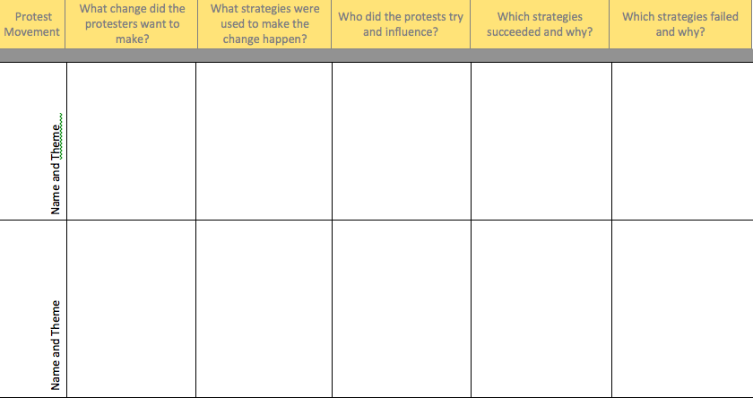
Analyse the chosen campaign/ movement
Notes:
Learners to use, RS34 ‘Movement for change checklist’ and RS24 ‘Nonviolent methods checklist’ and other tools such as RS16 ‘Pillars of support’ when analysing the movement/issue, hoping to develop an understanding of the issue and what has been acted on so far. Can they predict whether the people taking action will be successful based on their analysis? What else could people do (both in the place concerned and other people to support them)?

Slide 7
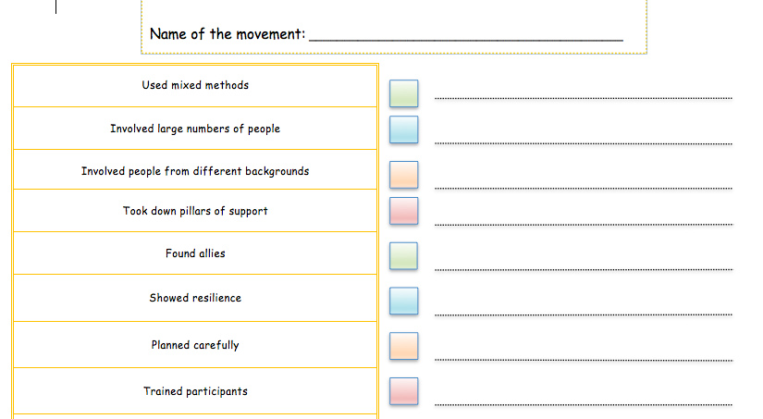

Slide 8
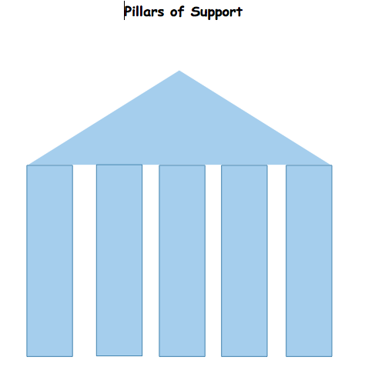

Slide 9
Can you predict whether the people taking action will be successful based on your analysis?
What else could people (both locally and elsewhere) do to support them)?

