Slide 1
Non-violent Action: A Force for Change
Case study lesson:
The Bristol Bus Boycott

Slide 2
Bristol Bus Boycott
https://www.bbc.co.uk/news/av/uk-england-21525110/bristol-bus-boycott-50-years-on (3 mins.)
OR https://www.youtube.com/watch?v=-0eR7dH7BYY (3 mins.)
What happened and why did they act as they did?
Think > Pair > Share
Notes:
If clicking on the film links don’t work on your computer try Control Click or copy link into your browser.
Teacher Notes: Introduce the Bristol Bus Boycott:
Recap on what we have learnt so far about things we can do if we want to change something that’s not fair.
Show film: https://www.bbc.co.uk/news/av/uk-england-21525110/bristol-bus-boycott-50-years-on (3 mins, BBC)
OR https://www.youtube.com/watch?v=-0eR7dH7BYY (3 mins, Labour Party)
What happened and why did they act as they did?
Think > Pair > Share
(Ensure understanding of colour bar, boycott and conductor)

Slide 3
Questions
In pairs, come up with some questions to discuss that have been stimulated by the film.
As a class sort questions using the Question Quadrant and combine questions where appropriate.
Answer any ‘Comprehension’ questions as a class.

Slide 4
Question Quadrant
Only about the stimulus
Comprehension ‘Look and see’ | Speculation ‘Use your imagination’
General knowledge ‘Ask an expert’ | Philosophy ‘Think it over’
OPEN – many possible answers
CLOSED – only one answer
Could be about life in general

Slide 5
General Knowledge Questions
Research the answers to your general knowledge questions by using the following websites:
https://www.blackhistorymonth.org.uk/article/section/bhm-heroes/the-bristol-bus-boycott-of-1963/
Bristol Bus Boycott website: https://bristolbusboycott.uk/
https://www.bristolmuseums.org.uk/stories/bristol-bus-boycott/
https://heritagecalling.com/2023/04/20/the-story-of-the-bristol-bus-boycott/
https://www.blackpast.org/global-african-history/the-bristol-bus-boycott-of-1963/

Slide 6
Links to images
https://www.blackhistorymonth.org.uk/wp-content/uploads/2015/12/bristol-bus-boycott-1963.jpg
https://en.wikipedia.org/wiki/Bristol_Bus_Boycott#/media/File:Bristol_Bus_Boycott01.jpg
https://en.wikipedia.org/wiki/Bristol_Bus_Boycott#/media/File:Student_march_in_support_of_the_Bristol_Bus_boycott.jpg
Notes:
If clicking on the links don’t work on your computer try Control Click or copy the links into your browser:
https://www.blackhistorymonth.org.uk/wp-content/uploads/2015/12/bristol-bus-boycott-1963.jpg
https://en.wikipedia.org/wiki/Bristol_Bus_Boycott#/media/File:Bristol_Bus_Boycott01.jpg
https://en.wikipedia.org/wiki/Bristol_Bus_Boycott#/media/File:Student_march_in_support_of_the_Bristol_Bus_boycott.jpg

Slide 7
Plenary
What questions have we answered?
What do we still need to find out?

Slide 8
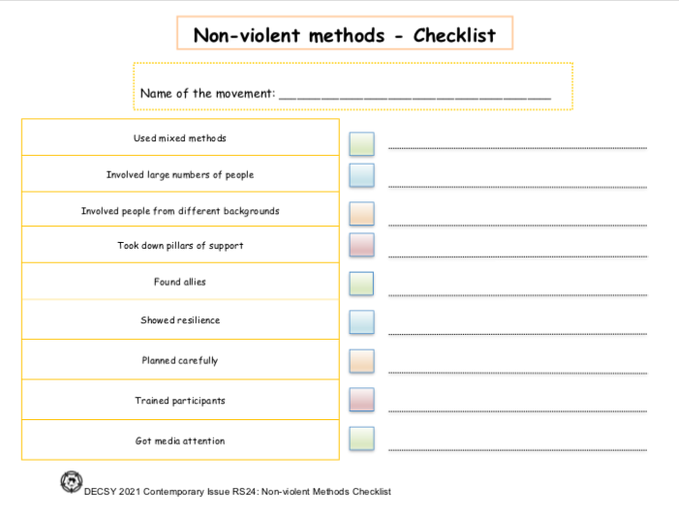
Non-violent methods checklist
Individually using the non-violent methods checklist evaluate the Bristol Bus Boycott
Notes:
Teacher notes: Non-violent Methods Checklist:
Recap learning from previous lessons on non-violence and Otpor case study (if done)
Complete the Non-violent Methods Checklist individually
Share in groups and amend as appropriate

Slide 9
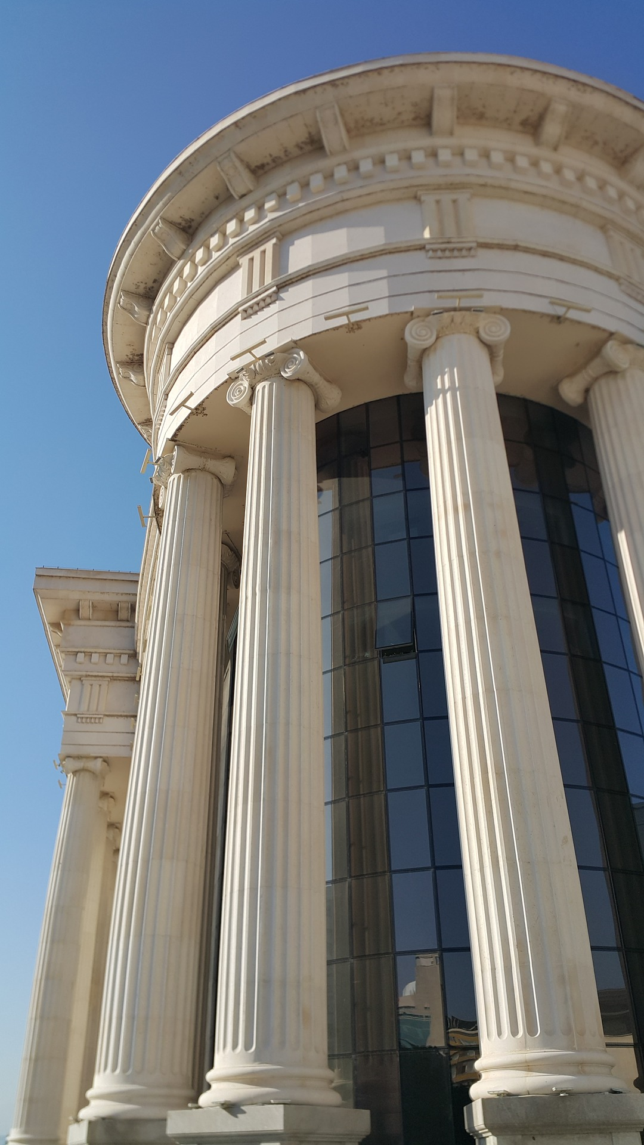
Pillars of support
Notes:
Source: Parthenon in Athens, Steve Swayne
https://commons.wikimedia.org/wiki/File:O_Partenon_de_Atenas.jpg
Other image – pixaby no attribution required
Teacher notes: Introduce slides 8 and 9 if this is the first case study (if OTPOR has already been completed there is no need) Ask - What are the pillars doing for the buildings? Explain that pillars do not always have to be physical.

Slide 10
What are the pillars of support that hold up the school?
Notes:
Teacher notes: E.g. governors, teachers, parents, resources, pupils, money
What would happen if we took any of them away?
Ask: If we take the teachers away what happens to the school?
Option to go into groups and discuss what would happen if each pillar were taken away. One pillar per group.

Slide 11
Pillars of support
What strategies did the leaders of the Bristol Bus Boycott use to work on the pillars of support?
Complete the Pillars of Support Task Sheet in groups.
Notes:
Image: Parthenon in Athens, Steve Swayne
https://commons.wikimedia.org/wiki/File:O_Partenon_de_Atenas.jpg

Slide 12
Speculative Questions
A chance to do some creative thinking in relation to the speculative questions the class has come up with.
Choose a question and compose a response in the form of a poem, piece of art, letter, diary account or drama.
Notes:
Teacher Notes: Speculative Questions from Question Quadrant
This will depend on what sort of ‘Speculation Questions’ learners have come up with from the Question Quadrant e.g. How did it feel to be rejected because of your skin colour?
You may like to devise a role-play, freeze frame, role on the wall etc. to address these.

Slide 13
Pillars of Support: Diamond Nine
In pairs discuss ‘Which pillar of support was most effectively engaged with? Arrange cards into a diamond nine shape.

Slide 14
Share with another pair and see if they want to change theirs.
As a class compare similarities and differences.
Notes:
Teacher Notes: Diamond Nine of pillars of support:
Cut up cards so that each pair has a set of nine.
In pairs discuss ‘Which pillar of support was most effectively engaged with? Arrange into a diamond nine shape.
Share with another pair and see if they want to change theirs
As a class compare similarities and differences

Slide 15
P4C Enquiry
Vote on the ‘Philosophy Questions’ from the Question Quadrant
First thoughts
Building
Last thoughts
Review

