Slide 1
Non-violent Action: A Force for Change
Case study lesson:
Chipko

Slide 2
My tree
Notes:
https://pixabay.com/photos/lone-tree-field-wheat-tree-4127920/
Attribution: Nottmpictures/ Pixabay License (Don't use images with identifiable brands to create a misleading association with a product or service.)

Slide 3
My wood
Notes:
https://commons.wikimedia.org/wiki/File:Old_woodland_copse_at_Mossend_Farm_ruins.JPG
Rosser1954 Roger Griffith [Public domain

Slide 4
My forest
Notes:
https://pixabay.com/photos/black-forest-triberg-waters-forest-4572312/
Attribution: roemi62/ black forest/ Pixabay License

Slide 5
My planet
Notes:
https://www.flickr.com/photos/wwworks/2222523486
Attribution: woodleywonderworks/ Blue Marble(Planet Earth)/ CC BY 2.0

Slide 6
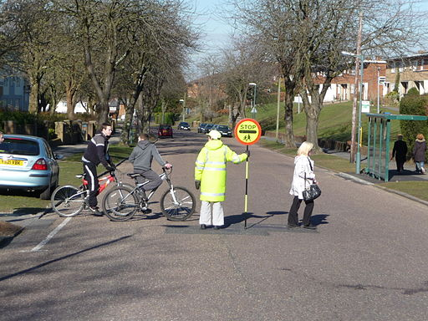
The school traffic wardens are to be removed because the council is making cuts in spending.
Notes:
https://commons.wikimedia.org/wiki/File:Bournemouth_,_Moore_Avenue_and_Lollipop_Lady_-_geograph.org.uk_-_1746368.jpg
Attribution: Lewis Clarke/ Bournemouth: Moore Avenue & Lollipop Lady/ CC BY-SA 2.0
Use this one for Primary or next slide for Secondary

Slide 7
A local bus service which serves the school is going to be reduced from every 15 minutes to once an hour.
Notes:
An Arriva the Shires bus at Milton Keynes Central railway station in April 2019. It is a Scania L94 UB with Wright Solar body, fleet number 3621, registration mark YN55 PZY.
https://commons.wikimedia.org/wiki/File:Scania_L94_UB_Wrightbus_Solar_Arriva_Milton_Keynes_3621_YN55_PZY.jpg
SFletcher06 [CC BY-SA (https://creativecommons.org/licenses/by-sa/4.0)]
Use this one for Secondary or previous slide for Primary

Slide 8
The Chipko Movement background
Before the British colonisation of India, local people, mostly women, sustainably managed the forests.
They relied on them for the survival of their families and communities, harvesting fruits and seeds, firewood and animal fodder.
The forests prevented land slips and provided perennial supplies of drinking water.

Slide 9
During colonisation, the British took over the forests to use the wood for ship and railway building.
Forest struggles took place for over two centuries to resist the colonisation of the people’s forests.
After Indian Independence, following the example of the British, the Indian government still saw the forests as a source of wealth from the timber and companies were given permission to chop down trees.

Slide 10
Many forests were cut down causing soil to be washed away, leading to landslides, floods and silting in the rivers below the hills. Crops and houses were also destroyed and women had to walk further and further for their fuel, fodder and water.
In Mandal, Uttar Pradesh in 1973, a contractor had been given the rights by the state to fell 3000 trees for a sporting goods store, to make cricket bats and tennis rackets.
Local women decided to stop the tree felling when the woodcutters arrived.
Notes:
https://commons.wikimedia.org/wiki/File:India_Uttar_Pradesh_locator_map.svg
This Image was created by User:PlaneMad. If you are using the image under the creative commons share alike license please credit the photo CC-by-sa PlaneMad/Wikimedia and include a link to this page.

Slide 11
Should the trees be felled?
In your groups study the role card you have been given (local women, woodcutters, government officials, sports company) and discuss what arguments you will make. You can imagine what it would be like to be your role and add ideas of your own.
Be prepared to respond to the question in role ‘Should the trees be felled?’

Slide 12
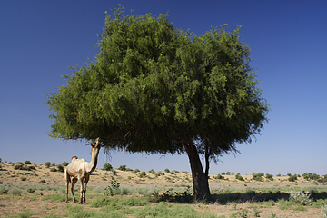
Origin of the Chipko Movement
In 1731, more than 300 members of the Bishnoi community in Rajasthan, led by a woman called Amrita Devi, sacrificed their lives to save their sacred khejri trees by clinging to them.
’Chipko’ means ‘cling’ in Hindi and with that event begins the earliest recorded history of the Chipko movement.
Khejri tree
Notes:
Image: https://commons.wikimedia.org/wiki/File:Khejari_(Prosopis_cineraria).JPG
Anuomkara / CC BY-SA (https://creativecommons.org/licenses/by-sa/3.0)
Khejri tree

Slide 13
The Chipko Movement in the 1970s: what actually happened
A woman grazing her cows spotted a few people with axes in their hands
She whistled and collected all her companions who surrounded the woodcutters and said “This forest is our mother. When there is a crisis of food, we come here to collect grass and find fruits to feed our children. We dig out herbs and collect mushrooms from this forest. You cannot touch these trees.”
Notes:
Quote from Bimla Bahuguna, ‘Contribution of Women to the Chipko Movement’, in Indian Farming, November 1975

Slide 14
The women embraced the trees to prevent the woodcutters from cutting them down.
They formed vigilance groups to watch the trees and eventually the government was forced to set up a committee which recommended a 10-year ban on felling in that area.
Notes:
Image:
https://commons.wikimedia.org/wiki/File:Big_chipko_movement_1522047126.jpg
NA, CC BY-SA 4.0 <https://creativecommons.org/licenses/by-sa/4.0>, via Wikimedia Commons
Chipko Movement

Slide 15
In 1977 in another area women tied sacred threads around trees fated to be cut down. This was a symbolic gesture in Hindu customs confirming the bond of a brother-sister relationship. They said that their trees would be saved even if it cost them their lives.

Slide 16
Even when non-local private contractors were removed and a government agency (the Forest Development Corporation) started working through local labour contractors and forest cooperatives, the women continued to struggle against the exploitation of the forests.
Bachni Dvi of Adwani even led a resistance against her own husband who had obtained a local contract to fell the forest.
Forest officials who arrived to stop the women and Chipko activists found the women holding up lighted lanterns in broad daylight.

Slide 17
When they were asked what they intended to do the women replied “We have come to teach you forestry”. The official replied “You foolish women, how can you who prevent felling know the value of the forest? Do you know what forests bear? They produce profit and resin and timber”.
The women immediately sang back in chorus:
What do the forests bear?
Soil, water and pure air. Soil, water and pure air
Sustain the earth and all she bears
Notes:
Image: https://commons.wikimedia.org/wiki/File:Trees_are_for_Hugging.jpg
Notnarayan / CC BY-SA (https://creativecommons.org/licenses/by-sa/3.0)

Slide 18
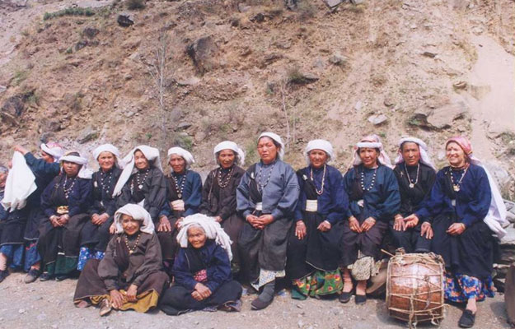
With these successes, the Chipko campaign grew into the Chipko movement, spreading throughout India.
Using non-violent action and people power, villagers were able to prevent numerous companies from felling any trees in the region.
The committee declared the Reni forest a sensitive area, and in 1980, a 15-year-long ban on all logging in Uttar Pradesh was passed.
Surviving Members of the Original Reni Squad at the Chipko 30th Anniversary 2004
Notes:
Image: https://commons.wikimedia.org/wiki/File:Chipko_2004.jpg
Ceti at English Wikipedia / CC BY-SA (http://creativecommons.org/licenses/by-sa/3.0/)
Surviving Members of the Original Reni Squad at the Chipko 30th Anniversary 2004

